Slide 1
Environmental and non-technical impacts of lean principles applied to offshore wind farms
20th June 2017
Mihaela DRAGAN
Environment & Planning Analyst, WindEurope

Slide 2
Presentation outline
  Introduction
  Methodology
  Industry survey results
  Case study: habitat loss
  Social acceptance of offshore wind farm

Slide 3
  Introduction
  Objective: examine the environmental and non-technical impacts of lean principles applied to offshore wind farms with a particular focus on life cycle analysis.
  environmental impacts resulted from new foundation systems: fixed and floating, from installation activities, operation and maintenance strategies deployed as well as decommissioning activities.
  non-technical impacts refers to creation of local employment, local growth, training and skills as wells as synergies with other sea users.
  Community engagement for offshore wind farms.

Slide 4
  Methodology
Literature review:
  EWEA proceedings 2010 to 2016 (sessions dedicated to environment and social acceptance)
  Scientific papers and journals
  Policy reports and studies
  EU funded projects
Stakeholder survey (Leopold matrix analysis)

Slide 5
Methodology - Leopold matrix definitions
NUMBER | MAGNITUDE | DEFINITION
5 | Great | The impact is predicted to have a long term positive effect on the environment on a global scale
4 | Major | The impact is predicted to provide a leading advantage to the environment and the community
3 | Moderate | The impact is predicted to have a positive impact on the ecosystem
2 | Slight | The impact is defined to have a mild but positive impact on the changes to the environment
1 | Negligible | The impact is defined to have a minor positive impact
-1 | Negligible | The impact is identified as modest, almost non-existent
-2 | Slight | The impact is minor with a short-term effect on the local environment without changes to the distribution or status of the species.
-3 | Moderate | The impact is identified as mild, short-term and reversible without changing overall integrity of the natural habitat and the community
-4 | Major | The identified impacts are predicted to result in a primary change to the environment with a long term effect
-5 | Catastrophic | The impact is predicted to results in an adverse and irreversible effect on a global scale
NUMBER | SIGNIFICANCE | DEFINITION
5 | Great | Impact of cross-border character
4 | Major | Impact of national character
3 | Moderate | Impact of regional character
2 | Slight | Impact of importance for municipality
1 | Negligible | Limited impact on location
NUMBER | PROBABILITY | DEFINITION
3 | Impact is certain (100% probability)
2 | Impact is probable (probability of over 50%)
1 | Impact is possible (probability of less than 50%)
NUMBER | DURATION | DEFINITION
2 | Long-term/Permanent
1 | Occasional/temporary

Slide 6
Survey results – construction phase

Slide 7
Survey results – operational phase

Slide 8
Industry survey results
Five innovations were further analysed in the report:
Design of a Cylindrical Caisson buoyant GBF
Design of a floating jacket
Use of suction buckets with a floating jacket
Design of a an innovative semi-submersible platform
Cable laying, burial and trenching
Total number of respondents: 6
Main limitation: respondents must understand the LEANWIND innovations
Notes:
The total number of respondents to the survey is six and they represent the following stakeholder categories: wind project developers, industry associations, research institutes and academia. The figure below also shows the share of participation per stakeholder group and reveals that project developers represent 50% of total respondents.
As it can be observed, there are five innovations that were rated by all respondents and that were further analysed in the report. They mainly refer to substructures and to cable laying, burial and trenching:
Design of a Cylindrical Caisson buoyant GBF
Design of a floating jacket
Use of suction buckets with a floating jacket
Design of a an innovative semi-submersible platform
Cable laying, burial and trenching

Slide 9
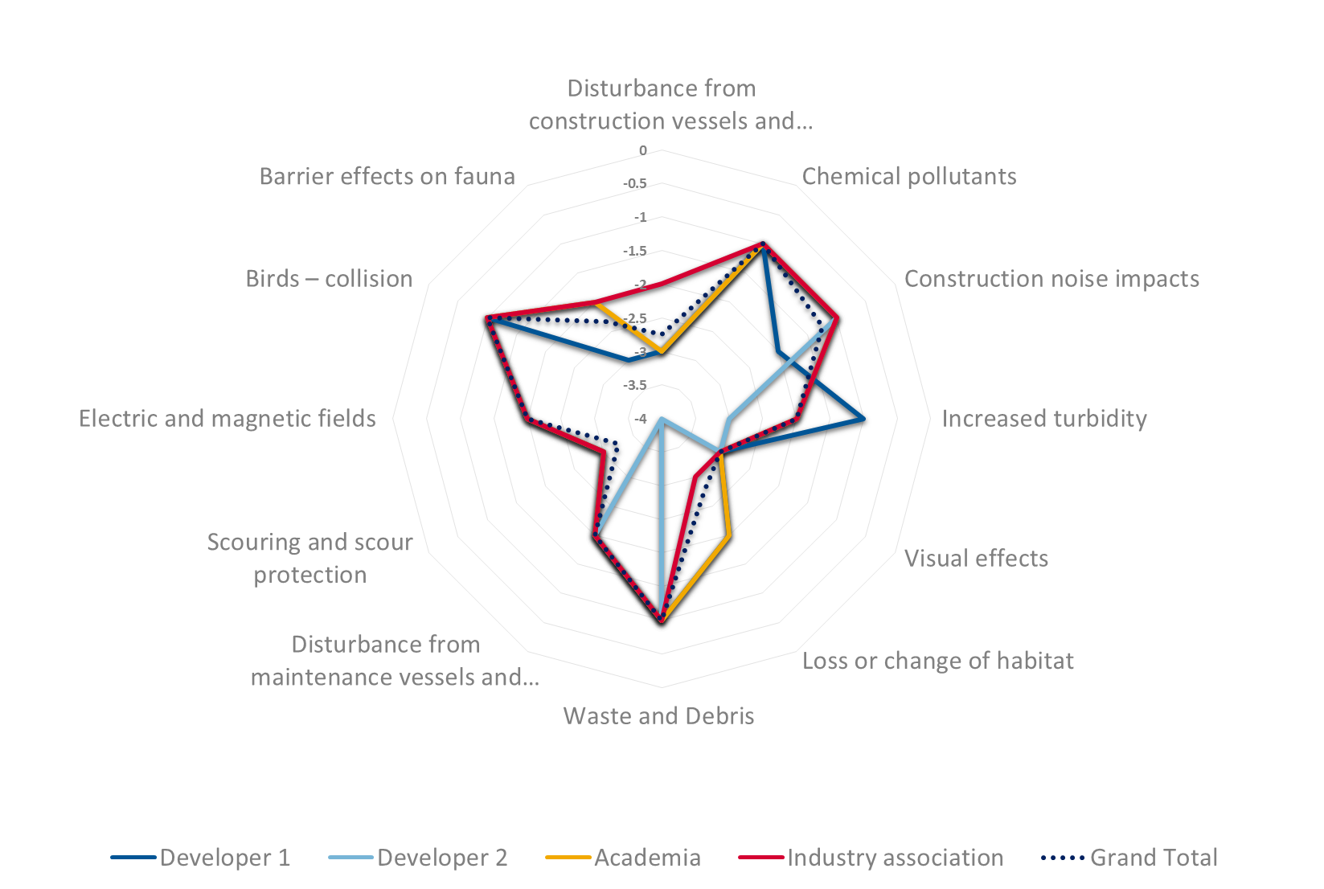
Gravity Based Foundation: magnitude
Operational phase impacts
Construction phase impacts
Notes:
Innovation description:
GBF is designed to float for transport to site before sinking for installation on the sea bed. The innovation consists in the design optimisation of a self-buoyant cylindrical caisson to be manufactured in a floating dock. The optimum concrete and sand ballasting heights were also determined, in order to satisfy the requirements of floatability and in-service conditions. The responsible project partner is ACCIONA Construcción.
Analysis:
The chart below maps the magnitude of environmental impacts in the construction and operational phase resulted from the Cylindrical Caisson buoyant GBF. We can observe that most of the negative impacts occur during the construction phase; they refer mainly to disturbance from construction vessels and equipment, increased turbidity, loss or change of habitat, scouring and scour protection. The loss change of habitat in the case of a buoyant GBF is rated by most respondents as having a negative environmental effect (-2 to -4) since it will occupy the sea-bed and will require sea-bed preparation for installation. Scouring and scour protection is behaving similarly and was also rated by the respondents with grades between -3 and -4.

Slide 10
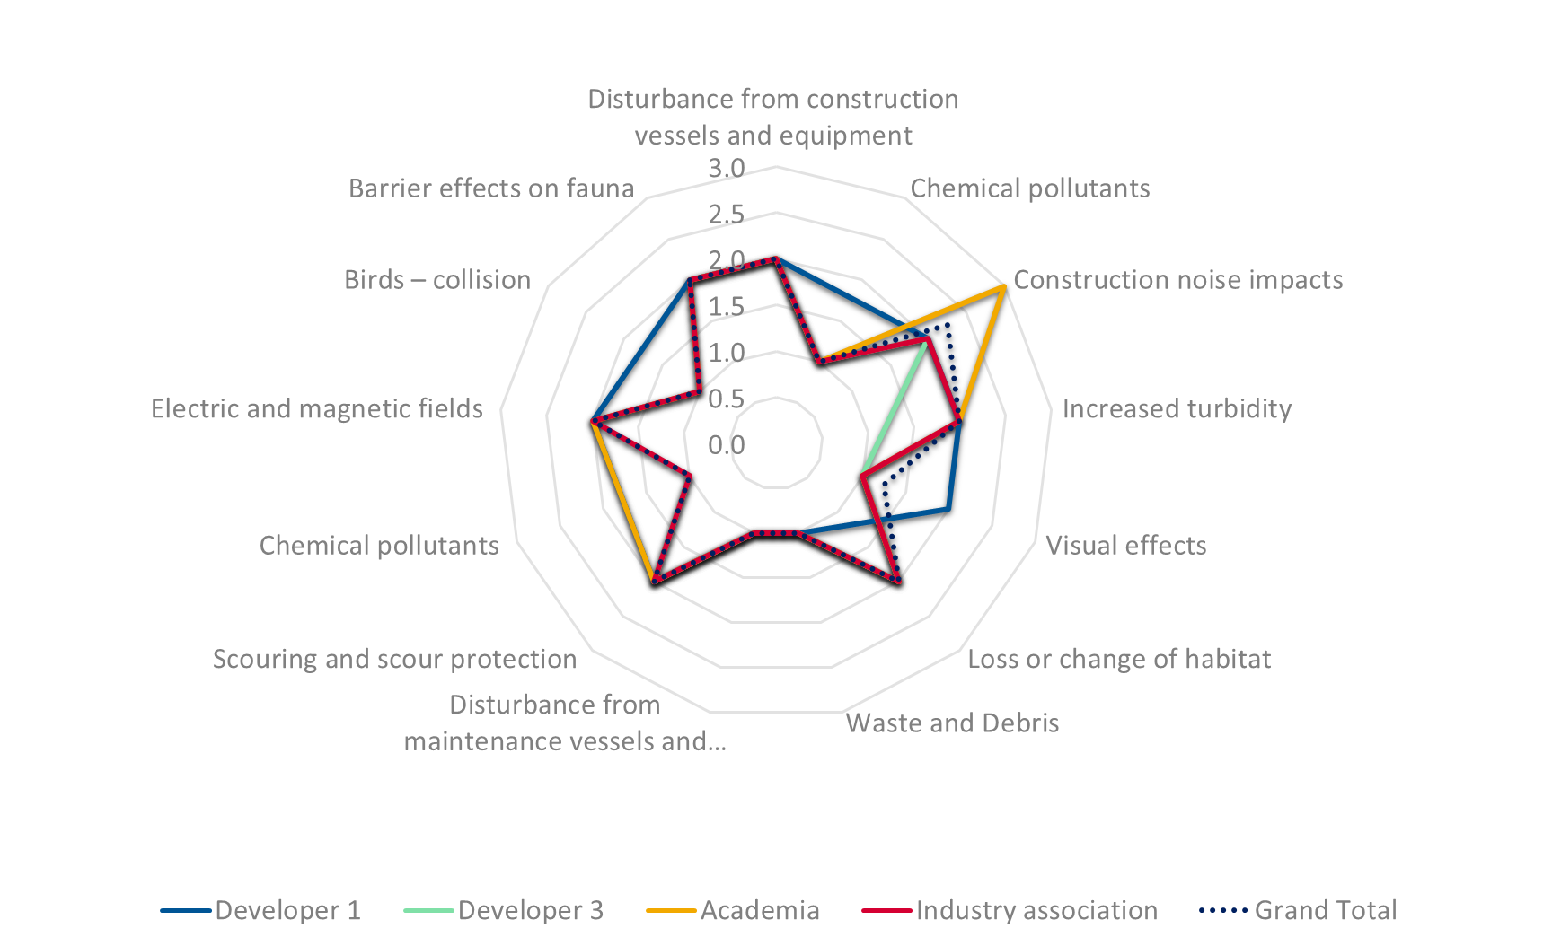
Gravity Based Foundation: significance
Operational phase impacts
Construction phase impacts
Notes:
SIGNIFICANCE analysis: figure 3 shows that most respondents have a similar opinion on the significance criteria. Turbidity increase, loss or change of habitat, scouring and scour protection, electromagnetic fields and barrier effect on fauna have a low significance impact, being considered very project specific.
There is just one respondent that assessed the impact of construction noise from floating GBFs as attaining a regional level of impact. Even if the significance of this kind of impact is generally important, we saw in the magnitude analysis that construction noise scored well for this innovation as it does not involve piling.

Slide 11
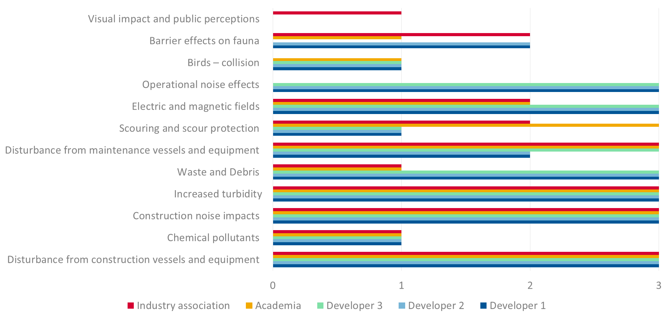
Gravity Based Foundation: probability
Operational phase impacts
Construction phase impacts
Notes:
PROBABILITY analysis:
The figure below represents the probability of environmental impacts associated with cylindrical caisson buoyant GBFs. The data shows that 3 impacts were rated by respondents with 1, meaning that the probability rate for them to happen is less than 50%. These impacts are: bird collisions, scouring and scour protection (highly dependent on the project location and the type of rock) and chemical pollutants during the operational phase. On the opposite side there are some impacts that will certainly occur such as environmental disturbance resulted from the installation vessels activity or O&M vessel activities, construction noise, increased turbidity or electromagnetic fields.

Slide 12
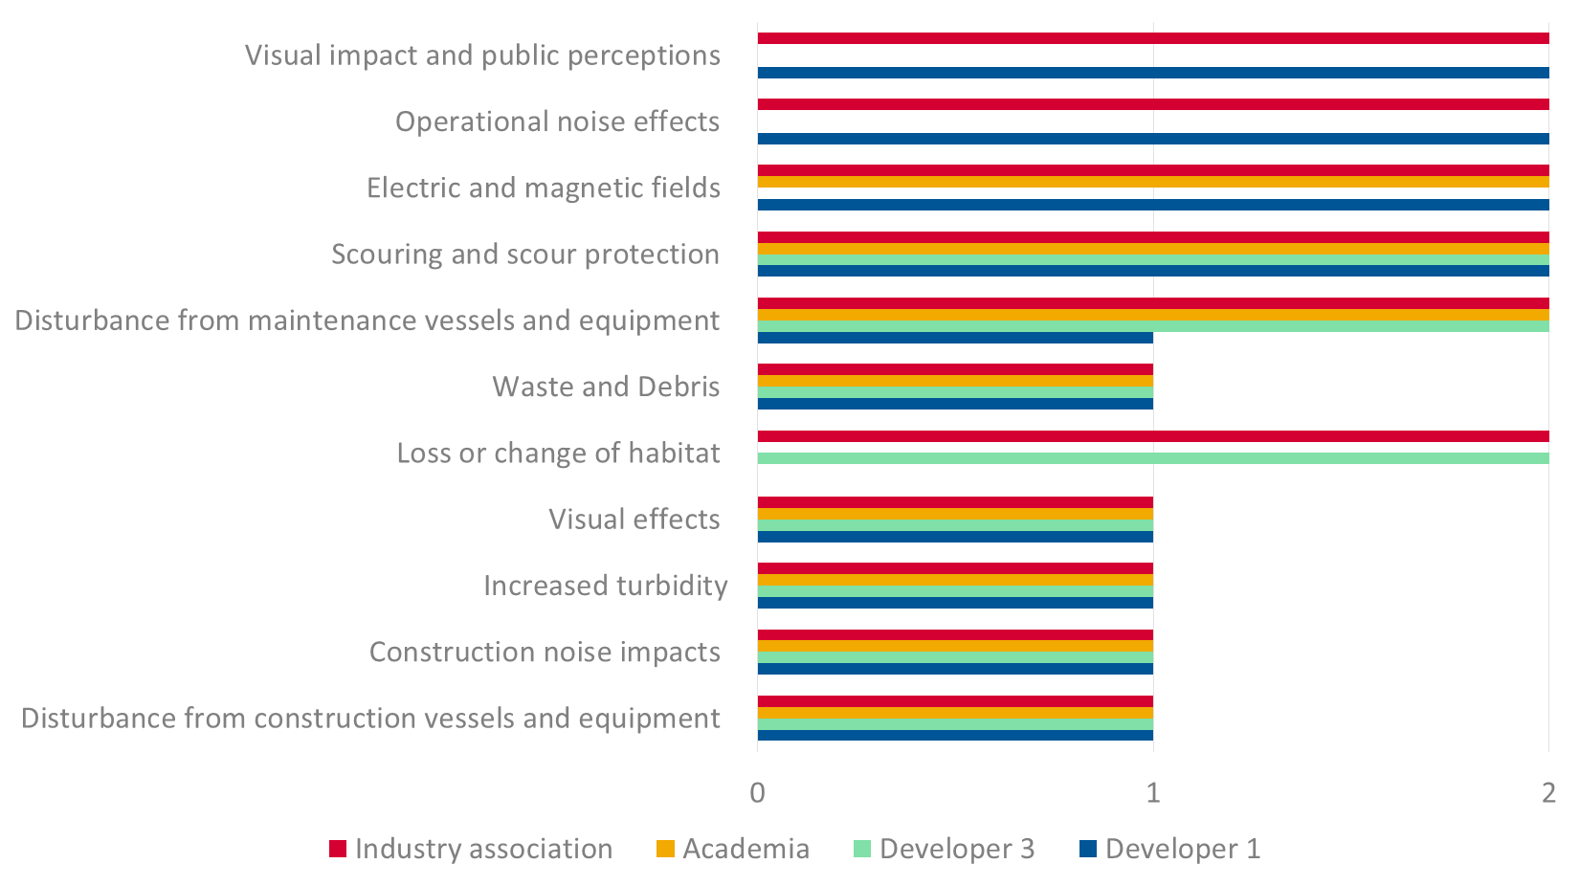
Gravity Based Foundation: duration
Operational phase impacts
Construction phase impacts
Notes:
DURATION analysis:
We can remark on the chart below that most of the construction impacts are rated to be temporary, while the environmental impacts arising in the operational phase are considered to be permanent. Loss or change of habitat is rated as being a permanent impact as once the GBF is installed will stay in place for the whole lifetime of a project, usually 20 to 25 years.

Slide 13
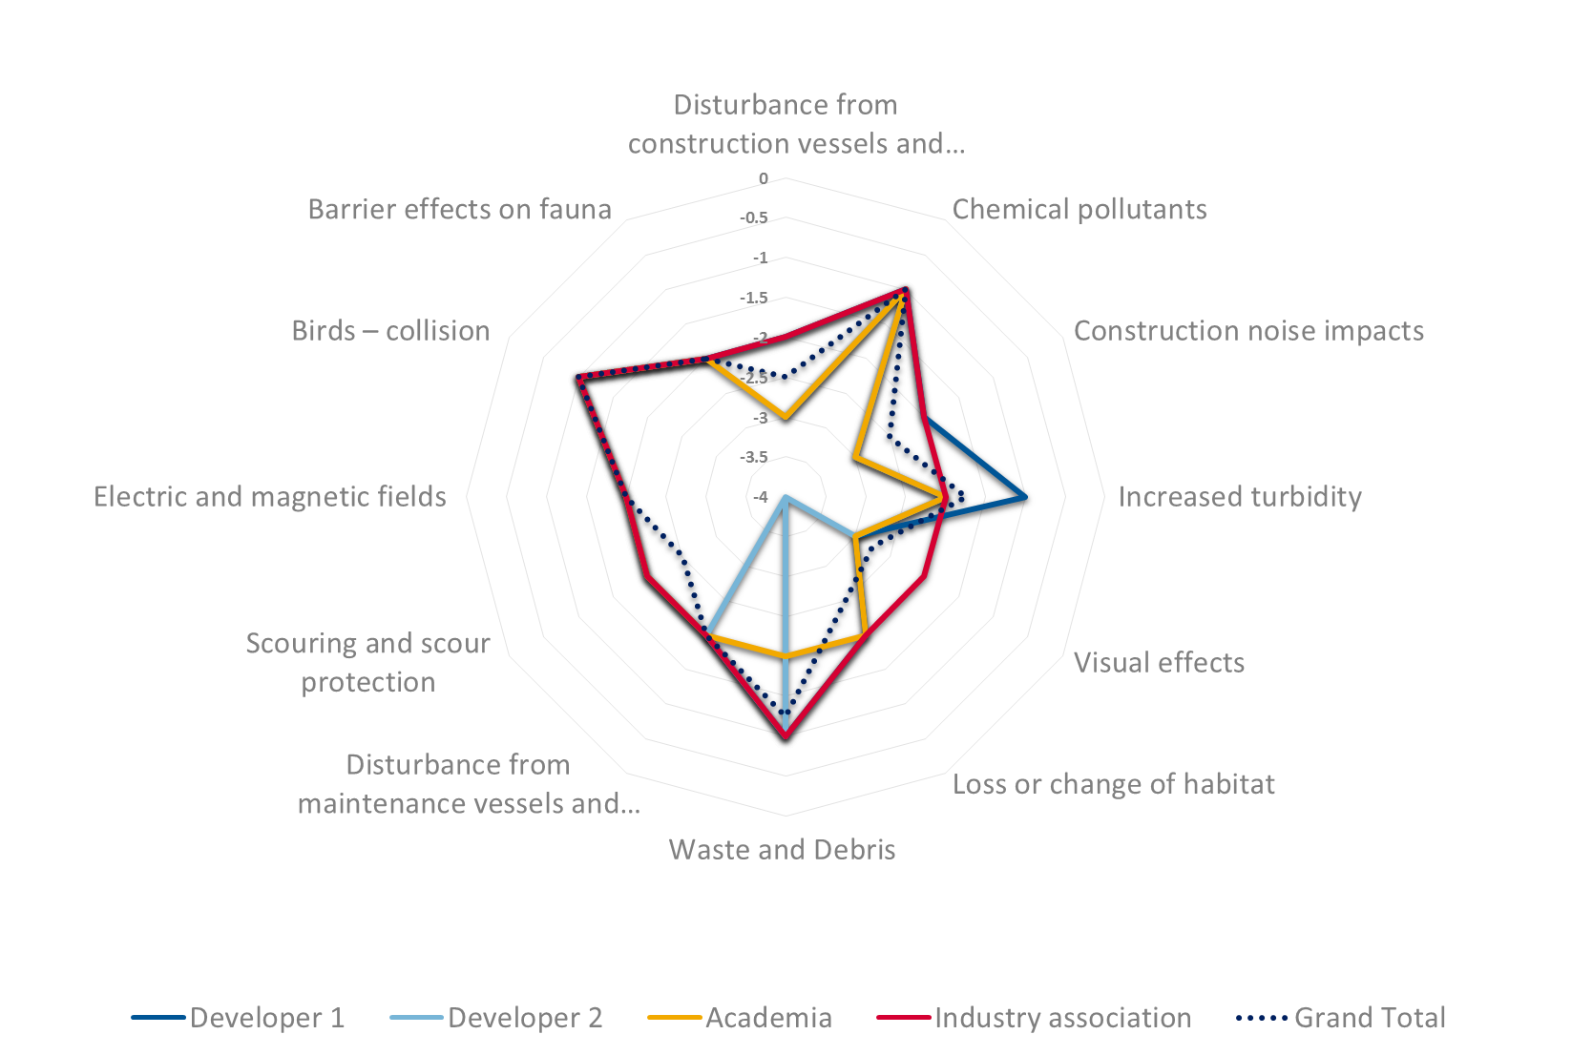
Design of a floating jacket foundation: magnitude
Operational phase impacts
Construction phase impacts
Notes:
Innovation description: design and optimisation of a floating jacket foundation for the 8MW LEANWIND turbine, which can be floated to the site in a vertical position, eliminating the need for the installation vessels. The responsible project partner is EDF.
MAGNITUDE analysis:
Chemical pollutants, increased turbidity, waste debris or bird collisions register a negligible negative impact. Disturbance from construction vessels and equipment and increased turbidity are rated as having a slight negative impact on the environment, while construction noise as having a moderate negative impact.
Figure 6 shows also that respondents rated a series of environmental impacts with a slight to major negative effect (-2 to -4), notably the loss or change of habitat and scouring and scour protection.

Slide 14
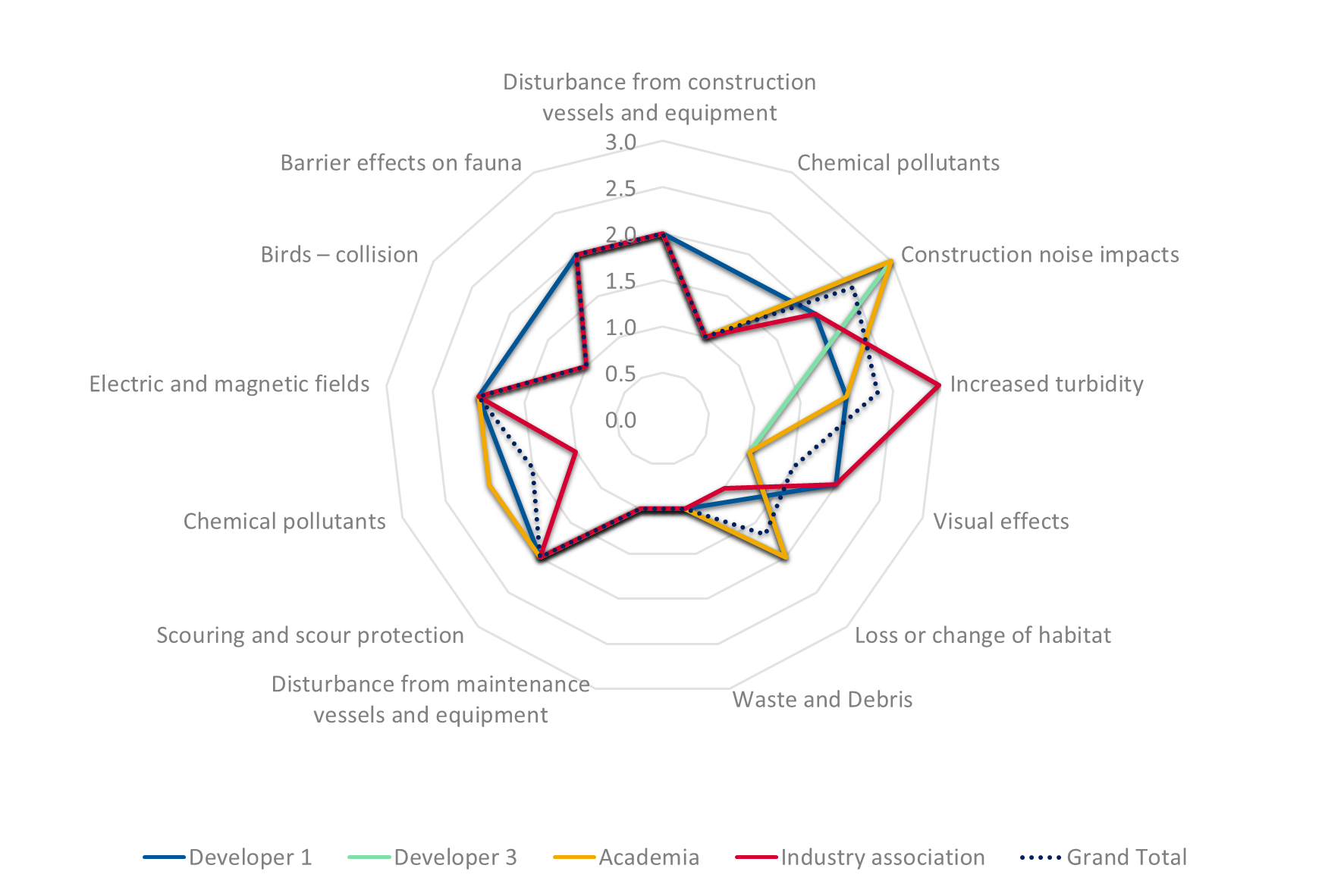
Design of a floating jacket foundation: significance
Operational phase impacts
Construction phase impacts
Notes:
SIGNIFICANCE analysis:
The significance chart displays the high majority of environmental impacts as having either a project specific impact or local impact. Only two environmental indicators were rated as potentially being able to have a regional impact; these are the construction noise impact and the turbidity increase.

Slide 15
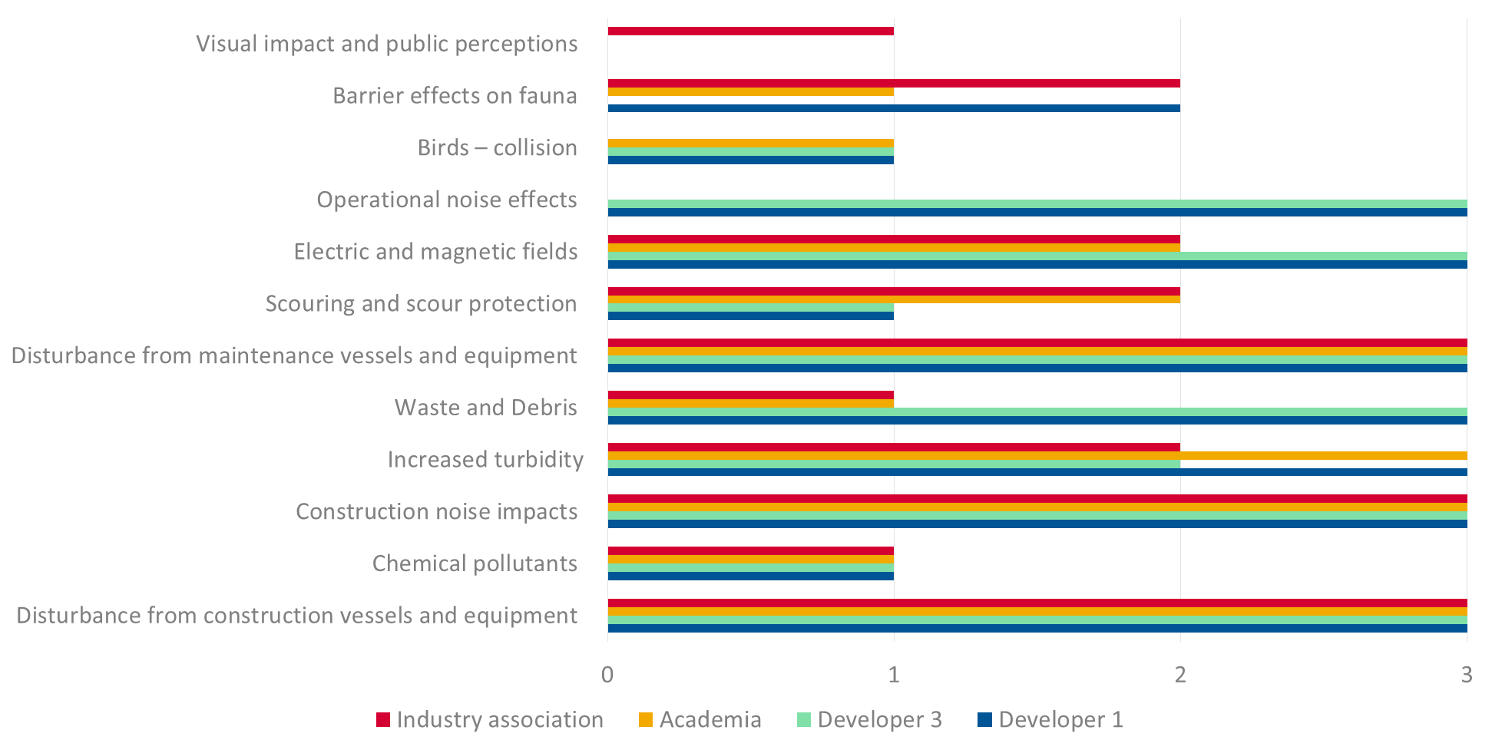
Design of a floating jacket foundation: probability
Operational phase impacts
Construction phase impacts
Notes:
PROBABILITY analysis:
We can identify on figure 8 the degree of probability of the environmental impacts listed.
Disturbance from construction and operational maintenance are certain. This is the case also for construction noise impacts and operational noise impacts.
Chemical pollutants, scouring and birds collisions are rated as possible with a rate of occurrence of less than 50%.

Slide 16
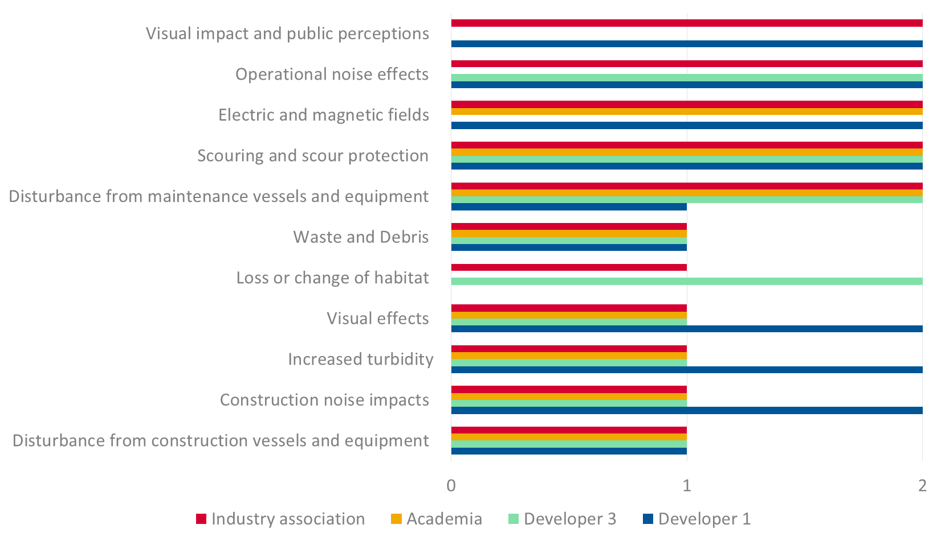
Design of a floating jacket foundation: duration
Operational phase impacts
Construction phase impacts
Notes:
DURATION analysis:
The duration chart exposes that all operational impacts are considered permanent, while the construction ones are considered temporary. These trends are similar to those of the cylindrical caisson buoyant GBFs.

Slide 17
Final thoughts on the environmental impacts
Different environmental performance from one type of foundation to another mainly on magnitude and significance:
  E.g. magnitude of the loss or change of habitat is negative for both the GBF and jacket foundation. The explanation is that despite the innovative way of assembling the foundation (floating dock) and of transporting it to the installation site (floating) the foundation would have the same environmental impacts. As the current GBFs installed they still require sea-bed preparation and would occupy the sea-bed. The same is valid for the jacket foundation,
  E.g. for the same GBF instead the construction noise rates as negligible as sitting the foundation on the sea-bed doesn’t require pilling, while for a regular jacket it would, and for a jacket with suction buckets,
  E.g. the innovative way of transporting the GFB and jacket to site (float them) would result in a smaller carbon footprint as less fuel for transportation will be consumed in this phase. Less disturbance from construction will be registered too as there wouldn’t be a need for a installation vessel,
Notes:
The most common environmental impacts associated with the installation of GBFs are: the physical sea-bed footprint, meaning the exact space occupied by the foundation, the direct loss of sea-bed habitat and benthos, changes in the sediment flow, change in habitat from soft habitat to hard substratum habitat. To be noted that all types of foundations have an environmental impact but recovery from these effects is expected within the lifespan of the windfarm project [6].

Slide 18
Electromagnetic fields (mitigation)
Stakeholder | Cylindrical Caisson buoyant GBF | Design of a floated to site jacket | Suction buckets with a floated to site jacket | Innovative semi-sub platform | Cable laying, burial and trenching
Developer 1 | -2 | -2 | -2 | -2 | n/a
Developer 2 | n/a | n/a | n/a | n/a | n/a
Developer 3 | n/a | n/a | n/a | n/a | n/a
Research Institute | n/a | n/a | n/a | n/a | -4
Academia | -2 | -2 | -2 | n/a | n/a
Industry association | -2 | -2 | -3 | -2 | -3
Average score | -2 | -2 | -2.3 | -2.0 | -3.5
Good practice measures and mitigation which could be adopted to reduce potential disturbance of cabling activities on intertidal and subtidal habitats, marine mammals, birds, fish and shellfish:
Early dialogue with the appropriate regulatory and advisory authorities;
Sensitive timing and routing of cable installation to avoid important feeding, breeding/spawning and nursery areas and seal haul out areas especially during sensitive periods (breeding season);
Avoidance of areas of sensitive habitat and sensitive timing and routing of maintenance vessels to reduce number of trips;
For marine mammals and birds: preparation of on-site protocol in sensitive locations as well as briefing of cable installation contractor’s personnel for on-site procedures and protocol;
Monitoring effects using a Before-After-Control-Impact (BACI) study

Slide 19
Community engagement strategy
Providing Information
Engaging local communities
Innovative Financing / Benefit sharing
2 way interaction: dialogue & exchange of views.
1 way information to targeted stakeholders.
Partnership models.
Community benefit for onshore wind received positively, transfer of the experience to offshore?
However, differences in identifying nearby communities, maturity of the industry, technology and project economics?

Slide 20
Socio-economic and community benefits
(Walney offshore wind farm)
Contribution to the local economy
Approximately £1 million per month during the construction phase
Local employment
5,697 worked on Walney I and II during its construction
Community benefits
Community fund established worth up to £660,000 each year
Environmental benefits
​Walney produces enough electricity to power over 320,000 UK homes
Notes:
Walney
​Walney produces enough electricity to power over 320,000 UK homes.
Number of turbines: 102
Generation capacity: 367 MW
Commercial operation: 2012
Owner of the project: DONG Energy (50.1%), PGGM and Ampère Equity Fund (24.8%) and SSE (25.1%)
The Walney Offshore Wind Farm is located approximately 15km from the coastline of Walney Island in a north west to south-easterly direction covering an area of approximately 73 km².
The Walney Offshore Wind Farm consists of Walney 1 and Walney 2 each comprising 51 wind turbines with a total capacity of 367 MW.
In May 2010 the 750 MW capacity Walney Extension was awarded. The application for consent was accepted by the Planning Inspectorate in July 2013.

Slide 21
Community engagement
(London Array offshore wind farm)
Community fund establish worth £850,000
£200,000 for nature conservation, donated to and handled by Kent Wildlife Trust,
£300,000 for community benefits, donated to and handled by the specially established Graveney and Goodnestone Trust,
A new car park and road crossing for Graveney Primary School,
£2,000 a year each for three local schools to spend on extra-curricular activities (with a link to sustainability, environment, engineering etc),
A 10-year university bursary scheme to help fund one local student a year through university.
Notes:
Construction of the onshore substation at Cleve Hill started in July 2009 and was completed in October 2012. Offshore construction started in March 2011, when we installed the first of 177 foundations for the project.
The first turbine was installed in January 2012, first power was achieved in October that year and the final turbine was installed in December 2012.
Facts and Figures
An offshore area of 100km2
175 wind turbines
Two offshore substations
Nearly 450km of offshore cabling
One onshore substation
630MW of electricity
Enough power for nearly half a million UK homes a year – two thirds of the homes in Kent
Reducing harmful CO₂ emissions by more than 925,000 tons per year

Slide 22
Community engagement
Gwynt y Môr offshore wind farm)
Community fund: £19 million over 25 years
Tourism fund: £690,000
Facilitating pier upgrade for cruise liners
RNLI partnership: £3.8 million
Achieving blue flag status for beach
5 year partnership to support lifeguards
Privately funded grant and loan scheme
Fully flexible fund objectives
Engaging local communities
Early and thorough engagement with local communities should be a first step for assessing the needs and concerns of communities, discussing appropriate and desired benefit models, and determining potential beneficiary communities.
Shorter and smoother administrative procedures through local community engagement
Acceptance of wind power projects by local communities could, in theory, contribute to faster permitting procedures and thereby a faster and wider deployment of wind power across Europe. The easiest way for communities to accept wind power is to be regularly and openly informed, engaged and consulted.
Explore the possibility of a potential financial partnership
Developers and TSOs may wish to consider how to provide information to communities, how to facilitate engagement and dialogue, and how to explore the potential for a financial partnership with a community organisation. Co-ownership through coastal communities, co-operatives or non-local energy utilities for offshore wind energy projects remains rare.
Notes:
To date it is considered challenging to establish a quantitative correlation between the numbers of wind energy projects consented relative to the communities proactively engaged. Nonetheless, from interviews with specialists there is indication of a potential positive correlation at least in the case of onshore wind energy projects.

Slide 23
Co-ownership
Co-ownership
Legal obligation of 20% ownership for nearshore wind farms in Denmark
Municipal utilities ownership and citizen participation possible in Germany
Developer of Dutch Westermeerwind Offshore Wind park grants the possibility of community buy-in
Notes:
Co-ownership through coastal communities, co-operatives or nonlocal energy utilities is very rare
Benefits are generated through revenues from partial ownership of wind farm
Legal obligation of 20% ownership for nearshore wind farms in Denmark
Revenues generated through ownership are also administered by funds and trusts
Municipal utilities ownership and citizen participation possible in Germany (community buy-in)
Developer of Dutch Westermeerwind Offshore Windpark grants the possibility of community buy-in
Denmark:, (non-voluntarily)
Germany: Global Tech 1, Windreich
Netherlands: Westermeerwind

Slide 24
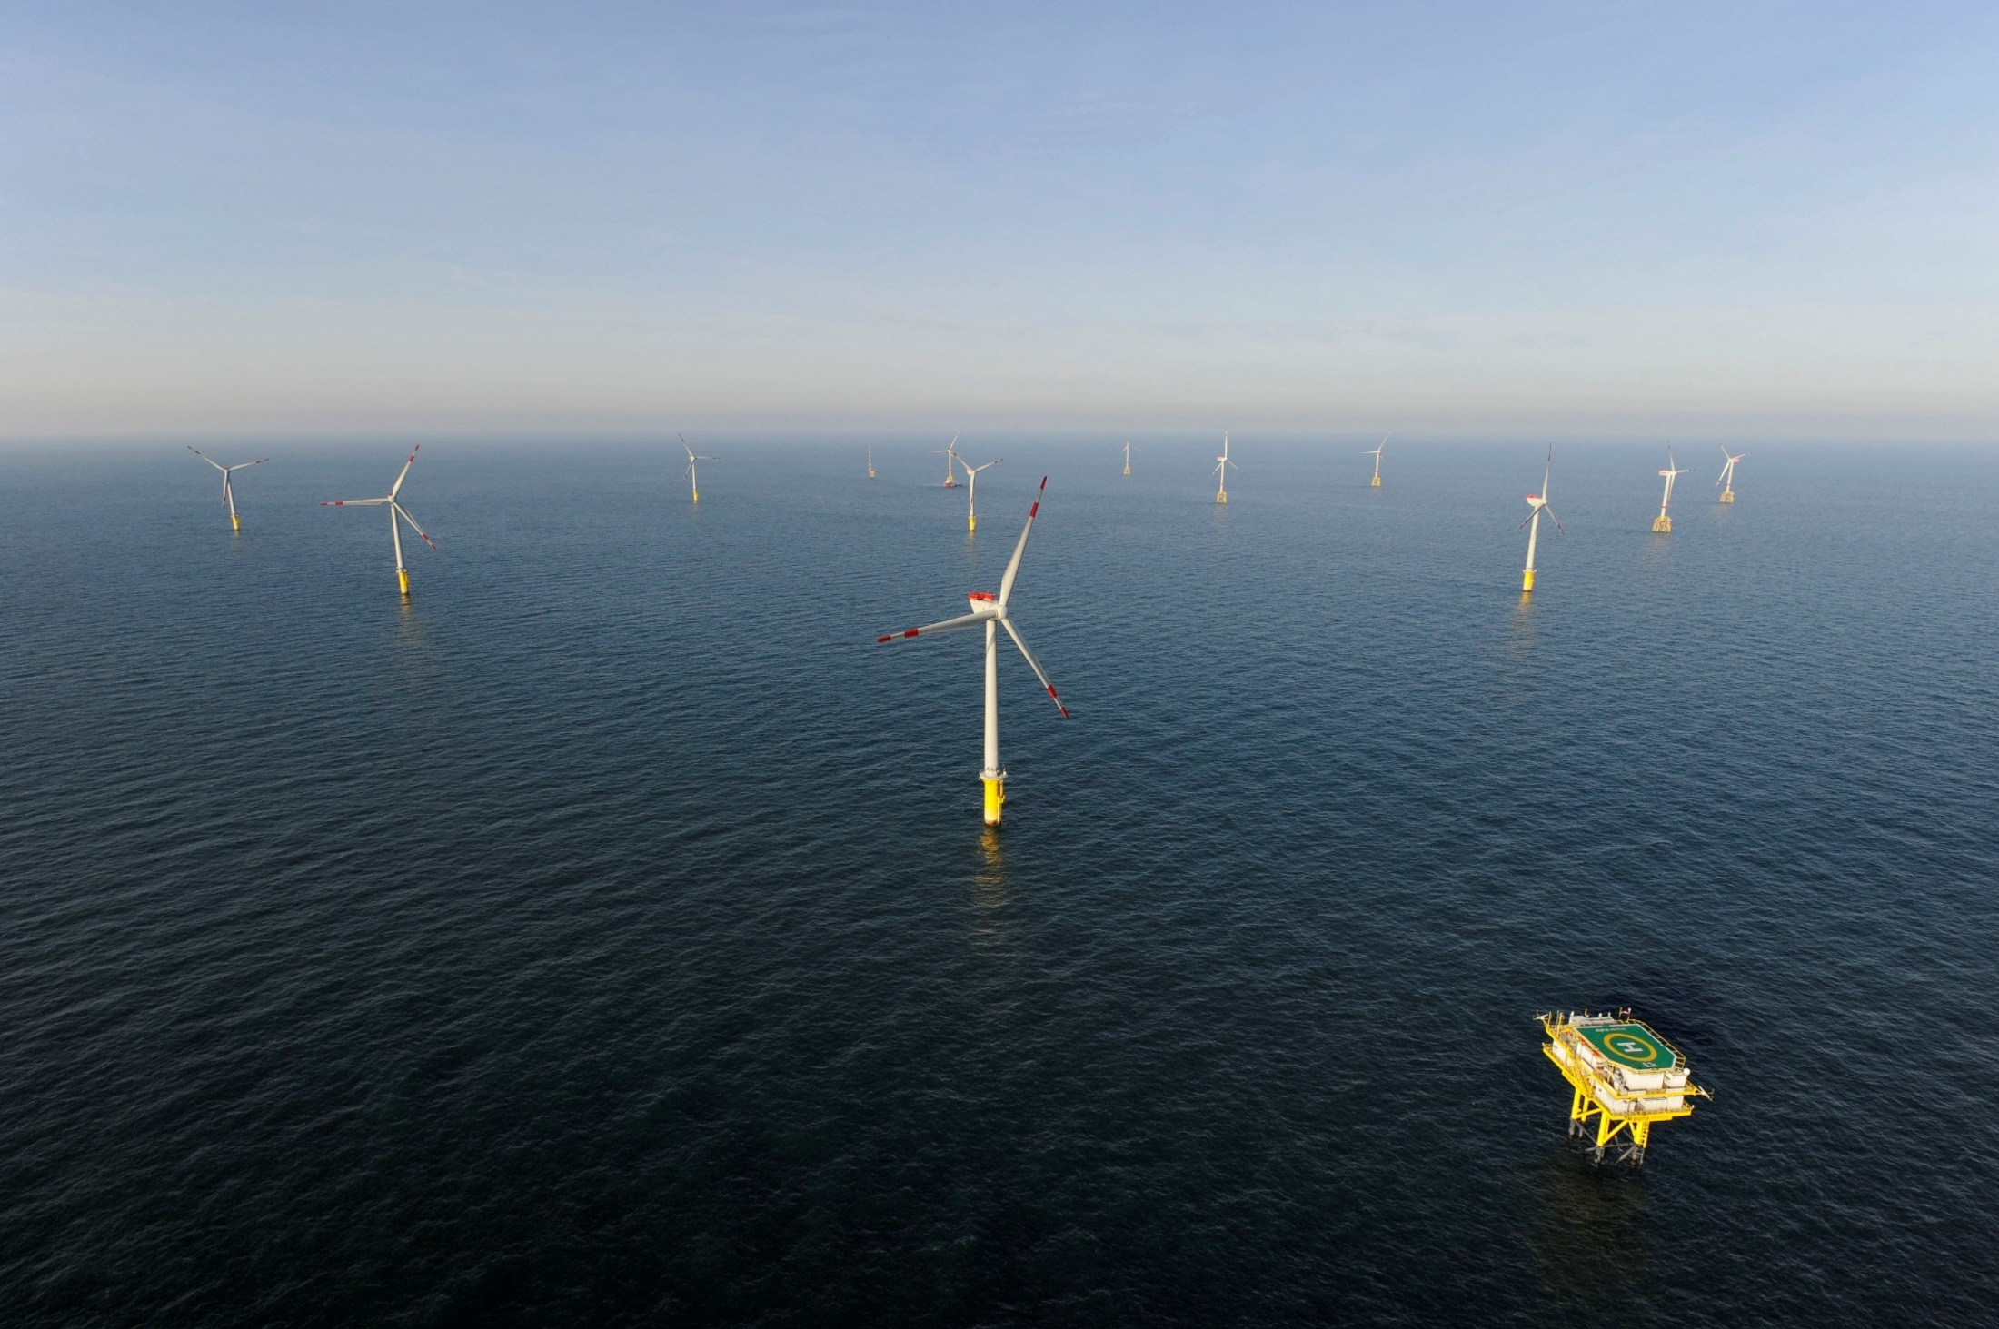
Conclusions
All types of foundations have an environmental impact but recovery from these effects is expected within the lifespan of the windfarm project,
Mitigation solutions available for all series of environmental impacts and usually these mitigation protocols are decided together with the permitting authorities (e.g. on electromagnetic fields),
Community engagement and benefit sharing are core aspects of a successful social acceptance strategy.

