Slide 1
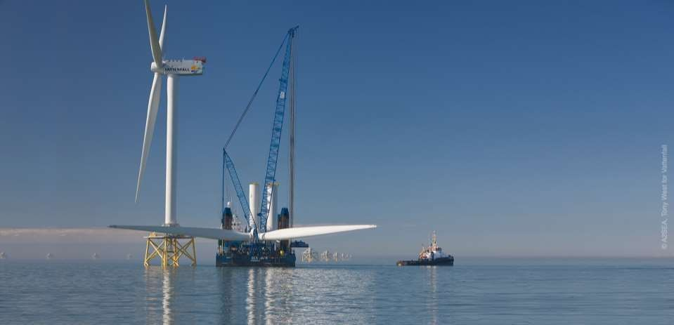


Installation Vessel Design
Mark Anju
Venkata Swarupanand Godavarthi
Lloyd’s Register
Final Event, 30th November 2017
Project supported within the Ocean of Tomorrow call of the European Commission Seventh Framework Programme

Slide 2
















Some of Our Partners
Partners Include:
Operators
Vessel Owners
Simulation Specialists
Research Institutions

Slide 3
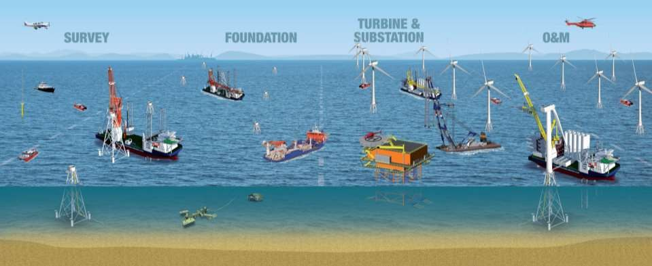
Variety of Vessels Operating for Windfarms
INSTALLATION VESSEL O & M VESSEL
Installation Vessels
O&M Vessels
Anchor Handling / Supply Vessel
Crew Transfer Vessel
Offshore Tug/Supply Vessel
Platform
Standy Safety Vessel
Research/Survey Vessel
Accommodation Vessel
Diving Support Vessel
Pipe Laying Vessel
Cable Laying Vessel
etc….

Slide 4
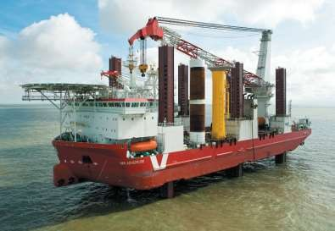




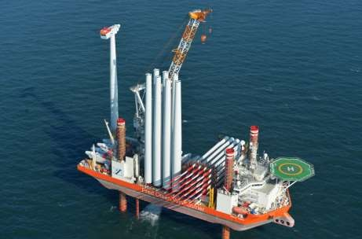
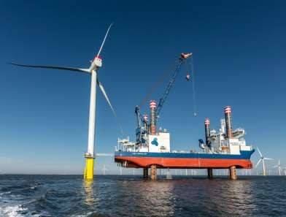
Installation Vessels
Foundation Installation vessels
Turbine Installation Vessels

Slide 5
Challenges for Installation Vessel
1
Mobilisation
2
Load-out
3
Transit to site
4
Positioning on site
5
Foundation handling
6
TP
installation
7
Transit to supply port
8
Turbine installation
9
Crew change
Increased demand for larger wind turbines
Farms growing further offshore
  Limitation of offshore lifts
  Operating constraints due to meteorological conditions
Improve weather monitoring and decision support system
Optimise the number and size of turbines loaded per trip
Decrease offshore operation duration
Reduce fuel consumption and improve energy efficiency

Slide 6
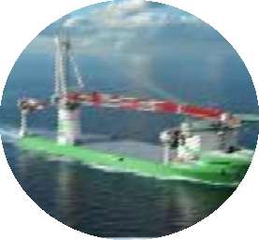
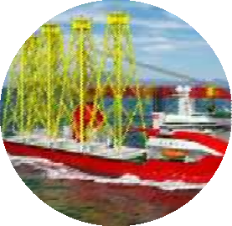
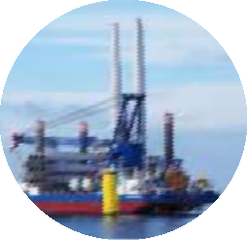
Vessel Concepts – Design Study
Ship-shaped, floating self-propelled, DP-stabilised vessel specialised for foundation installation (FTIV)
Ship-shaped, self-propelled and self-elevated vessel
specialised for foundation installation (FTIJ)
Ship-shaped, self-propelled and self-elevated vessel specialised for turbine installation (WTIJ)

Slide 7





Concept Selection Process
Location
Importan ce factor
Sub-criteria
Design implications
VESSEL CONCEPT
Operational phases & tasks
Factor
Δ T ime incurred or saved per turbine
Ranking
Cost incurred or saved per turbine
Types
Reduce
Carry
Wide
Optimised
Average
Factored
Factored
cost & time
bigger turbines
weather window
for site & transit op.’s
1.
SPIV (Jack up vessel) specialised for turbine installation
-0.2 -0.6 0.3 0.9
#1 FTIV
2
2
2
1
1.75
Case 0 – South Knock
Mobilisation
Deck seafastening system for components/equipm ent
3
#2 FTIJ
2
1
3
2
2
#3 WTIJ
3
3
3
3
3
Load-out
Crane lift for components
5
-0.8
-4
-0.5
-2.5
Operational Criteria
1- Less likely
2-Likely
3-Highly likely
Component positioning and fixing
4
-0.8
-3.2
-0.5
-2
Ballasting for jacking / submerging procedure
2
-0.2
-0.4
-0.1
-0.2
Ballasting for trim
2
0
0
-0.1
-0.2
Number/size of turbine components
4
-0.9
-3.6
-0.5
-2
Transit to site
Transit speed
3
-0.2
-0.6
-0.2
-0.6
Transit Hs
4
-0.5
-2
-0.2
-0.8
Transit wind speed
3
-0.1
-0.3
-0.5
-1.5
Ship-shaped, self propelled and self- elevated vessel specialised for turbine installation
(WTIJ)
Positioning on site
Route
3
-0.2
-0.6
0
0
DP operations
3
0
0
0
0
Jacking, hull elevation, pre- loading
3
-0.2
-0.6
-0.4
-1.2
Foundation handling
Jack-down
3
-0.1
-0.3
-0.4
-1.2
Lifting and Handling
5
0.7
3.5
0.4
2
Foundation Installation
Positioning / Upending and Hammering
4
0.7
2.8
0.7
2.8
TP Installation
Lifting and grouting
3
0.5
1.5
0.4
1.2
Turbine Installation
Seafastenings
3
-0.2
-0.6
0.3
0.9
Technician transfer to TP
5
-0.8
-4
-0.2
-1
Lifting components and assembly
5
-1
-5
-0.8
-4
Crew change
Helicopter operations for crew change
1
-0.1
-0.1
0.1
0.1

Slide 8
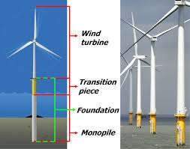
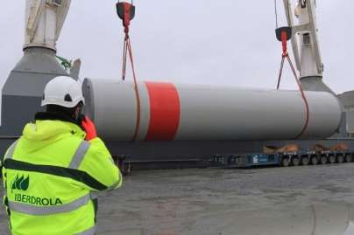


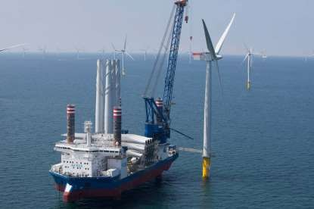
WTIJ Design Selection
Key parameters
Cargo Selection & Capacity
Vessel Economics
  CAPEX & OPEX
  Time reduction
Port and Site restrictions
Crane operations

Slide 9




Vessel Economics – Turbine Selection
Time to install (days)
Hundreds
2.0
150 NM
100 NM
50 NM
20 NM
Thousands
Effective Installation cost per turbine
1.8
€ 480.00
5, € 474.48
€ 470.00
Sample Vessels
1.6
Installation cost per turbine
€ 460.00
5 6 7 8 9 10 11
No of turbines per vessel
€ 450.00
Installation time
€ 440.00
6, € 435.56
€ 430.00
11, € 428.71
€ 48
€ 46
€ 44
€ 42
€ 40
€ 38
€ 36
€ 34
€ 420.00
Installation Cost
Millions
9, € 414.55
150 NM
100 NM
50 NM
20 NM
€ 410.00
7, € 410.38
8, € 406.10
€ 400.00
€ 390.00
8, € 392.09
8
Turbine Number
4
6
10
12
5 6 7 8 9 10 11
No of turbines per vessel
Installation cost
Courtesy: Geosea Maintenance (DEME Group)

Slide 10
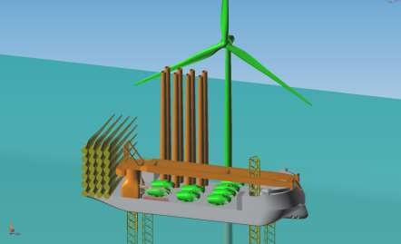
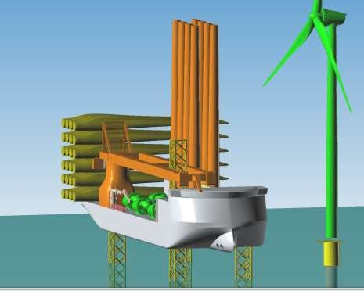
Installation Vessel Design Features
Ship type self elevating vessel (168.5x50x12)
Pedestal Crane (Max. 1500t)
Dual Fuel Engine
Cargo Capacity (9000 t)

Slide 11

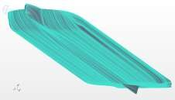
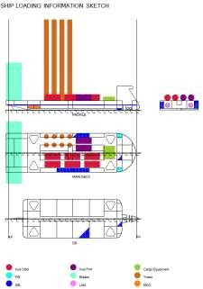
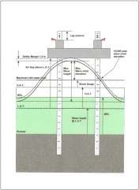
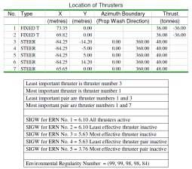
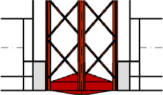
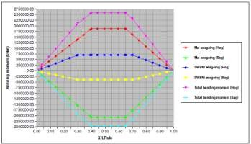
Examples of Concept Design Activities
Hull Form Design, Optimisation & CFD Analysis
Leg Length Calculation
DP Calculation
Conical spudcan for easy assembly
Stability Calculations
 |  |  | SEA G | OING | Dynamic | Positioning | Turbine In | stallation | Jacki | ng up
 | POWER | load | diversity | power | diversity | power | diversity | power | diversity | power
 | kW | factor | factor | kW | factor | kW | factor | kW | factor | kW
Accomodation Load
TOTAL | 2168 |  |  | 823 |  | 936 |  | 843 |  | 825
Main Crane | 5000 | 0.8 | 0 | 0 | 0 | 0 | 0.7 | 2800 | 0 | 0
Legs | 20000 | 0.8 | 0 | 0 | 0 | 0 | 0 | 0 | 0.9 | 14400
Forward crane | 200 | 0.8 | 0 | 0 | 0 | 0 | 0.2 | 32 | 0 | 0
Aft Crane | 150 | 0.8 | 0 | 0 | 0 | 0 | 0.2 | 24 | 0 | 0
DP bow thrusters 3300 CP x 2 | 5110 | 1 | 0 | 0 | 1 | 5110 | 0 | 0 | 0 | 0
Azimuths Aft US 355-P50 x 4 | 14800 | 1 | 0.6 | 8880 | 0.1 | 1480 | 0 | 0 | 0 | 0
 | 0 | 0 | 0 | 0 | 0 | 0 | 0 | 0 | 0 | 0
 | 0 | 0 | 0 | 0 | 0 | 0 | 0 | 0 | 0 | 0
TOTAL | 47428 |  |  | 9703 |  | 7526 |  | 3699 |  | 15225
Electric Load Calculations
Structural Calculations

Slide 12
Key Elements of WTIJ Concept
Pure LNG propulsion system
Capable to operate in all regions of ECA
Capable to carry and mount 8 units of 8MW (or 7 pieces of 10MW) wind turbines (for 10MW subject to design features)
Capable to install 32 wind turbines with 4 visits without refuelling
Capable to install wind turbines with 1500-ton main crane or to install both wind turbines and monopile foundations (4 pcs) with 2000-ton main crane
Capable to operate under higher wind speed conditions via
high wind boom lock system for installation of suspended weights
Environmental Regularity Number = (99, 99, 98, 98, 84) for dynamic positioning operations with existing propulsion and thruster system
6040 m² free main deck area optimized for fast installation
70 person capacity (crew + technicians)

Slide 13
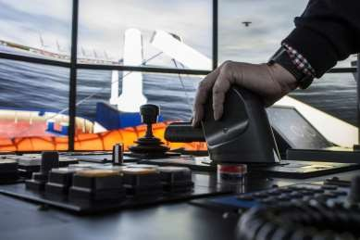
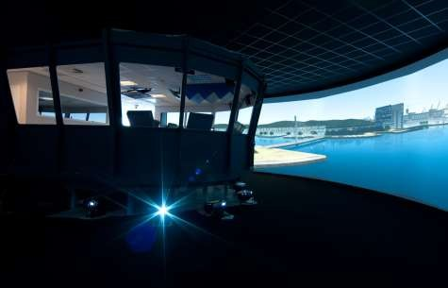
Simulation Activities - Scope
Simulator based studies supporting:
Feasibility Studies for innovative design
solutions
Development of Operational Procedures
Training of crews and operators
Development of thrust allocation strategies
Development and tuning of DP system
Development of combined/integrated operational procedures for DP and crane operations
Determination of weather windows for
safe operation

Slide 14
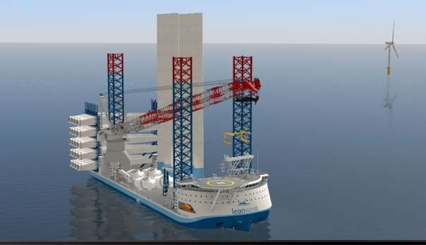
Leanwind Project Simulator Demo
K-Sim simulator model consisting of
  Vessel hydro dynamical model based on design principles
  Corresponding K-Pos DP SW with current off the shelf wind turbine installation and service functionality
  Installation crane
  4-leg jacking system
  Deck layout for 8 x 8 MW turbines
Operator environment for DP, jacking operator and crane operator

Slide 15

Commercial Benefits for LR
Update of LR rules and guidance
Testing impacts of regulatory changes
Opportunities to Class New Build/TOC
Access to information regarding corporate plans for new innovation and cost reduction
LR
Installation vessel concept design support
Strategic Offshore Wind market entry/design optimisation for vessel owners
Wind Turbine Foundation Certification (Design and Mnf Review)
Scour modelling on wind farms
O&M vessel operations support IRIS

Slide 16
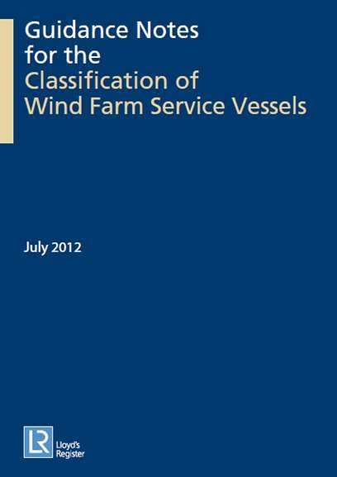

Rules and guidance – Classification of Wind Farm Service Vessels
Guidance Notes for the Classification of Wind Farm Service Vessels
The growing market for offshore wind farms has created an industry requirement for service vessels to support the construction and installation of the associated wind turbines. Typically these vessels are engaged in ferrying
workers and light cargoes to the wind turbines for construction and routine maintenance.
This guidance note is designed to assist designers, builders, operators and owners wishing to Class their Wind Farm Service Vessels with Lloyd’s Register
(hereinafter referred to as LR). For the Classification of these vessels, all parts the LR Rules and Regulations for the Classification of Special Service Craft (hereinafter referred to as the Rules
for Special Service Craft) are to be applied

Slide 17
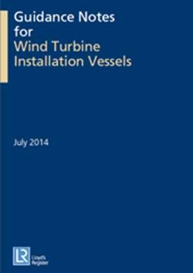
Rules and Guidance
Guidance Notes for Wind Turbine Installation Vessels
This Guidance Note provides summary information for designers and operators concerning classificatio requirements for offshore units engaged in installation and / or maintenance activities relating to offshore wind turbines.
It is intended that for these types of units class notations are assigned in accordance with Part 1 of our Rules and Regulations for the Classification of Offshore Units.
The following types of vessels (WTIVs) are covered by this Guidance Note:
Surface-type floating unit;
Surface-type self-elevating unit;
Self-elevating unit;
Column-stabilised unit.

Slide 18
The research leading to these results has received funding from the European Union Seventh Framework Programme under the agreement SCP2-GA-2013-614020.

Slide 19

Mark Anju
Venkata Swarupanand Godavarthi (Anand)
Lloyd’s Register EMEA
Global Technology Centre, Boldrewood Campus
Burgess Road, Southampton SO16 7QF
T +44 (0)330 414 0455/1056
E swarupanand.godavarthi@lr.org / mark.anju@lr.org w www.lr.org
Working together for a safer world

Slide 20
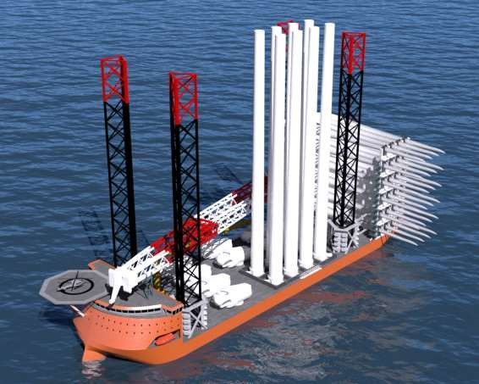

Q&A ?

