Slide 1
Operation & Maintenance
Strategy planning and optimisation to improve procedures and accessibility
Amsterdam 30th November 2017
John Dalsgaard Sørensen, Aalborg University
Professor

Slide 2
Outline
  Objectives
  O&M strategy optimization
  Dynamic O&M scheduling
  Risk-based O&M planning
  Remote Presence system
  Summary / Challenges addressed

Slide 3
Objectives
Optimise O&M strategies, procedures and scheduling for far-shore/deep water/more exposed locations.
Reduce OPEX costs by improving condition monitoring and remote presence systems to minimise the need for on-site and corrective maintenance.
Examine the influence of weather conditions, access criteria and access systems.

Slide 4
O&M strategy optimisation
Time scales
Strategic
(e.g. years)
O&M strategy model
O&M logistics strategy
Tactical
(e.g. weeks)
Maintenance scheduling model
Maintenance plan
(on a tactical level)
Dynamic O&M scheduling
Maintenance routing model
Operational
(e.g. day)

Slide 5
O&M strategy optimisation
Tools, models and techniques developed as basis for O&M optimization:
Reliability-based tools based on advanced RAMS techniques
Deterioration / degradation models
IDPS (Integrated Diagnosis and Prognosis System) Web Service - online system for CM and diagnosis/prognosis of faults in offshore WT

Slide 6
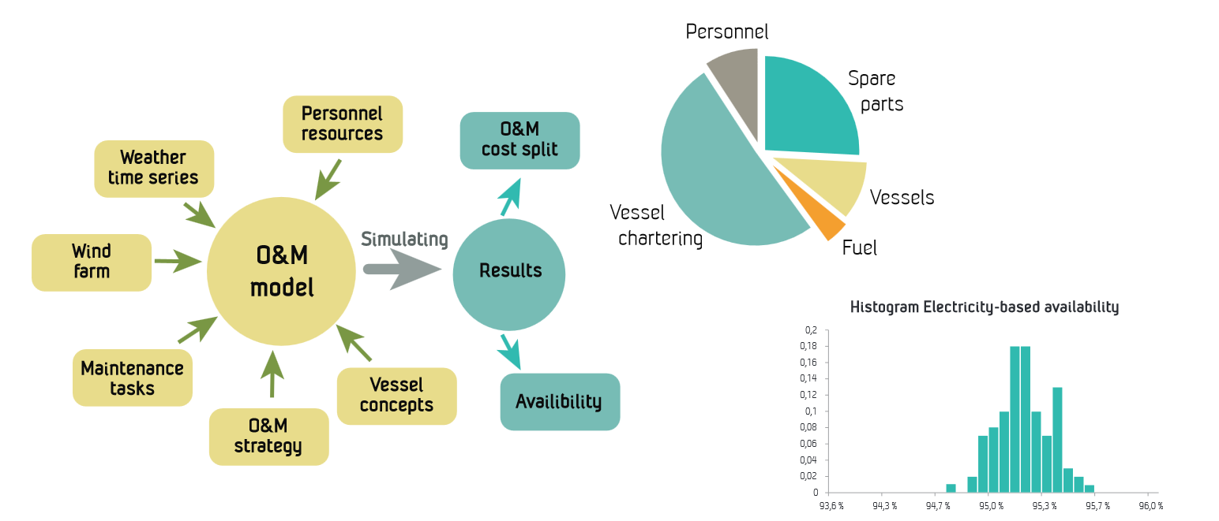
O&M strategy optimisation
LEANWIND O&M strategy model: Decision support tool for strategic offshore wind farm O&M and logistics decision problems.

Slide 7
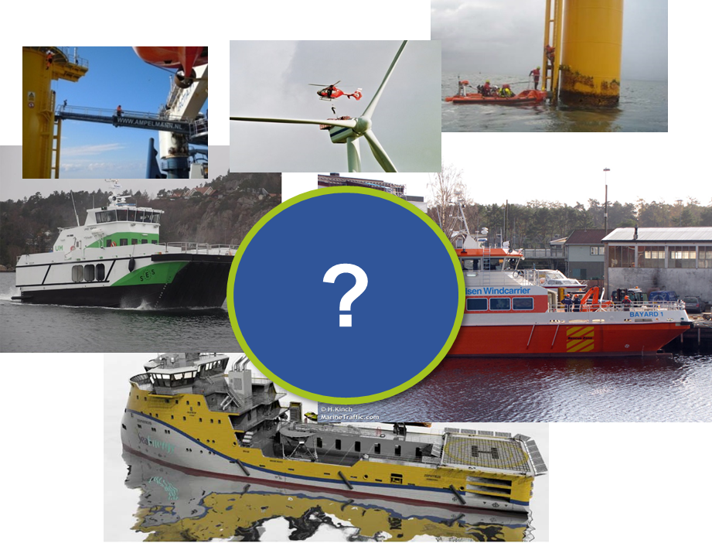
O&M strategy optimisation
Example of decision problem: What is the optimal composition of the vessel fleet for accessing the turbines to carry out maintenance?
Annual savings / increased profit ~ 1 M€/GW
Optimal
solution
Alternative O&M access vessel fleet solutions

Slide 8
O&M strategy optimisation
Example of decision problem: What is the optimal composition of annual pre-determined jack-up vessel campaign periods for heavy maintenance?
Annual savings /
increased profit
~ 2 M€/GW
Optimal solution
Worse solution
Results available from: Sperstad, IB.; McAuliffe, F. D.; Kolstad, M.; Sjømark, S. (2016): Investigating key decision problems to optimise the operation and maintenance strategy of offshore wind farms. Energy Procedia, vol. 94, pp. 261–268.

Slide 9
O&M strategy optimisation
Comparison of decision problems in terms of potential of cost reductions and associated uncertainties:
Cost reduction
potential relative to
optimal solution
Optimal solution
Worse solution
Results available from: Sperstad, IB.; McAuliffe, F. D.; Kolstad, M.; Sjømark, S. (2016): Investigating key decision problems to optimise the operation and maintenance strategy of offshore wind farms. Energy Procedia, vol. 94, pp. 261–268.

Slide 10
O&M strategy optimisation
Comparison and benchmarking of different models for O&M vessel fleet optimisation
StrathOW-OM
LEANWIND O&M strategy model
MAINTSYS
ECUME
MARINTEK vessel fleet optimisation model
ECN O&M Tool
Models only partly agree on
the optimal O&M vessel fleet
Results available from Sperstad, I. B.; Stålhane, M.; Dinwoodie, I.; Endrerud, O.-E. V.; Martin, R.; Warner, E. (2017): Testing the robustness of optimal access vessel fleet selection for operation and maintenance of offshore wind farms. Ocean Engineering, vol. 145, pp. 334–343.

Slide 11
O&M strategy optimisation
Comparison of models for O&M
vessel fleet optimisation
Models agree that accessibility
is a key parameter for the optimization
of the O&M vessel fleet
StrathOW-OM
LEANWIND O&M strategy model
MAINTSYS
ECUME
MARINTEK vessel fleet optimisation model
ECN O&M Tool
Results available from Sperstad, I. B.; Stålhane, M.; Dinwoodie, I.; Endrerud, O.-E. V.; Martin, R.; Warner, E. (2017): Testing the robustness of optimal access vessel fleet selection for operation and maintenance of offshore wind farms. Ocean Engineering, vol. 145, pp. 334–343.

Slide 12
Dynamic O&M scheduling
Yes
Maintenance Scheduling
(1-month)
Maintenance Routing
(1-day)
Revise Monthly Schedule?
No
PM
CM
Resources & Weather Condition

Slide 13
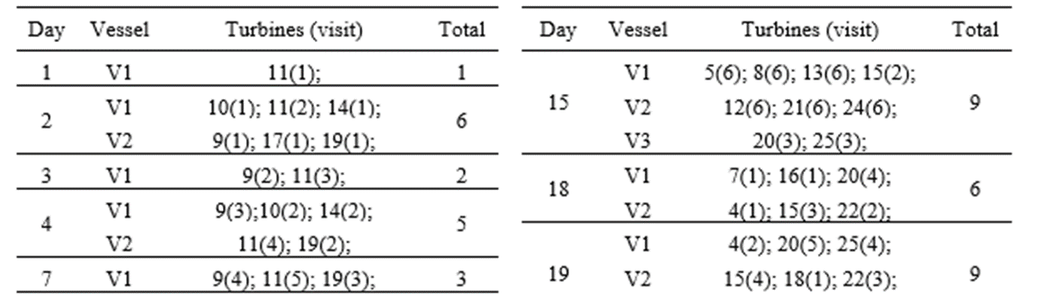
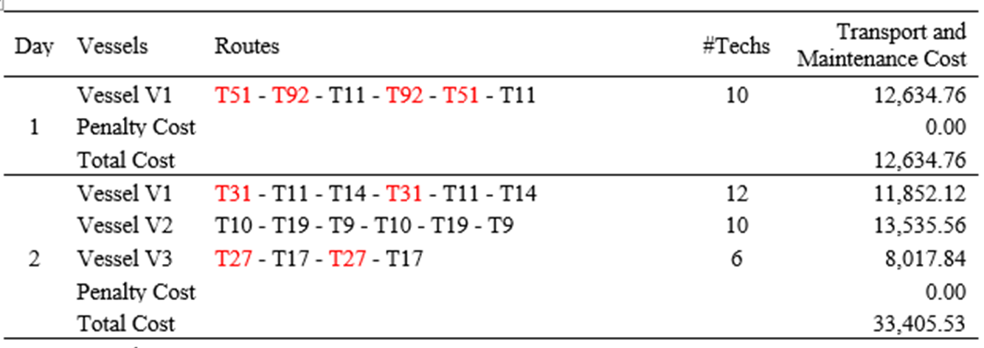
Dynamic O&M scheduling

Slide 14
Risk-based O&M planning
Plan inspections and maintenance such that
  Total expected lifetime costs are minimized
    Considering directly the influence of condition monitoring, inspections and repair strategy on failures rates
    Theoretical basis: Bayesian pre-posterior decision analysis

Slide 15
Risk-based O&M planning
Expected costs of:
Inspections
Repairs
Failures
Incl. lost revenue
Models for:
Deterioration
Monitoring
Inspections
Repairs
Decision rules for:
Inspections
Repairs
Simple decision rules, e.g.:
Equidistant
Directly on monitoring outcome
Advanced decision rules, e.g.:
Probability of failure
Select strategy with lowest espected lifetime costs

Slide 16
Case study: Blade maintenance
Deterioration model based on inspection data
Value of condition monitoring
Inspections by rope or drone, how often?
Repair using CTV for smaller defects
Blade exchange using jack-up for severe defects
Blade exchange costs

Slide 17
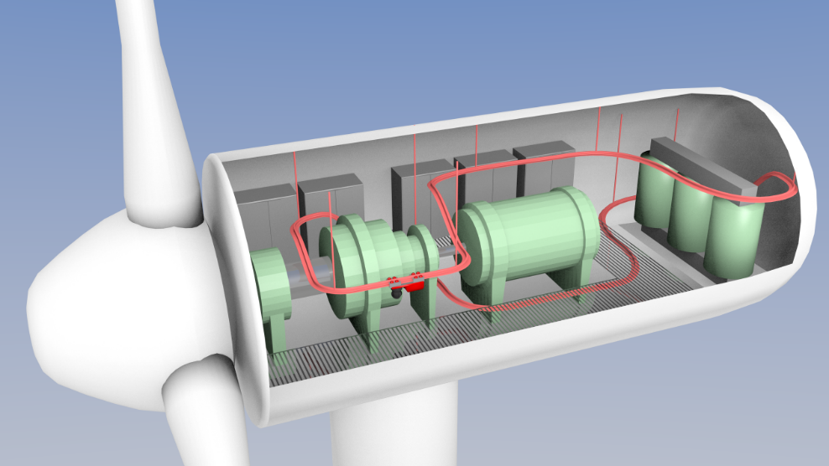
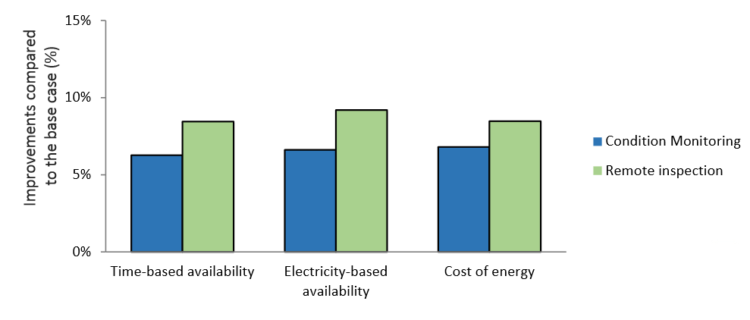
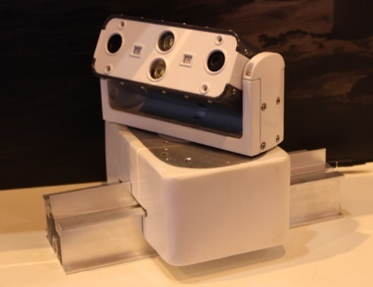
Remote presence system
A remote presence system for use in O&M is developed and tested
Provide wind turbine operators the ability to have a presence on a turbine without sending personnel there
Annual savings / increased profit
~ 2.5 M€/GW
Results available from: Netland, Ø.; Sperstad, I. B.; Hofmann, M.; Skavhaug, A. (2014). Cost-benefit evaluation of remote inspection of offshore wind farms by simulating the operation and maintenance phase. Energy Procedia, vol. 53, pp. 239-247.

Slide 18
Summary / Challenges addressed
Improvement in availability expected from improved CMS or novel concepts such as remote presence
Effect of weather conditions on the maintenance work to be performed by technicians
Effect of improved scheduling, grouping and routing on the overall operation of the wind farm
Interaction between the strategy for spare parts and the strategy for vessel logistics
Best strategies for chartering of heavy-lift vessels

