Slide 1
Operations & Maintenance Vessels
Safety and efficiency
Innovations for LCOE Reduction in Offshore Wind Energy – Technologies, Models and Strategies
November 30, 2017

Slide 2
O&M Vessels - Scope of presentation
Industrial Challenges
The LEANWIND O&M Vessel Design
LEANWIND simulator based tools
Design/feasibility studies
Optimization of operational procedures
Training programmes to improve efficiency and safety
Conclusions – Potential safety improvements and cost reductions

Slide 3
O&M Vessels - Industrial Challenges
The main challenges identified for O&M vessels are:
Establishing optimum vessel size and hull form type for far shore hostile environments.
Increase fuel efficiency;
Increase operability/accessibility in larger sea states;
Reduce seasickness and its detrimental effect on maintenance crews;
Optimisation of operational efficiency;

Slide 4
O&M Vessels - LEANWIND O&M Vessel Design
Key design drivers for O&M Vessels
CAPEX & OPEX
Seakeeping characteristics
Weather windows for safe operation
Comfort
Manoeuvring performance
DP system
Fuel consumption
Payload capacity, overnight accommodation
Motion compensated Walk-to-Work gangway system
Motion compensated crane
Daughter crafts and helideck for fast crew transfer to shore

Slide 5
O&M Vessel - LEANWIND Design
Notes:
Offshore vessel
Feedback from industry stakeholders has emphasised that there is currently a demand for larger vessels and that at the moment PSV’s are being used for windfarm support. This gap could therefore be filled by a larger Service Offshore Vessel (SOV) capable of carrying more spares, waste, perform balance of plant tasks, survey work , etc.
It should be ideally a mono hullform with 4 engines and IPS or azimuthing propulsors in the region of 40m in length. Diesel-electric propulsion will be used.
Capable of accommodating overnight up to 40 technicians in en-suite cabins.
A motion compensated system will be used to transfer technicians both at day and night to the turbine.
Large deck area and its own deck crane for cargo handling.

Slide 6
O&M Vessel - Design Particulars
Length overall : 80.00 m
Length perpendicular : 77.00 m
Breadth (moulded) : 20.00 m
Depth (moulded) : 7.50 m
Design draught : 5.00 m
Displacement : 5230 ton
Speed : 14 Knot
Crew : 20 Crew
Maintenance crew : 45 persons
Comfort class : Comf 3 or similar
DP requirements : Class DP2
Propulsion System : Dual Fuel (LFO/LNG)
: 2 AziPods + 2 Bow Thrusters

Slide 7
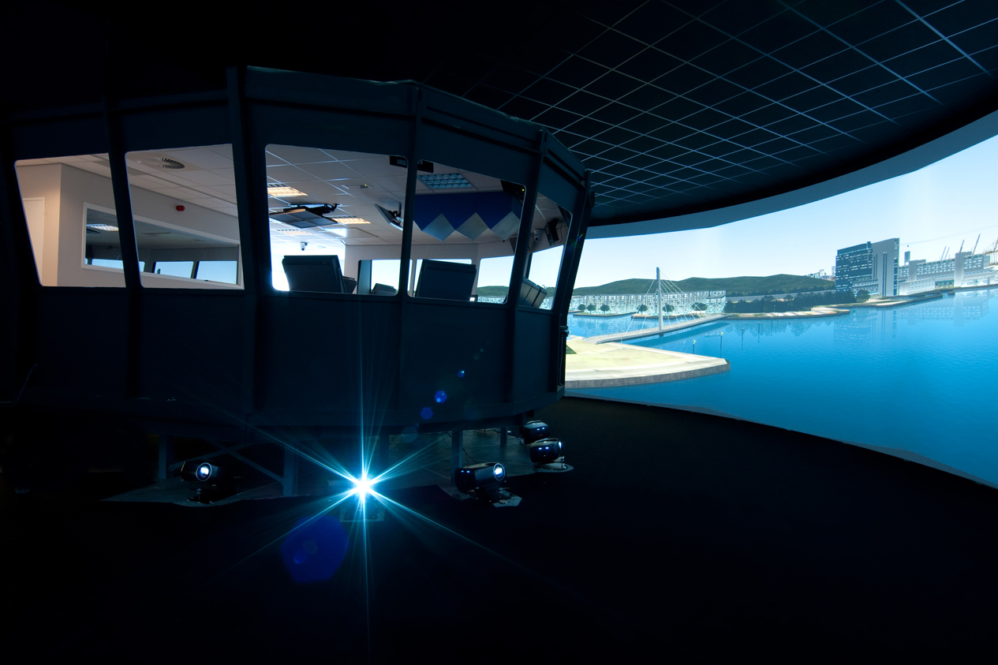
O&M LEANWIND Simulator based tools
LEANWIND has developed tools supporting:
Feasibility / Design Studies for innovative design solutions
Development of Operational Procedures
Training of crews and operators

Slide 8
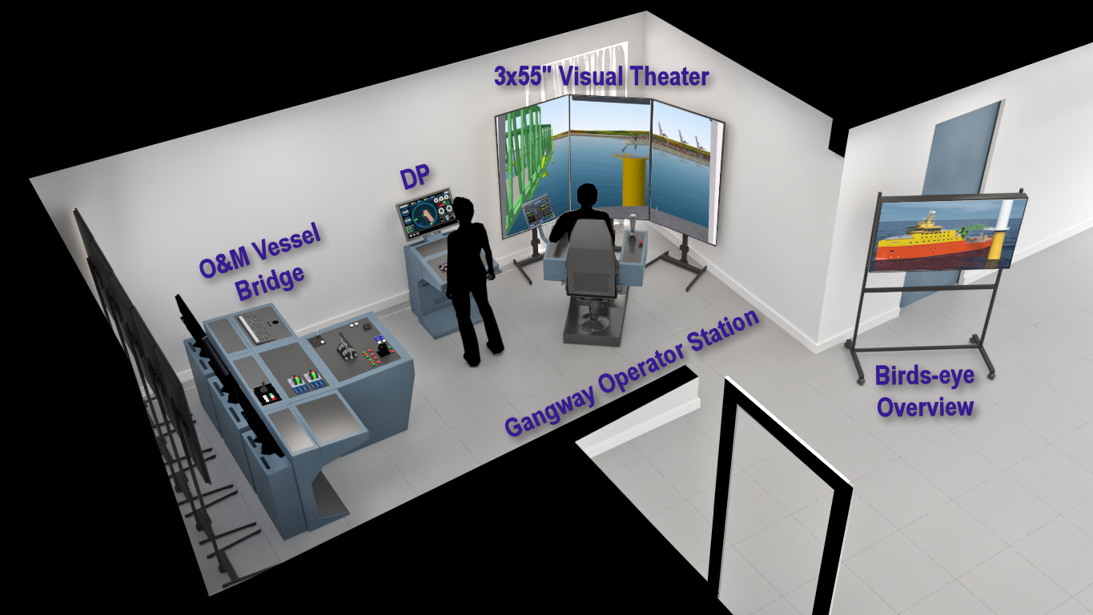
O&M Vessel – LEANWIND Simulator Set-up

Slide 9
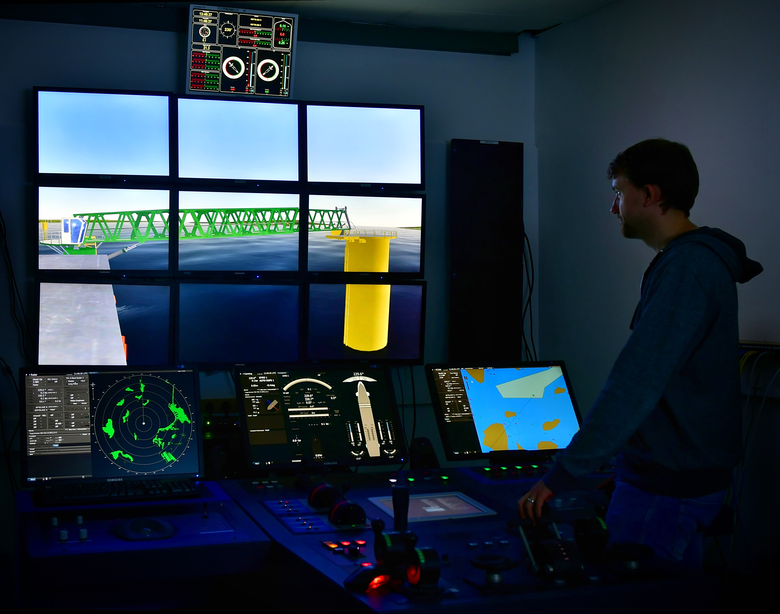
O&M Vessel – LEANWIND Manoeuvring Consoles

Slide 10
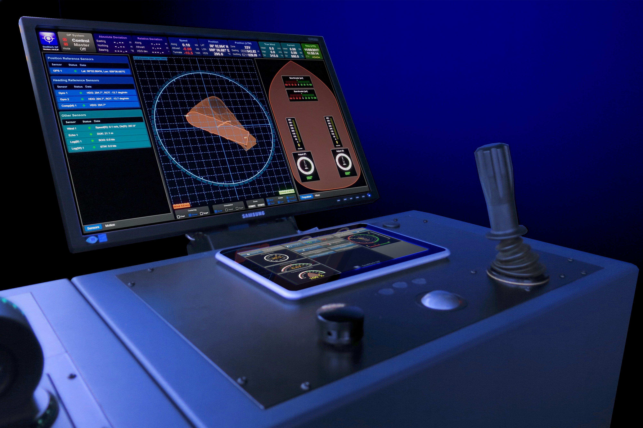
O&M Vessel – LEANWIND DP System

Slide 11
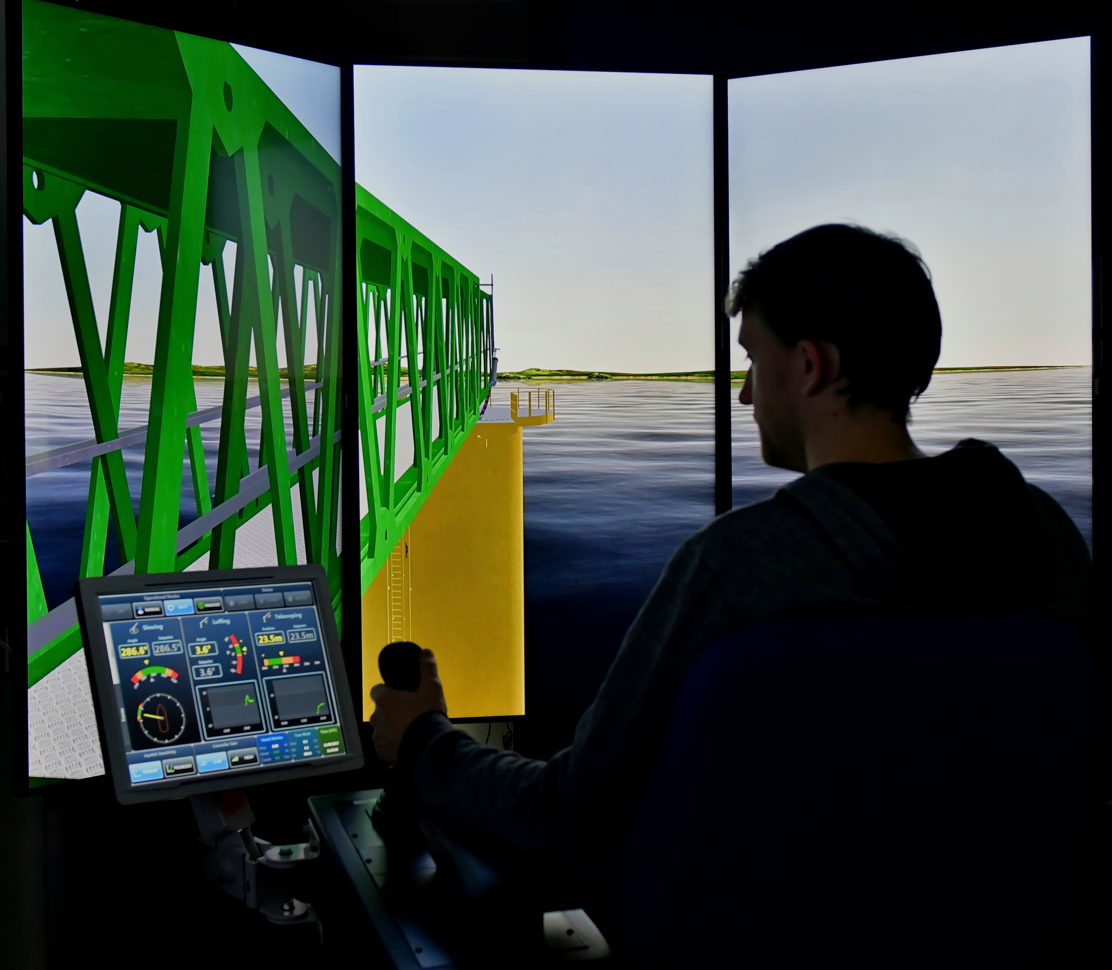
O&M Vessel – LEANWIND Gangway Operator Station

Slide 12
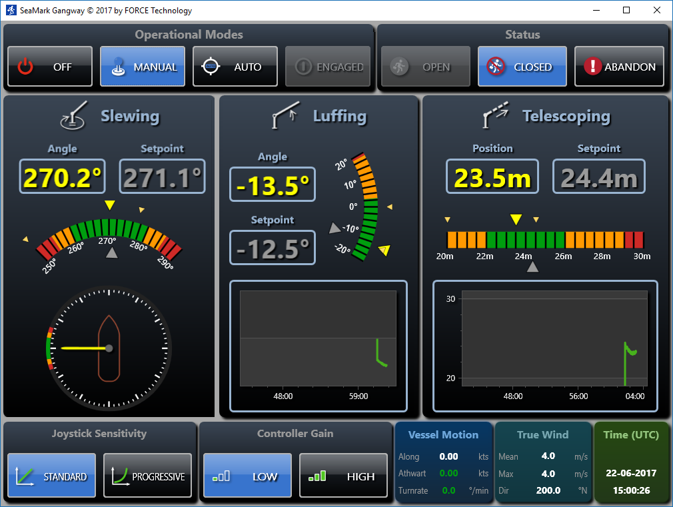
O&M Vessel – LEANWIND Gangway Control GUI

Slide 13
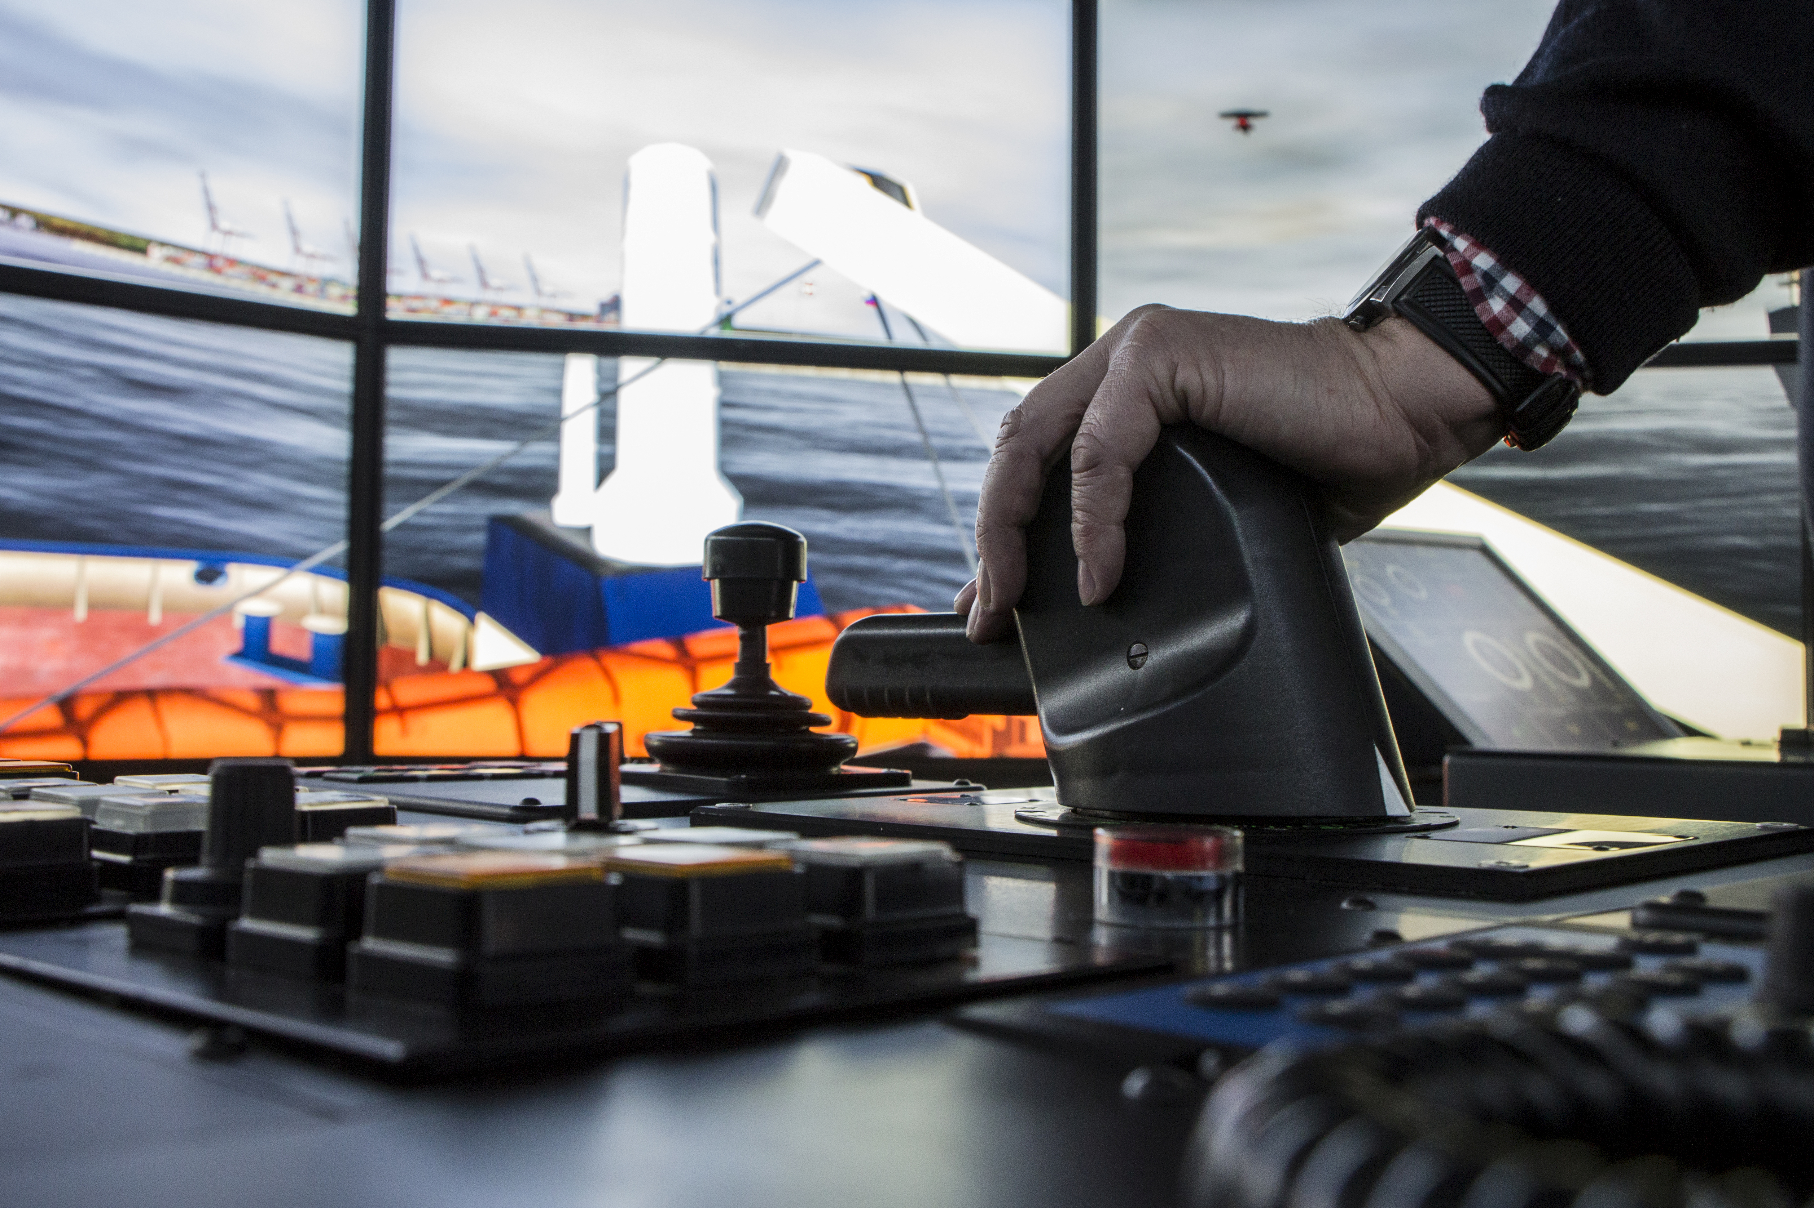
O&M Simulation Activities - Scope
Feasibility / Design Studies
Assessment of vessel suitability for mission requirements;
Assessment of manoeuvring and station keeping performance;
Optimisation of deck layout, and gangway and crane positions;
Optimisation of bridge layout including field of vision;
Assessment of required propulsion system configuration, thrust allocation strategies and required power;
Assessment of operational limits (determination of weather windows for safe operation);

Slide 14
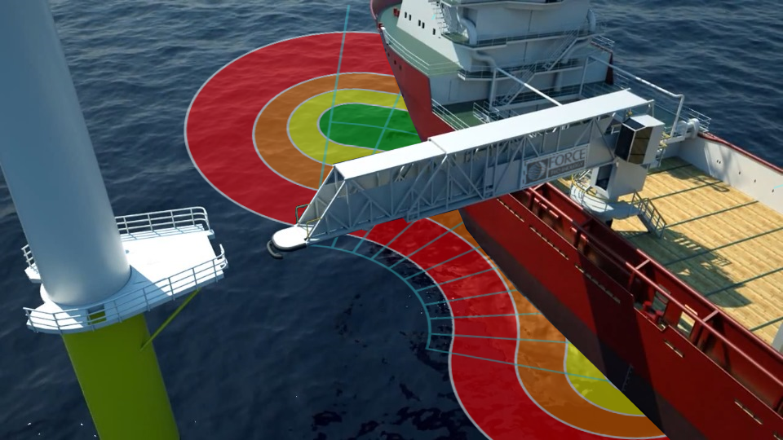
O&M Simulation Activities - Scope
Design of
Operational Procedures
Optimisation of gangway motion compensating concept (3-DOF vs. 6-DOF);
Tuning of DP system;
Tuning of gangway motion compensation control system (integrated with DP control system);
Assessment of operational limits (determination of weather windows for safe operation);
Development of combined/integrated operational procedures for DP and gangway control – incl. weather vaning strategies

Slide 15
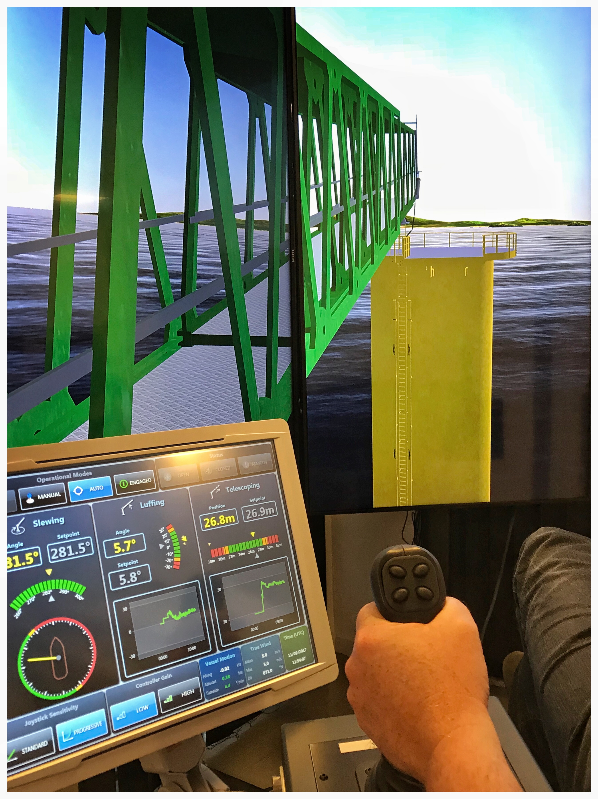
O&M Simulation Activities - Scope
Training of
Crews and operators
Training of navigators and gangway operators in operational and communication procedures;

Slide 16
Potential cost and safety benefits - Design simulations
Most valued design aspects (with respect to potential efficiency and safety benefits):
Optimisation of vessel against mission requirements;
Assessment of manoeuvring and station keeping performance;
Optimisation of deck layout, and gangway and crane positions;
Optimisation of bridge layout including field of vision;
Assessment of required propulsion system configuration, thrust allocation strategies and required power;
Assessment of operational limits (determination of weather windows for safe operation);

Slide 17
Potential cost and safety benefits - Training simulations
Most valued training aspects (with respect to efficiency and safety benefits):
Possibility to learn and train:
Handling of actual ship
Thrust allocation strategies
DP system, critical failure modes and emergency responses
Operational limits and weather windows for DP operation
Weather vaning constraints and strategies
Manual and automatic (motion compensated) control of gangway system
Operational limits and weather windows for gangway operation
Emergency and abandon procedures for gangway operation
Operational and communication procedures for the combined DP and gangway operation.

Slide 18
Thank you!
John Koch Nielsen R&D Coordinator Division for Maritime Industry FORCE Technology Hjortekærsvej 99 2800 Kgs. Lyngby Denmark Mobile: +45 20 47 83 45 e-mail: jnn@force.dk WWW.FORCETECHNOLOGY.COM

Slide 19
Questions?

