Slide 1
LEANWIND Project - Introduction
Jimmy Murphy
MaREI Centre, University College Cork
INNWIND, AVATAR and LEANWIND Final Event
30th November 2017

Slide 2
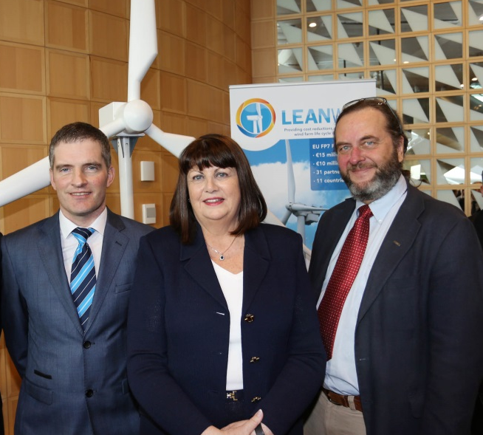
Project summary LEANWIND
Logistic Efficiencies And Naval architecture for Wind Installations with Novel Developments
UCC is coordinator
31 partner organisations
52% industry partners
Representing 11 countries;
€14.9m total funding; €10m EC funding
4 year duration
Start date: December 2013
OBJECTIVE: to provide cost reductions across the offshore wind farm lifecycle and supply chain and the development of state of the art technologies and tools.
Dr. Jimmy Murphy (UCC), Máire Geoghegan-Quinn (EU Commissioner for Research, Innovation & Science), and Ørnulf Jan Rødseth (Norwegian Marine Technology Research Institute) © Gary O'Neill

Slide 3
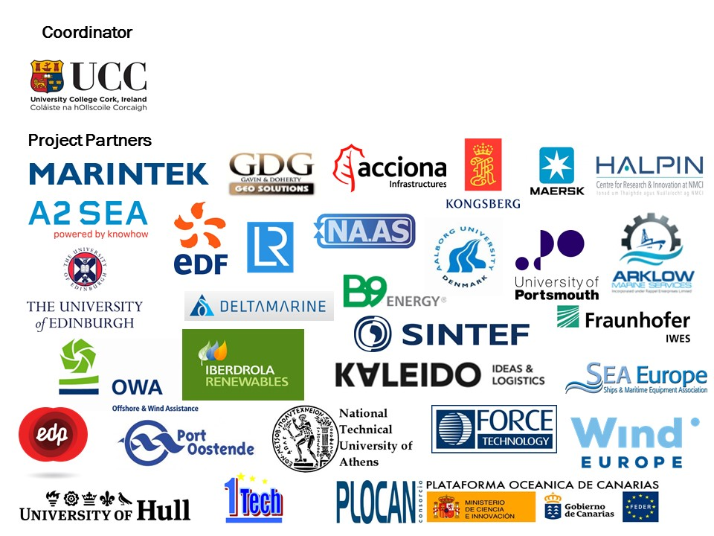
Project Summary LEANWIND Consortium
52% Industry Partners
Aims to be industry relevant and not simply an academic project

Slide 4
LEANWIND Work Structure
WP2 Construction, Deployment & Decommissioning
WP3 Novel Vessels & Equipment
WP4 Operation & Maintenance
WP5 Integrated Logistics
WP6 System Integration
WP7 Testing & validation of tools & technologies
WP8 Economic & Market Assessment

Slide 5
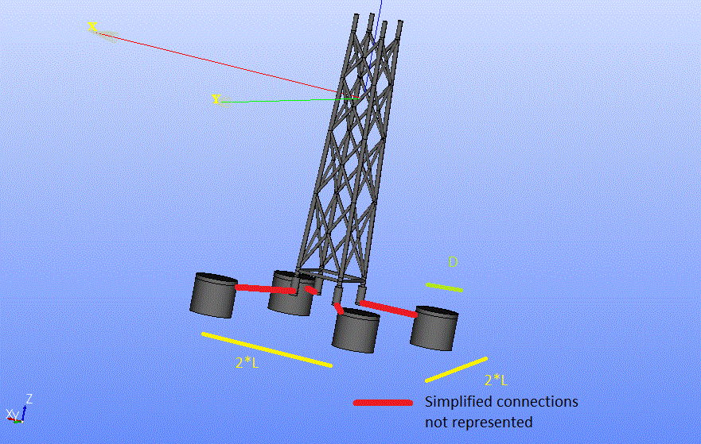
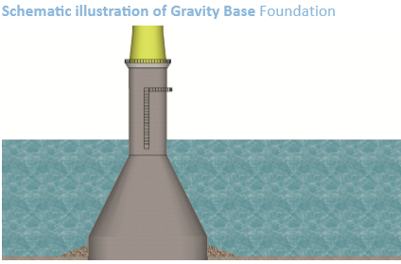
Project Summary
Courtesy of GDG

Slide 6
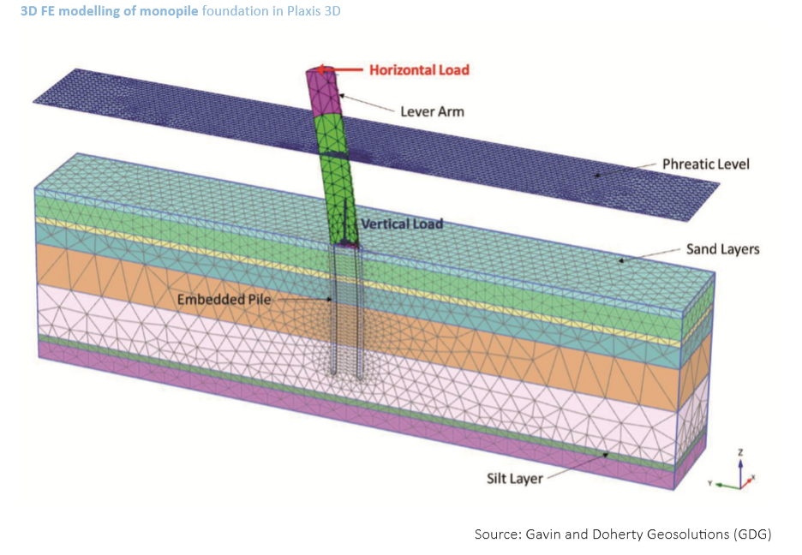
WP2 Construction, Deployment and Decommissioning
Courtesy of GDG

Slide 7
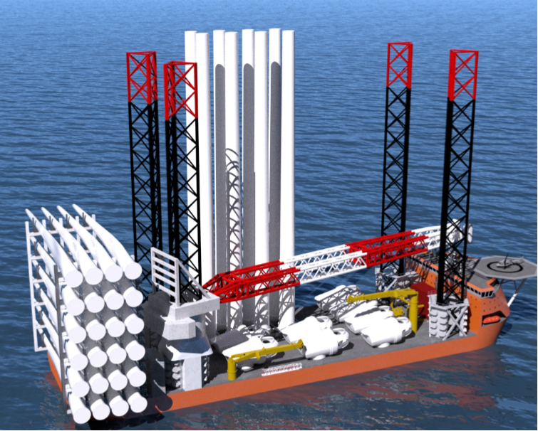
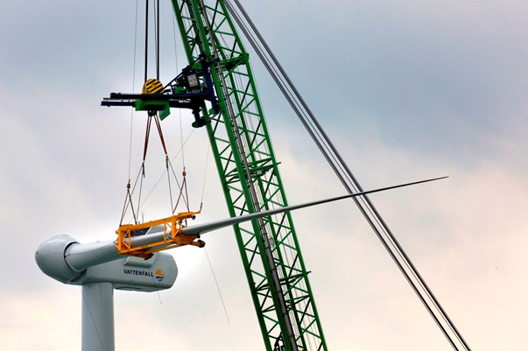
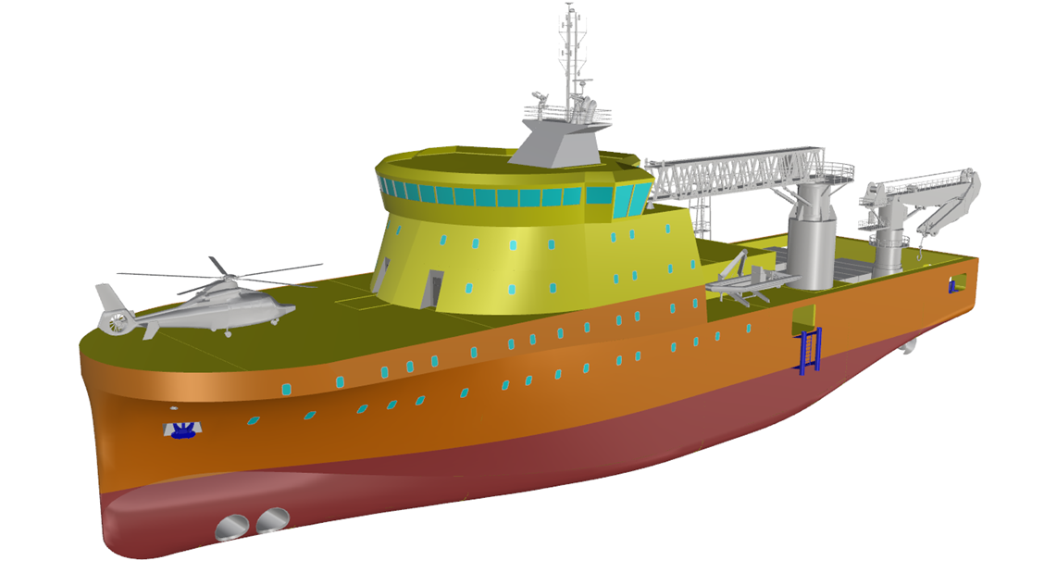
WP3 Novel Vessels & Equipment
http://www.swire.com.sg/Media/News-Archive/2014/Swire-Blue-Ocean-A-S-signs-key-contract-with-Van-O.aspx
© A2SEA A/S

Slide 8
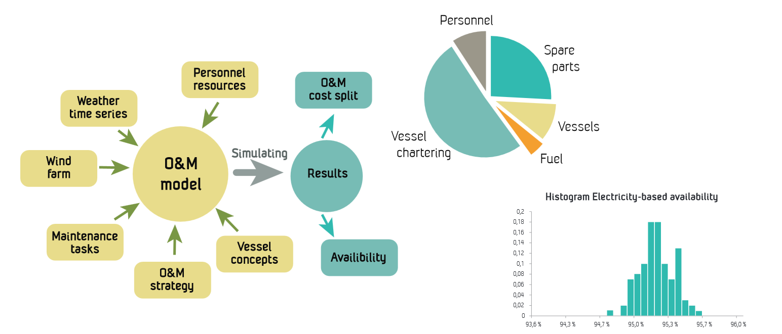
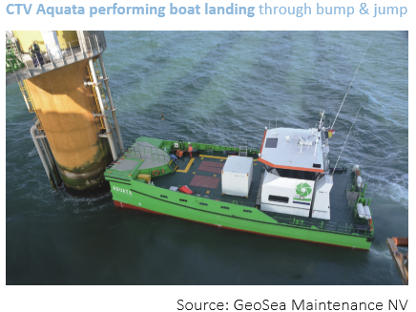
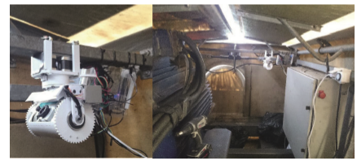
Operation and maintenance

Slide 9
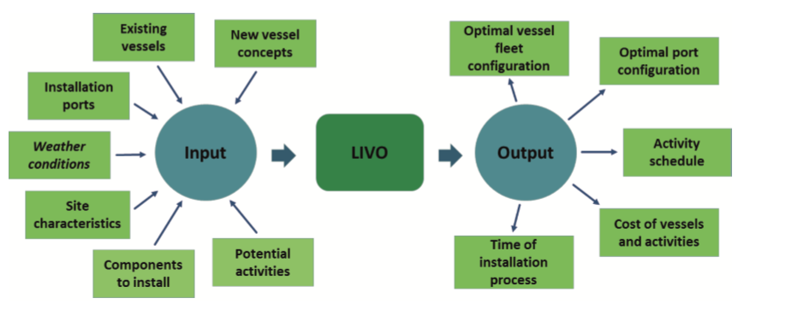
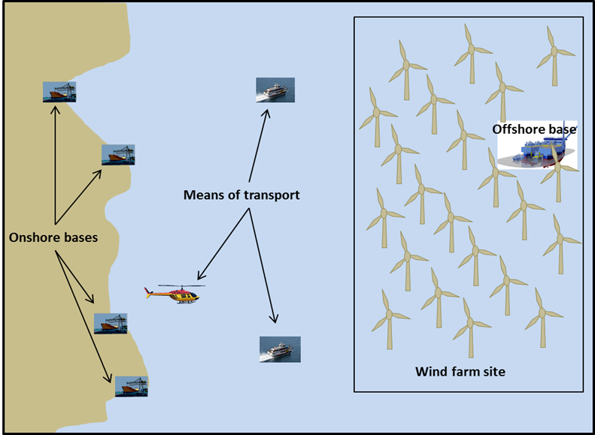
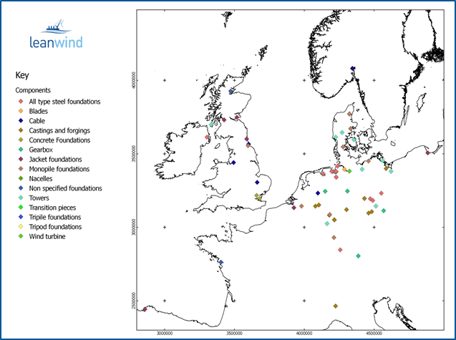
WP5 Integrated Logistics

Slide 10
WP8 Economic & market assessment
Courtesy of FORCE Technology

