Slide 1
Light weight rotor design for 10 - 20 MW wind turbines
Flemming Rasmussen
DTU Wind Energy

Slide 2
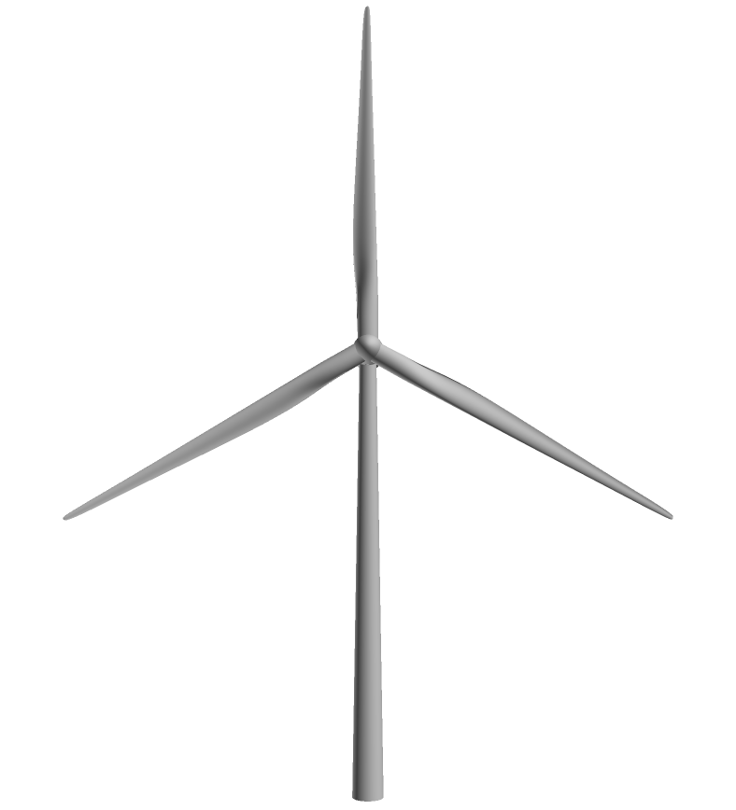
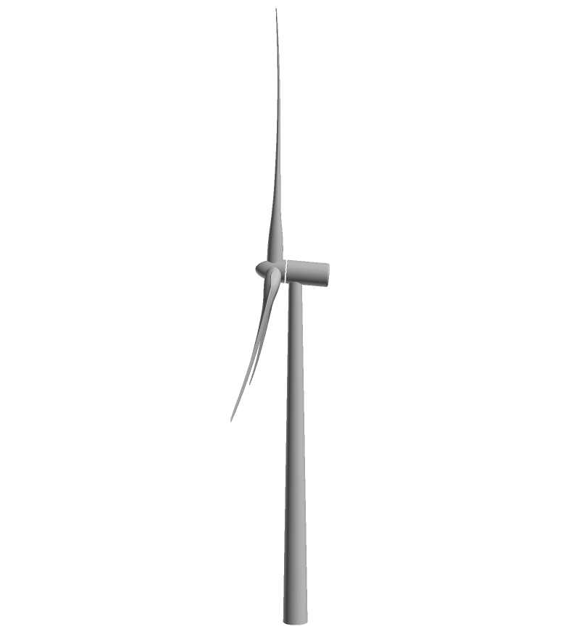
Standard three-bladed turbine, DTU 10 MW RWT
Improvements:
-Aerodynamics
-Structural design
-Aeroelastic tayloring
-Smart control
Innovations are applied to:
-reduce loads and thus
-stretch the rotor and
-increase swept area

Slide 3
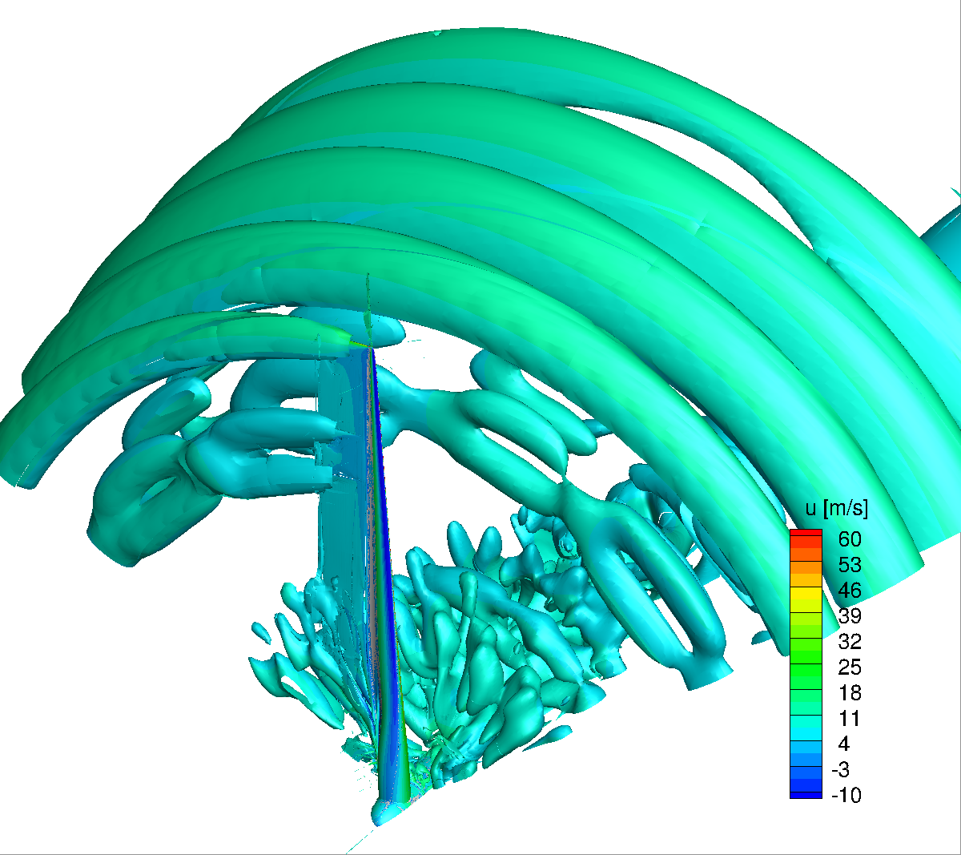
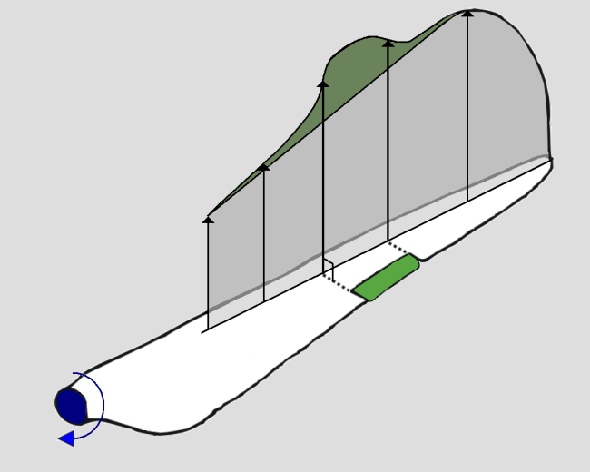
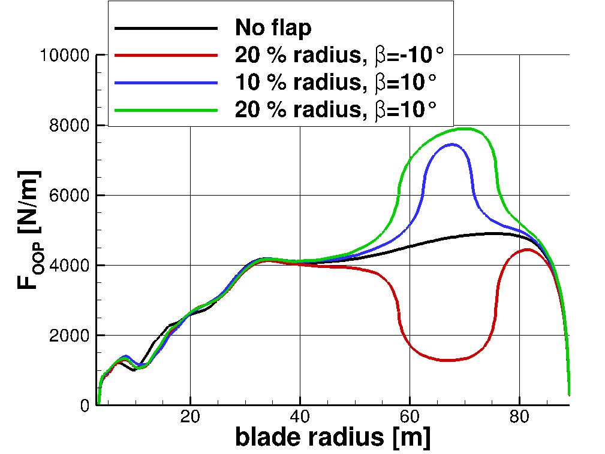
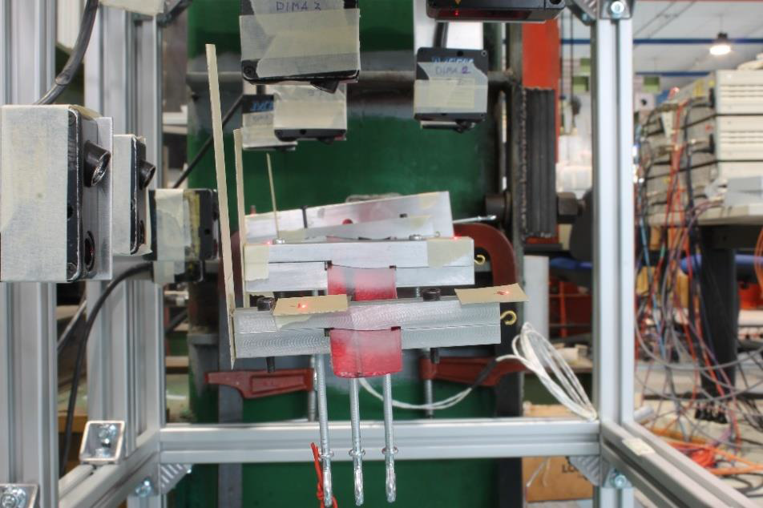
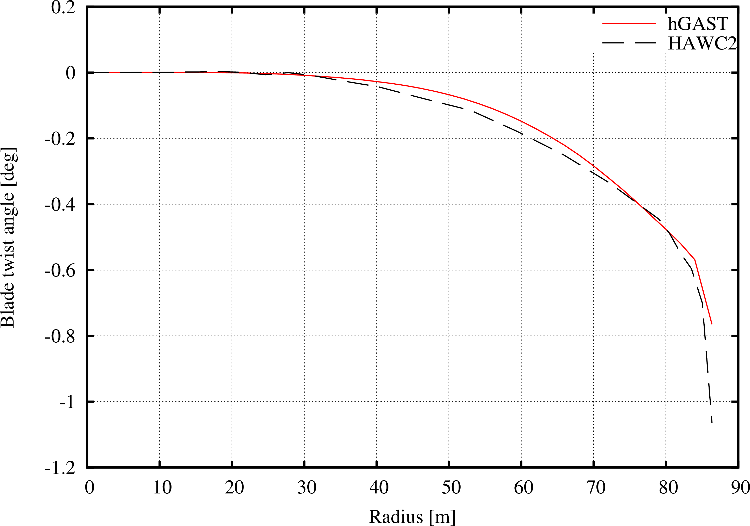
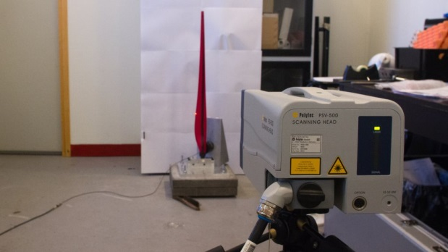
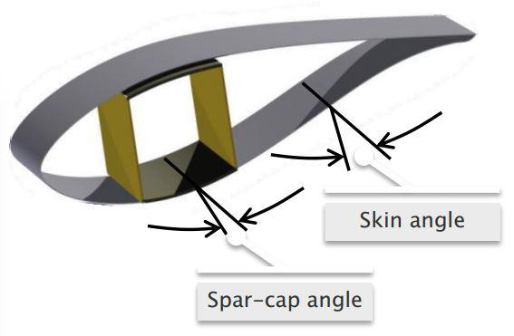
Validation of design tools used in INNWIND.eu
Reynolds no. effect
High Reynolds no. effects validated
Compressibility effects validated
Aeroelastics, geometric coupling effects
Material bend twist coupling
Aerodynamic model for active flaps
Compressibility effect
Active flaps model
Aeroelastics, geometric coupling effects
Material bend twist coupling

Slide 4
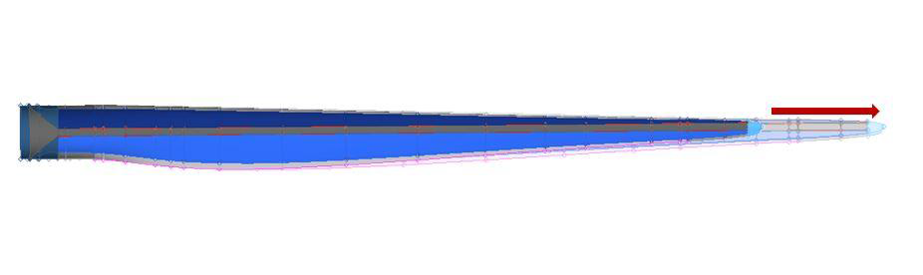
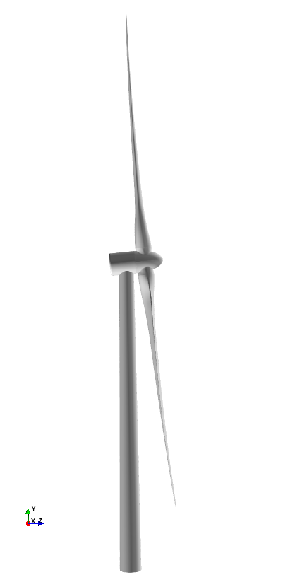
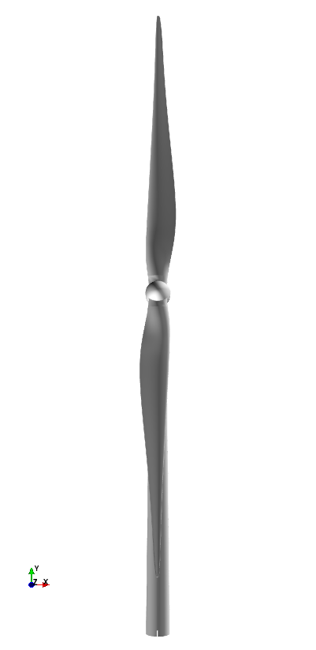
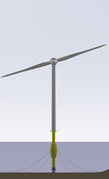
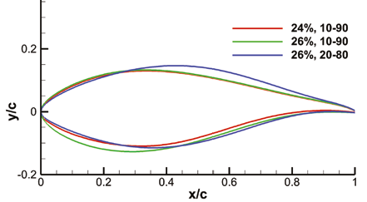
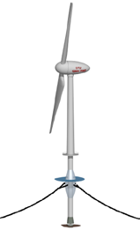
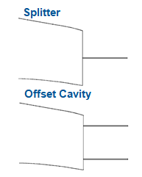
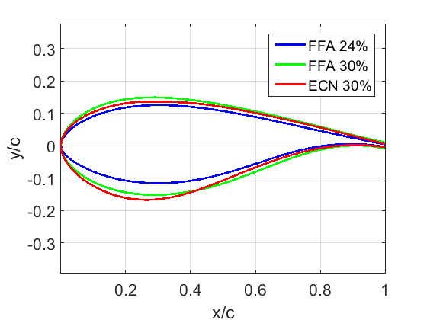
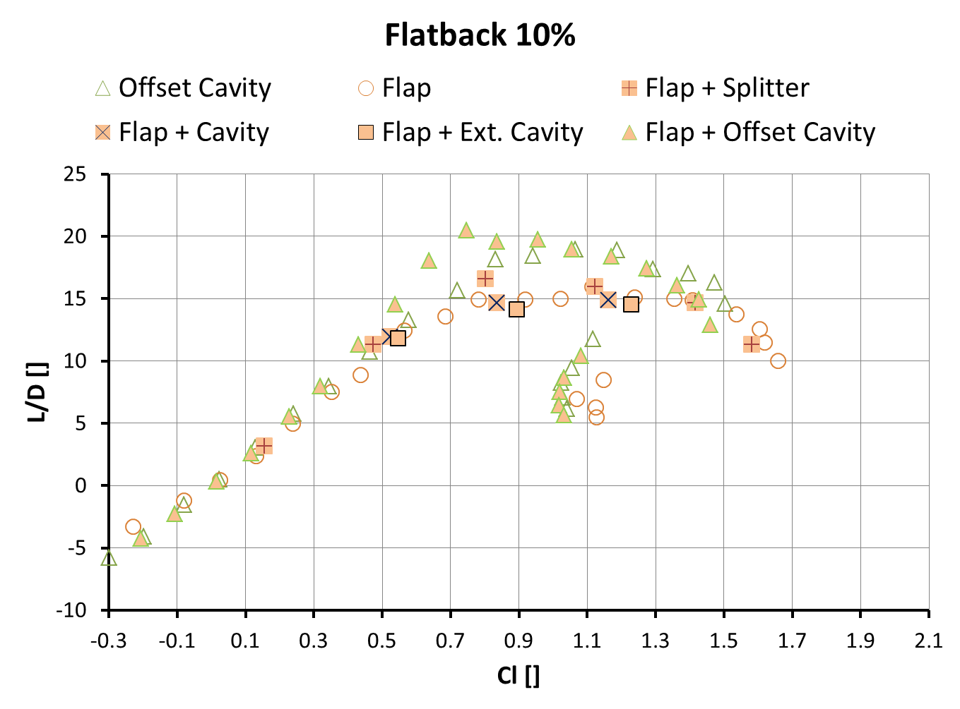
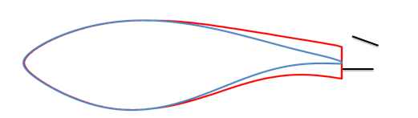
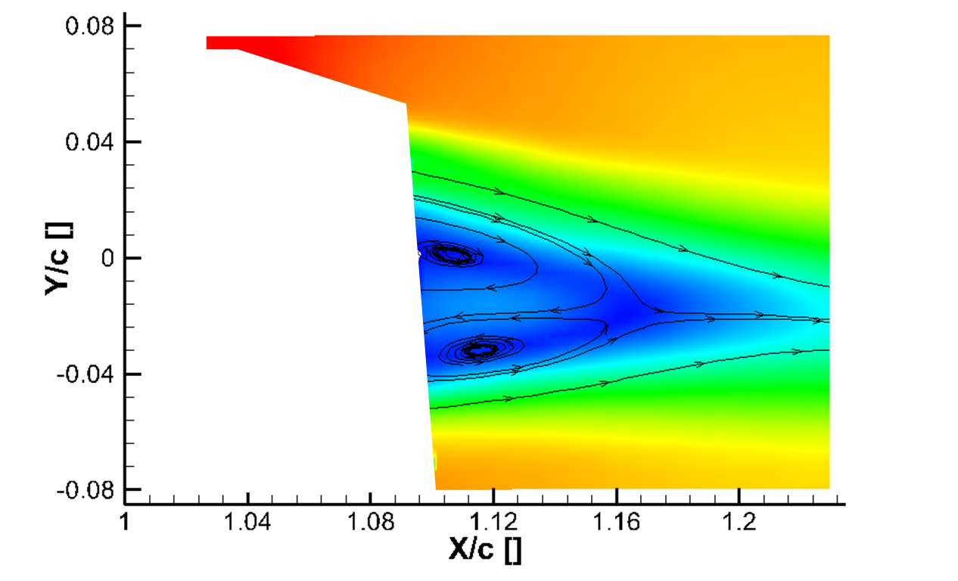
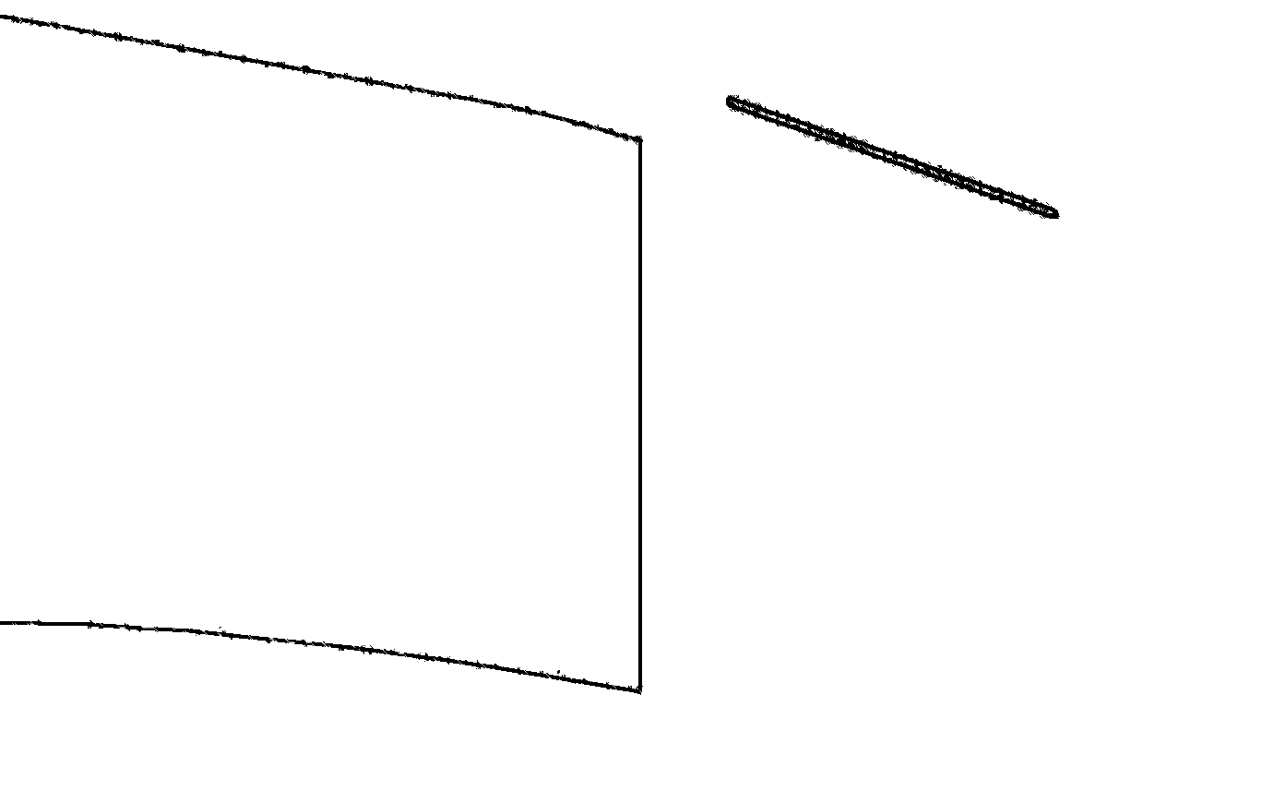
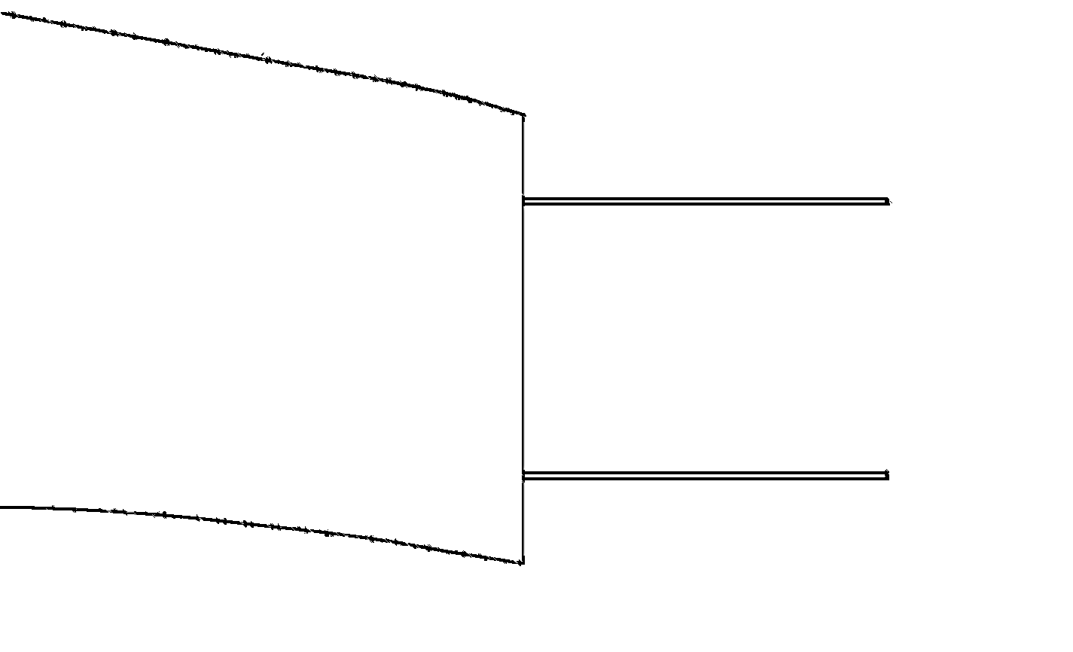
Innovative aerodynamic designs
+10% AEP
Low lift airfoil
- 30% weight
Low induction rotor
Two-bladed rotor
Thick airfoils outboard
Non conventional airfoils
Drag reduction devices
L/D 30% = L/D 24%
+ 28% L/D increase
PIV flow field
measurements

Slide 5
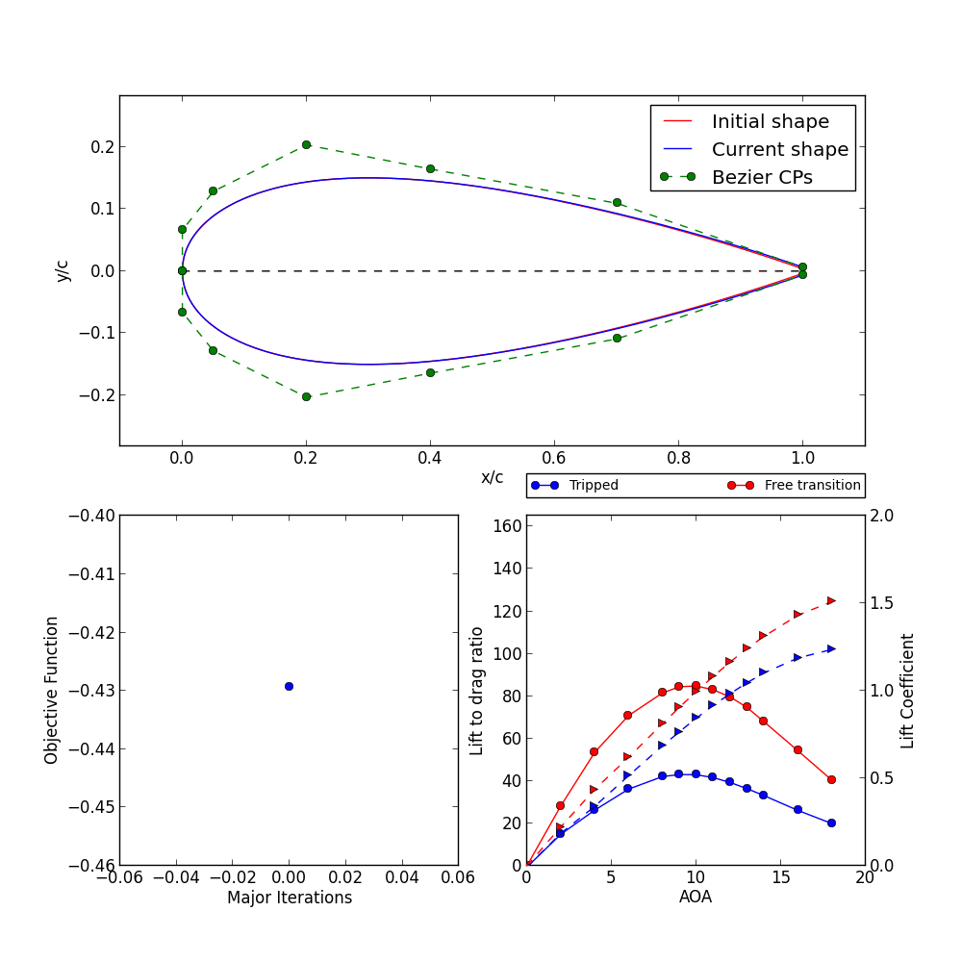
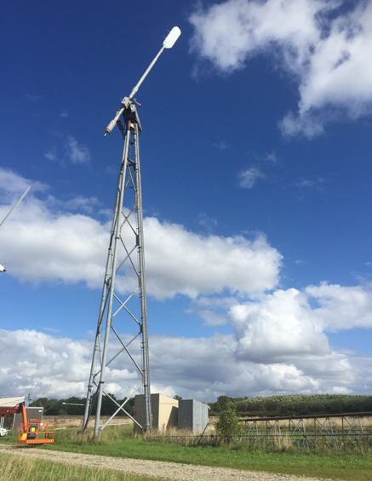
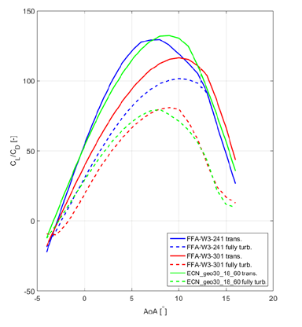
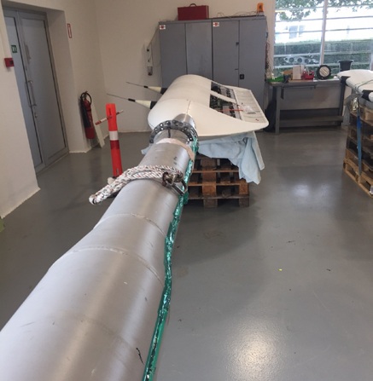
Thick Airfoil Design
- 30% thick airfoil to substitute 24% FFA
Testing

Slide 6
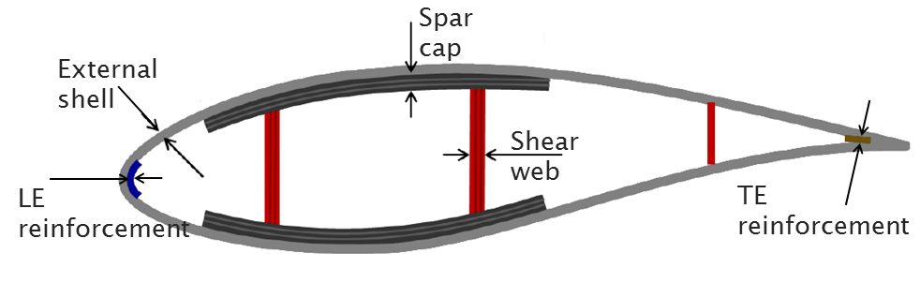
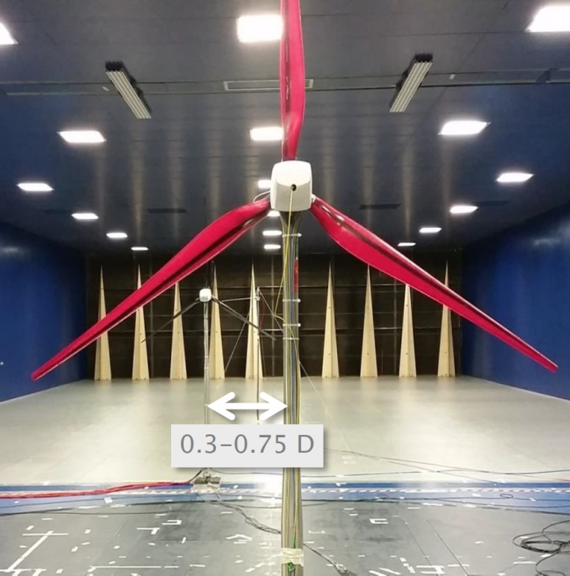
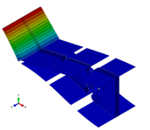
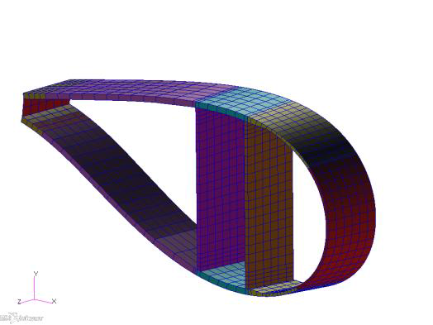
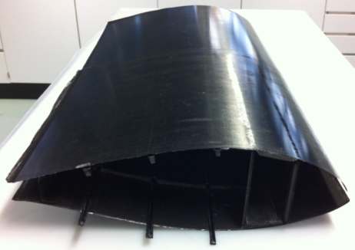
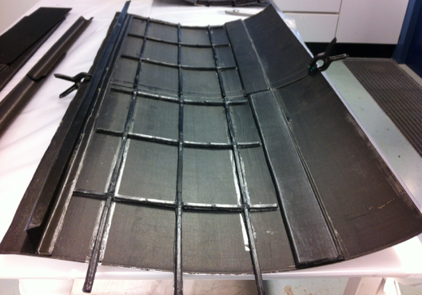
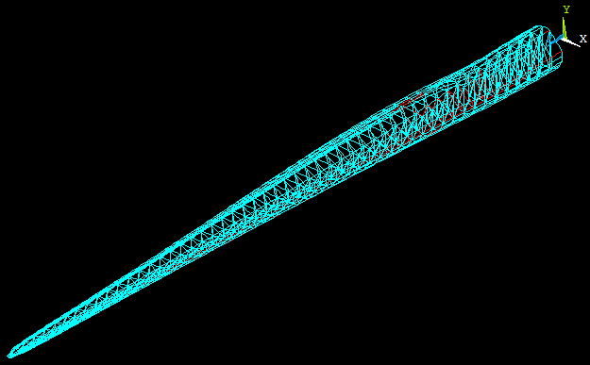
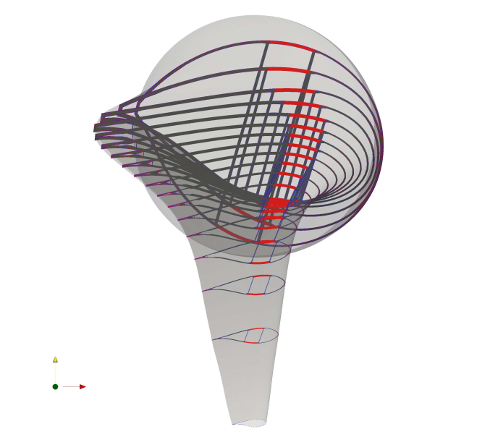
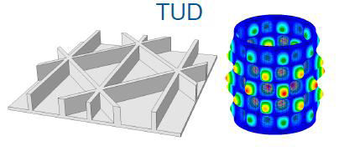
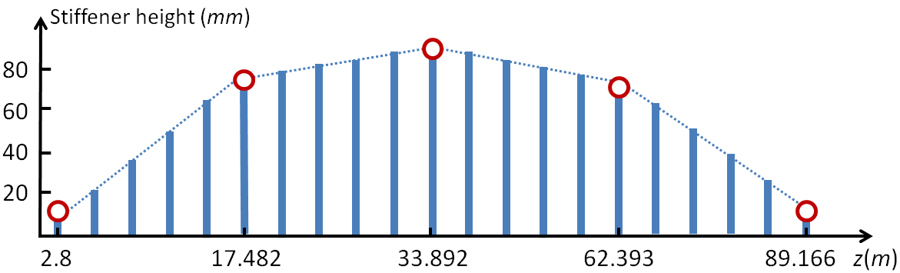
Structural design concepts
RWT 10 MW
Bend twist coupling
Flat back
(Same structure char.)
POLIMI scaled down version of the 10 MW RWT with BTC
Grid stiffened panels
(-30% panel weight)
Truss structure
(Weight reduction)
Spar cap offset
(Flap/torsion)

Slide 7
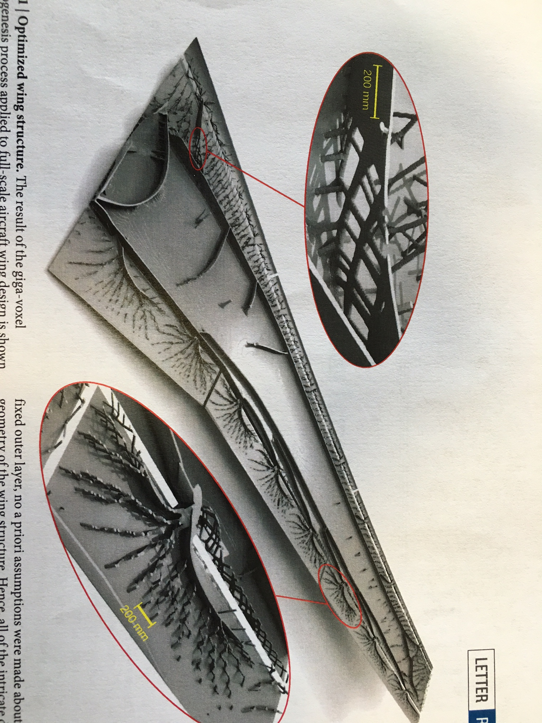

Future perspectives?:
Optimised airplane wing structure

Slide 8
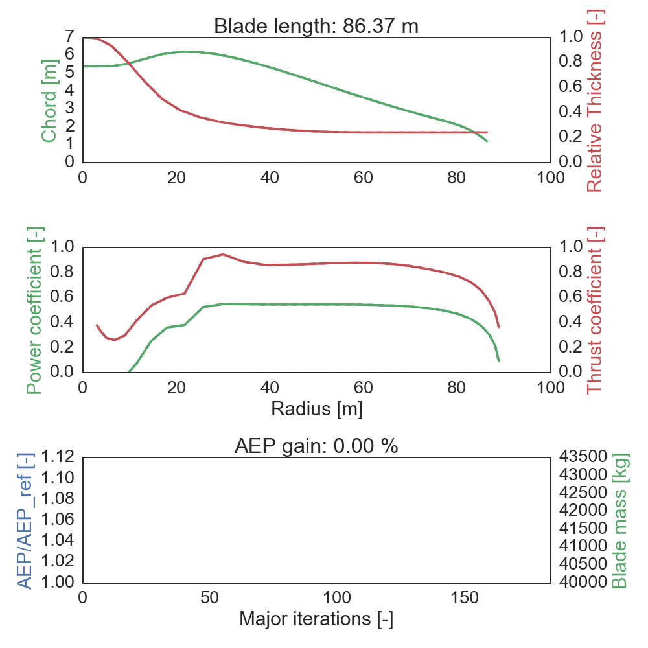
Aero-structural rotor design tool
DTU 10MW RWT
Basis for design studies of next generation MW-turbines
Aerostructural Optimization of a 10MW rotor

Slide 9
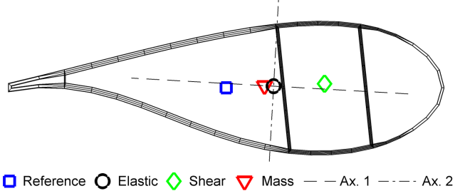
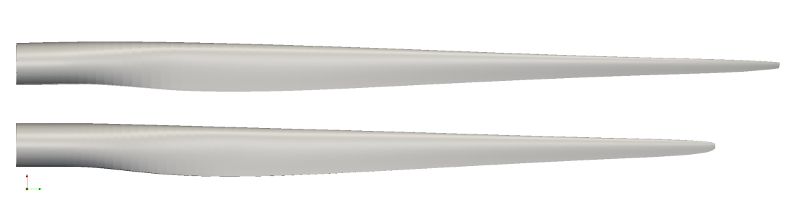
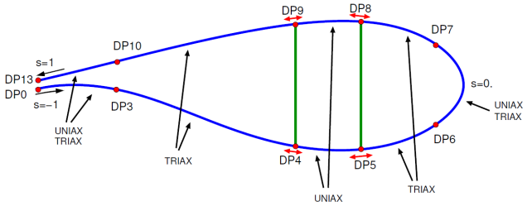
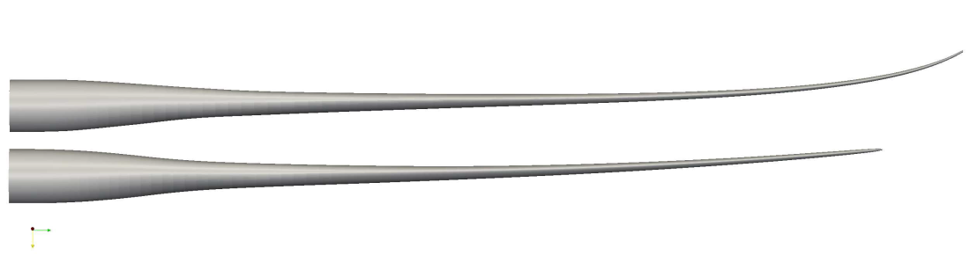
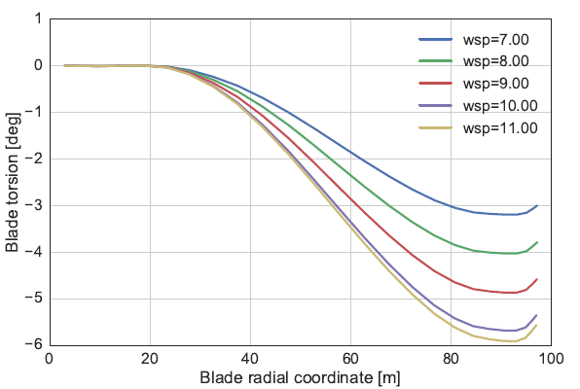
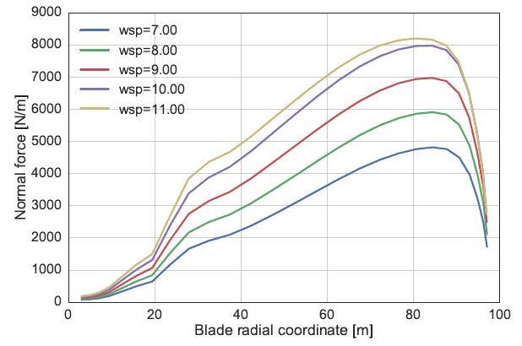
Stretched 10MW RWT
Aeroelastically Tailored 10 MW blade
Blade length increase: 9%
AEP increase: 8.7%
Flapwise fatigue reduction: 6%
Blade torsion at 11 m/s: 6 deg.
Extreme and lifetime equivalent loads within 5%
“Design of an Aeroelastically Tailored 10 MW Wind Turbine Rotor” Frederik Zahle et all

Slide 10
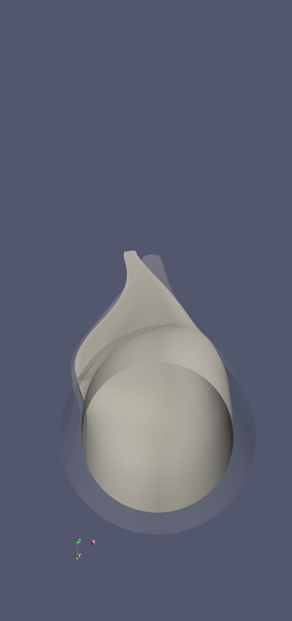
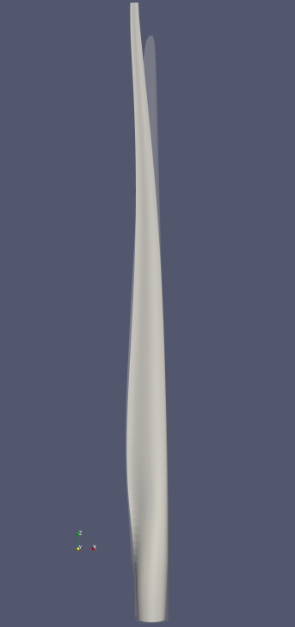
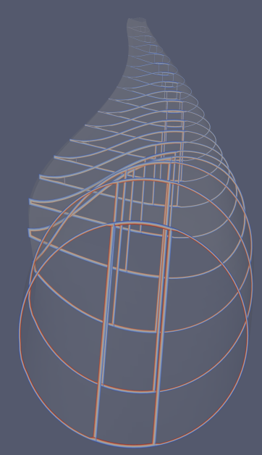
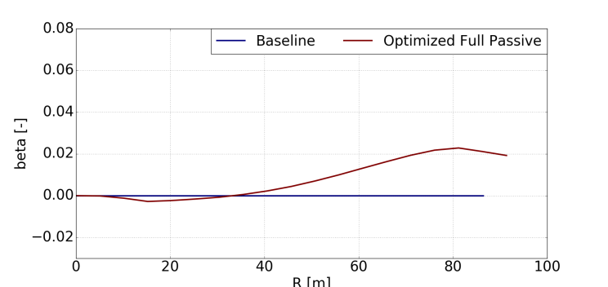
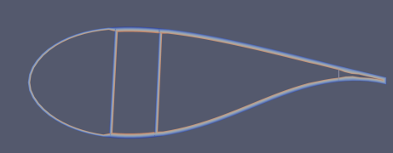
Preliminary Aeroelastic MDO of a Passive-Controlled Stretched Blade (Ref. Christian Pavese)
Sweep, spar caps offset, orientation of the fibres in the spar caps, blade radius are the relevant variables
~60 design variables and ~750 constraints
1st Passive Control Strategy
SWEEP
2nd Passive Control Strategy
CAPS OFFSET
3rd Passive Control Strategy
Material BTC
BTC Parameter

Slide 11
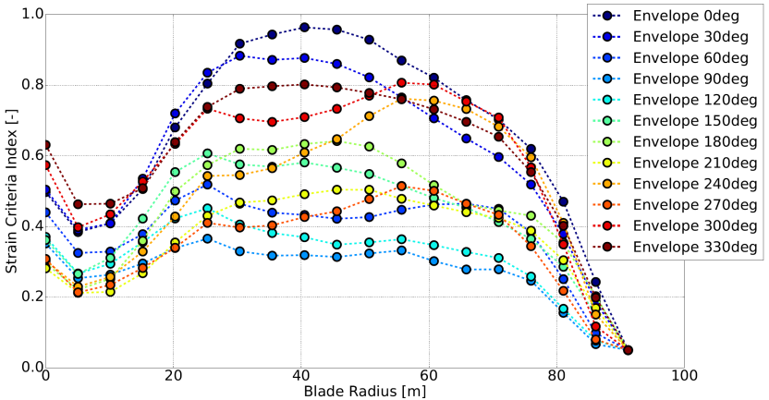

Preliminary Aeroelastic MDO of a Passive-Controlled Stretched Blade (Ref. Christian Pavese)
 | DTU 10MW RWT | PCSB
AEP [GWh] | 48.54 | +6.0%
Blade Radius [m] | 86.37 | +5.8%
Blade Mass [kg] | 41722 | +0.8%
Tower Clearance [m] | 3.656 | +36.2%
Failure
LTEFL
AEP is greatly increased within the tower clearance constraints
The torsional stiffness is particularly decreased
The combination of passive control methods regulate the tower loads, but fatigue constraints and frequency placement must be added to have a better control on the results
A fatigue constraint on blade root edgewise fatigue load must be added to improve the MDO

Slide 12




Investigations regarding direction of vibration
- and pitch (torsion) coupling
Flap-torsion coupling
Flap-edge
Rasmussen, F., Petersen, J., Madsen, H.A., ’Dynamic Stall and Aerodynamic Damping’,
J. Solar Energy Engineering 121, 150-155, 1999

Slide 13





Rotating Test Rig
Measured flap response
Change of Cl
UBristol flap concept
ECN 30%
Add Presentation Title in Footer via ”Insert”; ”Header & Footer”

Slide 14



Wind tunnel: active turbulence grid
Wind tunnel experiments using an advanced data-driven feedback controller that mitigates the loads. Turbulence intensity 3%
Active turbulence grid and two-bladed rotor with individual pitch control and free floating flaps

Slide 15
Passive and active load control
Up scaled 20MW turbine
Blade fatigue loads

Slide 16



Optimal aeroelastic rotor design with active flaps
Blade Chord
• Flap only deflected in below rated conditions
• Flap operates in a quasi-steady mode
Flap Deflection
Shear Center

