Slide 1
Wind observers and Advanced Controls for Innovative Turbines
Anand Natarajan
DTU Wind Energy

Slide 2
Introduction
Measurement of Wind Turbulence : Spinner anemometer, Spinner Lidar
Example of use of spinner anemometers in power curtailment under high turbulence
Spinner Lidar measurement potential
Distributed flap based loads control
Example of an innovative 2 Bladed rotor on a semi-floater structure
LCOE reduction potential

Slide 3
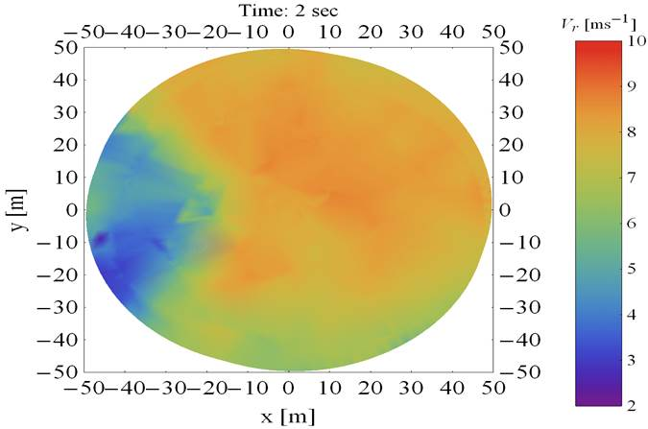
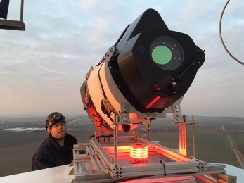
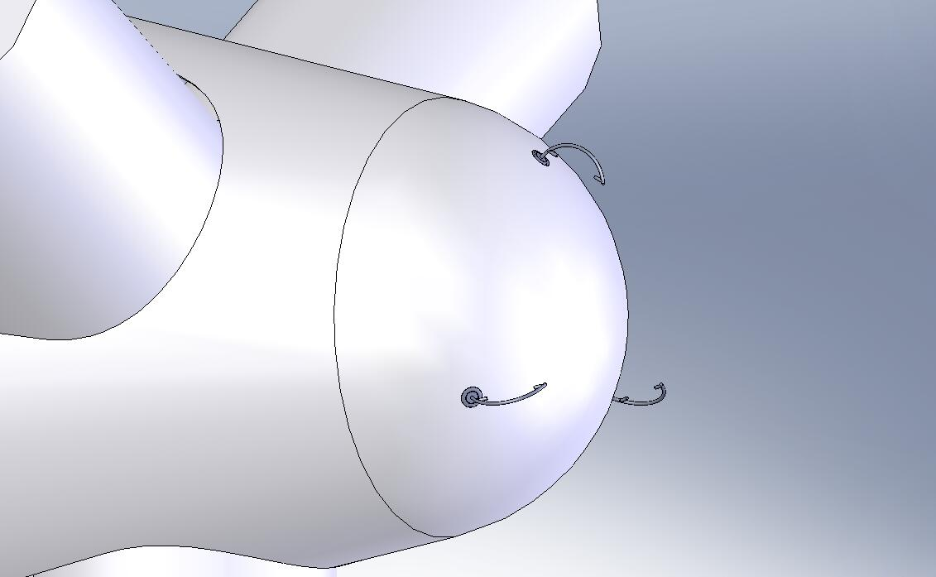
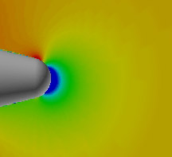
Wind Obervers - Spinner Lidars and Spinner Anemometers

Slide 4
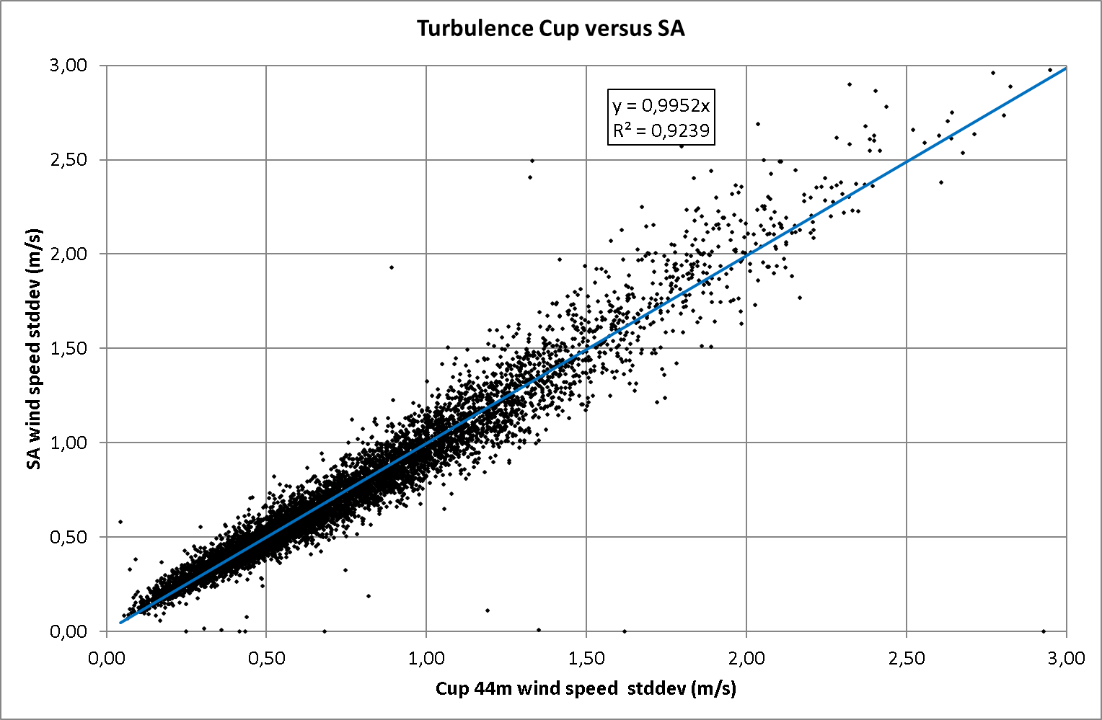

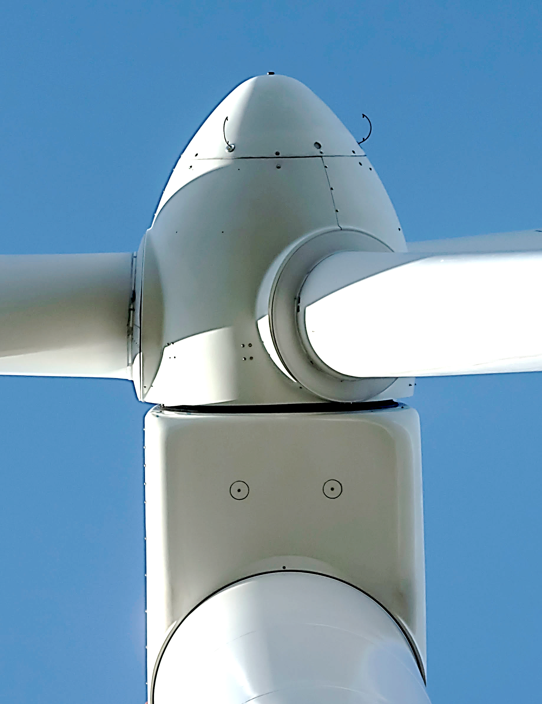
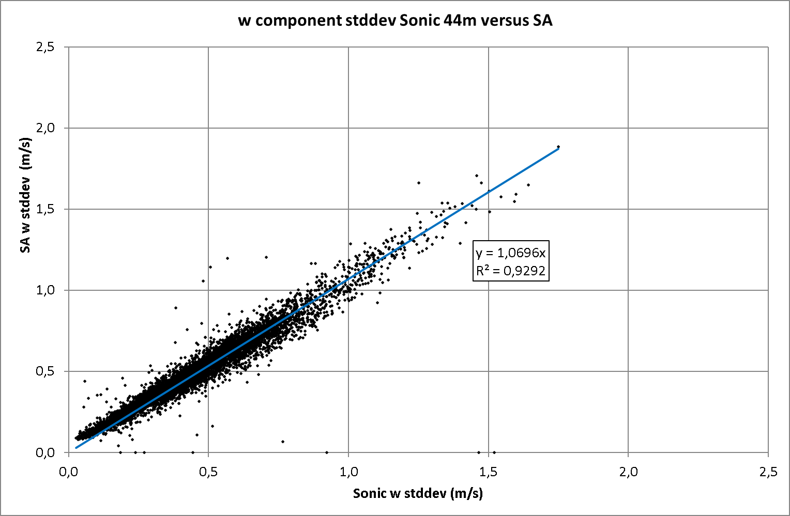
Spinner Anemometry for Wind Turbine Control
A spinner anemometer is sensing the wind at the nose of a wind turbine. It consists of a spinner nose and sonic sensors, each with a built-in accelerometer, and a converter box
Wind
A spinner anemometer measures instantaneous horizontal wind speed, yaw misalignment, inflow angle, rotor position and air temperature

Slide 5
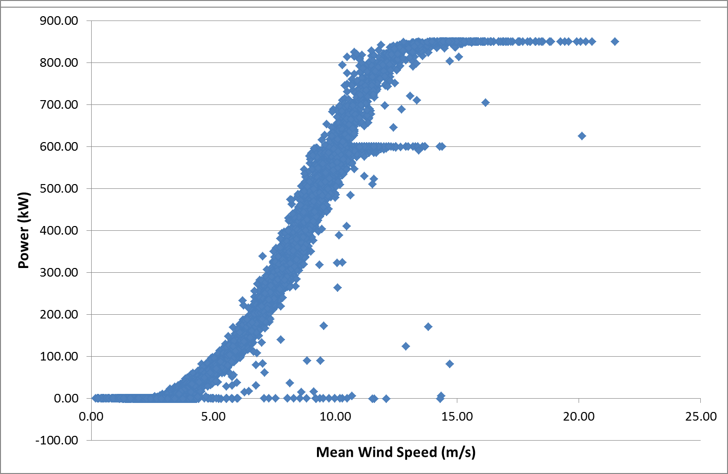
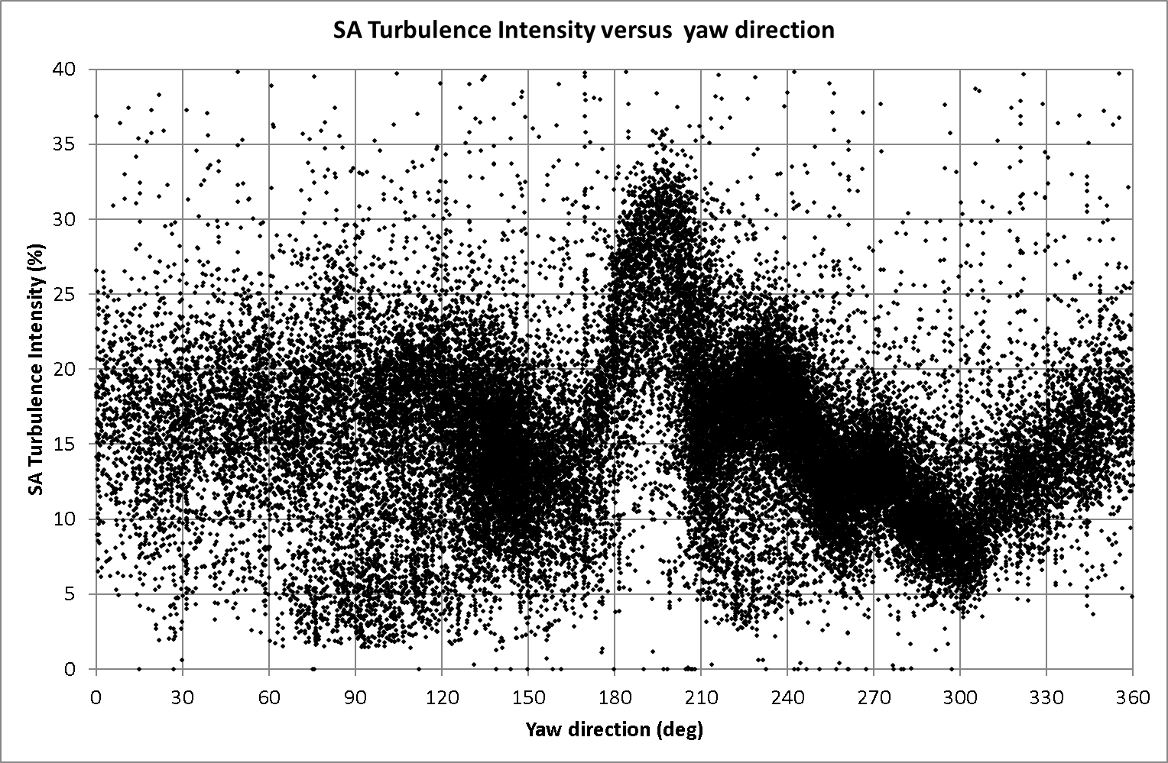
Curtailment of the Turbine during High Turbulence
Objective: Use measured turbulence to curtail the turbine operation on occasions of high turbulence
Turbulence measurements from spinner anemometer.
Quantify loss in energy production during curtailment versus savings in blade root and tower base fatigue loads
Novel potential for extending life of structural components based on turbine measured turbulence.

Slide 6
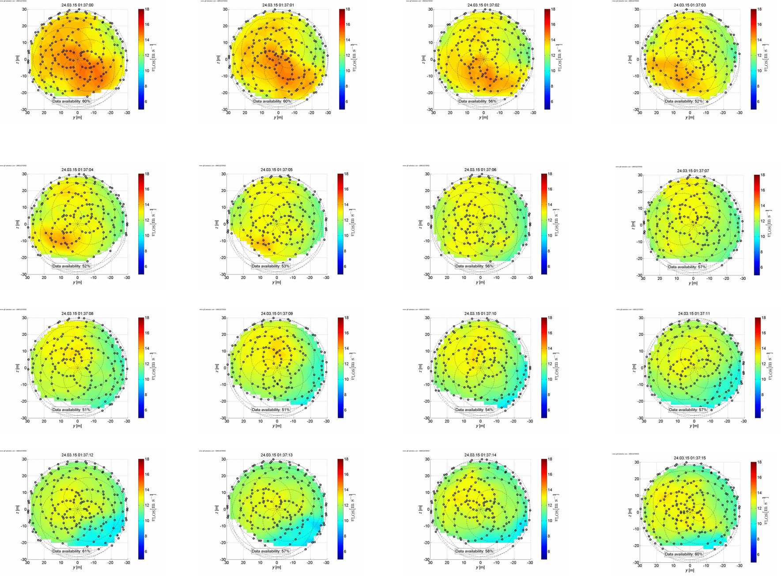
Spinner Lidar: ”400 Pixel Wind Camera”
2D rotor plane v_{LOS} wind fields @ 400 measurement points per second .
1s consecutive measurements of full rotor plane line-of Sight scans of the wind field at 2D distance upwind

Slide 7
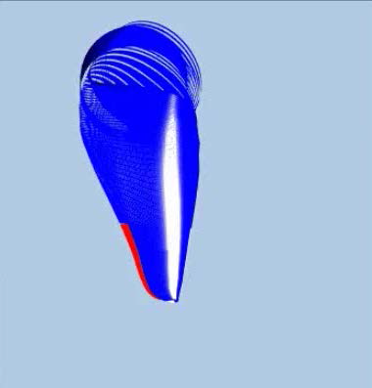
Individual Blade Flap Control (IFC)
The flap covers the outer 30% of the blade from 59m to 85m for a 10 MW wind turbine blade.
The controller is an individual flap controller for every blade with a PD feedback on the blade root flapwise bending moment
Baseline load evaluation on the 2-bladed rotor on the semi-floater for flap controller design

Slide 8
IFC on 2-Bladed Rotor on Semi Floater
  2 Bladed 10 MW Rotor
  Cannot be mounted on a fixed support structure due to significant 2P, 4P excitations
  At 50m water depths, can be mounted on an articulated substructure.
  Jointed to the sea floor and buoyancy supported with guyed cables.
  Minimize fatigue on the support structure and mooring lines – Individual Flap Control
  Maximize energy capture – Increase Rotor Radius

Slide 9
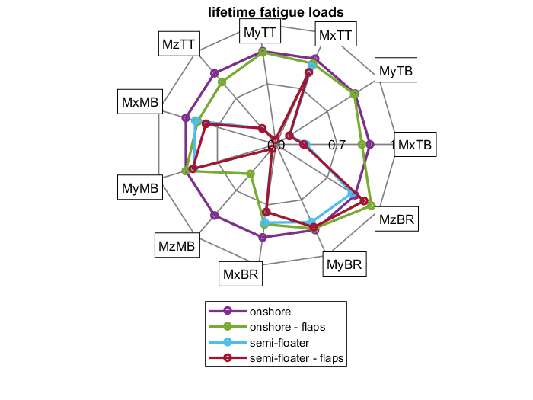
Fatigue reduction using the semi-floater and advanced controls
Comparison of operational fatigue damage equivalent loads

Slide 10
Lower LCOE for the 2-Bladed 10 MW on Semi Floater
 |  | Fatigue Load reduction
List of Components | Driving load sensor |  | 10 MW RWT IFC | 10 MW ++Rotor
Tower | MxTB |  | -6% | -10%
Floater | MxFT |  | -10% | -17%
Mooring line | FxML |  | -3% | -26%
Case: | LCOE (Eur/MWh)
10 MW RWT | 100.96
10 MW RWT IFC | 100.36 (-0.5%)
10 MW ++Rotor | 96.55 (-4.3%)
Loads
 |  | Cost reduction
List of Components | Driving load sensor |  | 10 MW RWT IFC | 10 MW ++Rotor
Tower | MxTB |  | -4% | -7%
Floater | MxFT |  | -7% | -11%
Mooring line | FxML |  | -3% | -26%
LCOE
Cost
 | 10 MW RWT [€] | 10 MW RWT IFC [€] | 10 MW ++Rotor [€]
Tower | 2.071E+06 | 1.991E+06 | 1.925E+06
Floating cylinder | 1.204E+06 | 1.119E+06 | 1.066E+06
Ballast | 6.972E+03 | 6.972E+03 | 6.972E+03
Buoyant chamber | 2.482E+05 | 2.482E+05 | 2.482E+05
Mooring lines | 7.675E+05 | 7.408E+05 | 5.701E+05
Anchors connector | 7.500E+05 | 7.500E+05 | 7.500E+05
Joint shell | 1.600E+02 | 1.600E+02 | 1.600E+02
Laminated rubber | 7.690E+05 | 7.690E+05 | 7.690E+05
RC Base | 1.313E+05 | 1.313E+05 | 1.313E+05
AEP
AEP: +3.4%

Slide 11
Summary
Wind Turbines need not be blind to wind turbulence.
Demonstration of wind measurement capabilities of Spinner Anemometer and Spinner Lidar made.
Can be input to both feed-forward control and supervisory control (curtailment under high turbulence)
Large turbines benefit from distributed blade controls such as flaps
Can stretch the rotor maintaining same loads using a combination of new airfoils and advanced controls.
Overall savings with stretched rotor can reduce LCOE by about 4%.

