Slide 1
LCOE reduction for the 20 MW wind turbine
P.K. Chaviaropoulos (NTUA)
INNWIND.EU, AVATAR and LEANWIND Final Event
30th November 2017, Amsterdam

Slide 2
Contents
Cost model for LCOE reduction of the 10-20 MW turbine
LCOE reduction for the 10-20 MW turbine elements
Overall LCOE reduction

Slide 3
We can further reduce the cost of offshore wind electricity through innovative designs aiming at :
Increasing wind farm energy yield
Reducing wind farm CAPEX
Reducing wind farm OPEX
A suitable Cost Model is needed for estimating the LCOE reduction potential

Slide 4
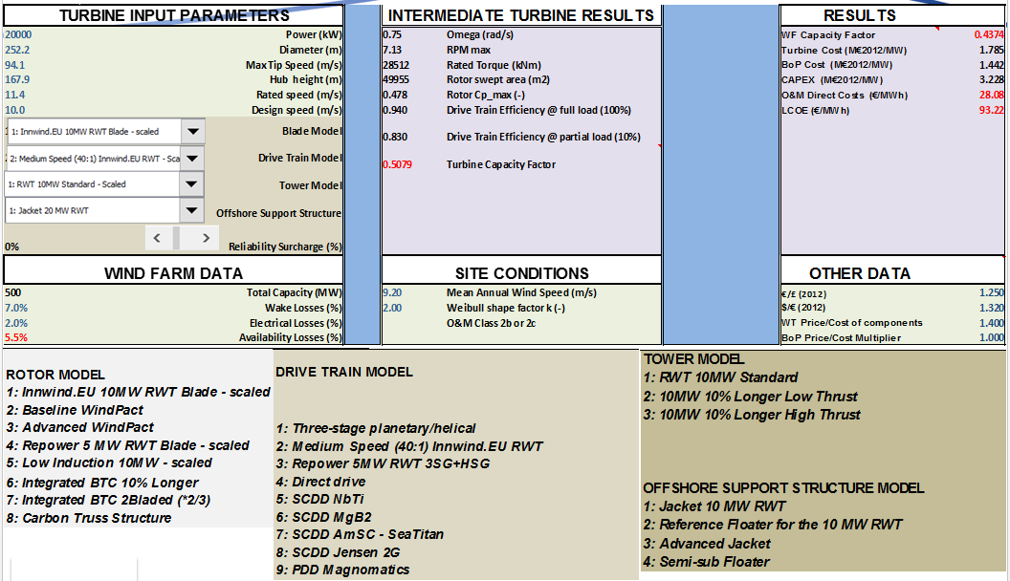
INNWIND.EU Cost Model

Slide 5
PIs and LCOE Reduction Potential

Slide 6
PIs and LCOE Reduction Potential

Slide 7
Conclusions
CONCEPT
ROTOR
Low Induction Rotor | The new hybrid blade is lighter (16%) than the full-glass classically up-scaled 20MW RWT blade but more expensive (7.3%), due to its longer span and the use of expensive carbon. The overall increase in turbine CAPEX is only 3.4% because in offshore wind the blades represent a small fraction of the turbine and support structure cost. The turbine yield increases by 7.5%, 4.5% coming from the LIR planform and another 3% from the dedicated low lift profiles. the wind farm capacity factor increases by 9.7% due to the lower wake losses of LIR rotors. Overall, LIR promises a 3.9% reduction of LCOE compared to the 20MW RWT.
Bend-twist Coupled Rotor | No real improvement in the cost of energy is expected maintaining the reference rotor diameter. Such designs may reduce primary the fatigue and secondary the ultimate loading of the blade itself but, also, of the support structure having an indirect effect on CAPEX reduction. The BTC blade is highly loaded and 8.5% lighter and cheaper than the RWT blade. The overall CAPEX and LCOE improvement is small (1%) leading to an LCOE reduction of 0.6%. Due to the assumptions made we can consider that BTC improvements can be superimposed to LIR summing up their individual impacts to all PIs. Alternatively, the BTC concept could be used to increase the diameter of a Cpmax rotor maintaining the loads to their reference level. Overall LIR+BTC or BLT alone can offer an LCOE reduction of 4 to 5%.

Slide 8
Conclusions
CONCEPT
DRIVE TRAIN
PMDD Generator | The PDD generator with highly efficient power electronics promises a good LCOE performance (2 % lower than the reference) combined with a significant nacelle/drive train cost reduction of 7%. The nacelle mass is slightly increased by 4% while the capacity factor increases by 1.1 % which, along with the reduced CAPEX, is the reason of LCOE improvement. The improved capacity factor comes as a combination of the highly efficient 20MW PDD generator (98.5% at full load) and the highly efficient power electronics.
OFFSHORE SUPPORT STRUCTURE
Advanced Jacket | An advanced design/manufacturing of the 20MW RWT jacket is expected to reduce the original cost of ~14 M€ by 20%. Such a reduction would decrease the overall CAPEX by 4.3% translated to 2.9% reduction of the LCOE.
CONTROL
Advanced Control | An LCOE drop of 4% can be expected due to the mitigation of design loads of the turbine and its support structure offered by advanced control. In the present context advanced control was mainly targeted in reducing blade than support structure loads. Such a reduction can be used for increasing the rotor diameter and improve LCOE through better energy capturing. Alternatively, one can target on the reduction of the support structure fatigue loads which are the design drivers of the jacket. Since the offshore turbine support structure has a significant contribution to CAPEX, the reduction of the jacket fatigue loads through advanced control can also lead to an LCOE reduction without increasing rotor diameter.

Slide 9
Conclusions
Bottom mounted designs at INNWIND.EU 20MW RWT expectations for LCOE reduction:
• Low induction rotors with conventional inner structure 4.0%
• Aeroelastically tailored rotors (adding on LIR) 0.5%
• Drive train (reduced CAPEX, increased efficiency) 2.0%
• Advanced Jacket 3.0%
• Advanced control 4.0%
Expected Overall LCOE reduction ~14%
Starting from the EWII LCOE value of 106.93 €/MWh corresponding to 5MW turbine sizes, this number dropped at 98.56 €/MWh (8.5% reduction) and 93.22 €/MWh (14.7% reduction) for the 10MW RWT.
Reductions due to: larger turbine sizes with lightweight rotor with thick profiles; shift from traditional three-stage geared drive trains to medium speed single-stage drive; employing state- of-the-art designed and manufactured jackets.
An additional 14% reduction of LCOE can be expected for 10 and 20MW designs due to the advanced concepts researched in INNWIND.EU, getting LCOE close to 80 €/MWh for 20MW turbines (and 85 €/MWh for 10MW turbines).

