Slide 1
Rotors in Complex Inflow, AVATAR, WP2
30-11-2017
Wind Europe, Amsterdam

Slide 2
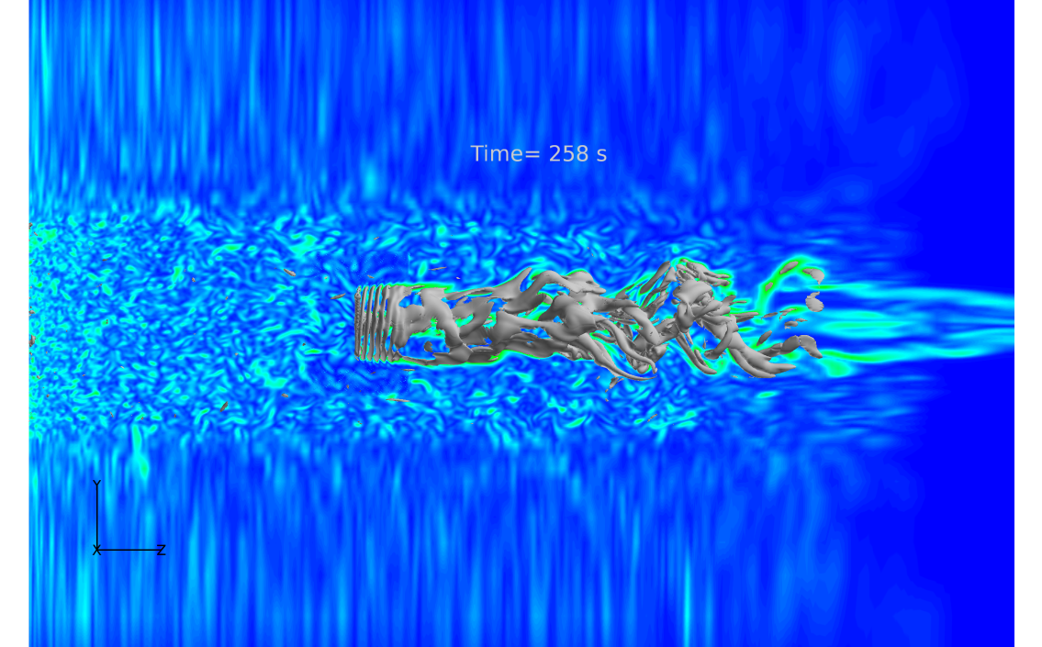
Outline
Introduction and background
Canonical cases
Results
Turbulent inflow
Results
Conclusion and Outlook

Slide 3
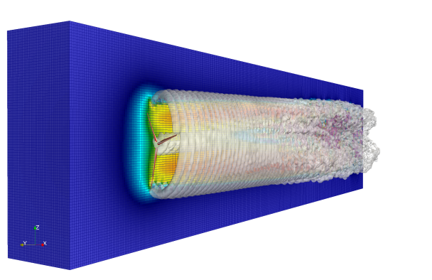
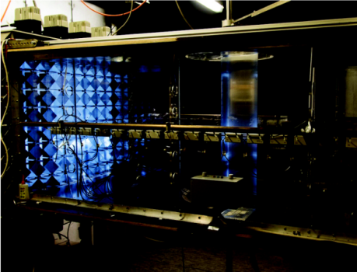
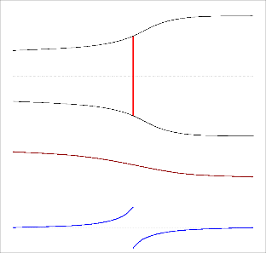
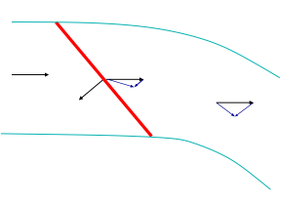
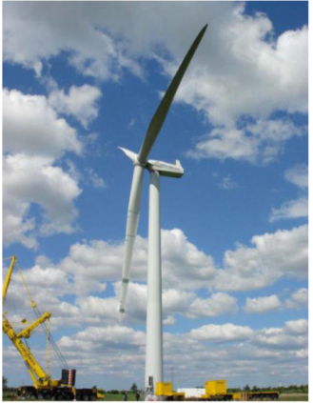
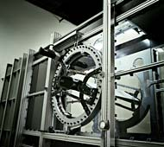
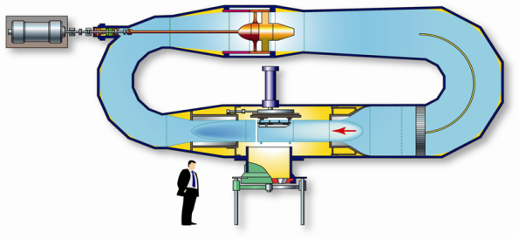
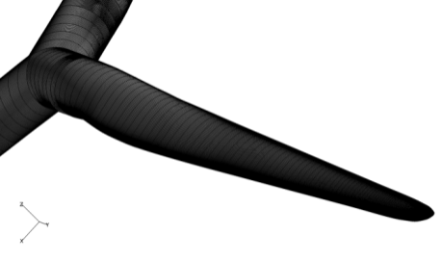
Objective of Advanced Aerodynamic Modeling
To provide cross validated and reliable aerodynamic tools capable of predicting the aerodynamics of the large scale wind turbines of the future (10-20 MW), based on code to code comparison, comparison with wind tunnel data and existing full scale data
Engineering Methods

Slide 4
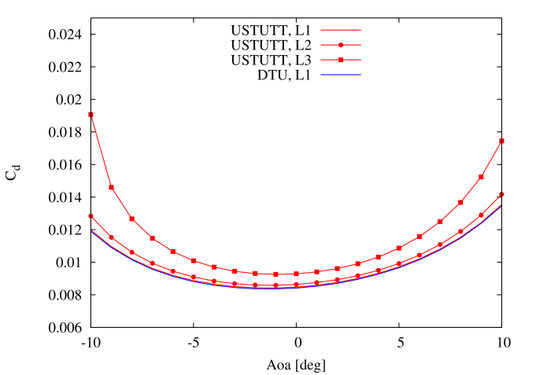
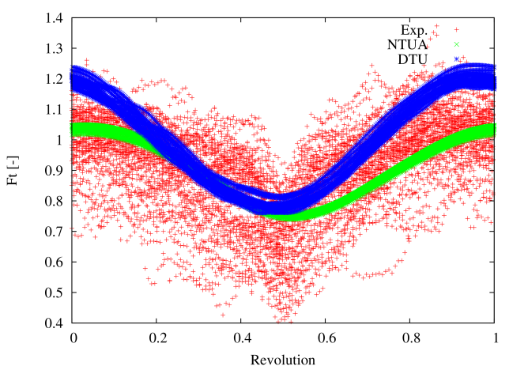
Verifying, Validating and Improving Aerodynamic Codes
Code to code verification
2D airfoil computations
3D rotor power curve simulation
Best practice, grid requirement etc.
Comparison with experimental data
Wind tunnel data (LM, DNW, Forwind)
LM Wind Power: ‘Standard’ wind tunnel data (3-6 mill)
DNW: High Reynolds number test data (6 - 15 mill)
ForWind: Turbulent inflow data
DanAero full scale wind tunnel data
Data base with CFD benchmark cases
‘Canonical cases’

Slide 5
Full Scale Measurements
Even though full scale measurements are necessary for the development of aerodynamic codes, they are inherently complex:
The inflow is not know in all details
The inflow is often highly turbulent and highly time evolving
The inflow + wind turbine + controls is an aero-servo-elastic problem
Structural turbine data and control algorithms are often confidential
Aerodynamic sensors are sparse or non-existing
Load and deflection measurements are sparse
The full scale turbine in the atmosphere is far from a pure aerodynamic problem !

Slide 6
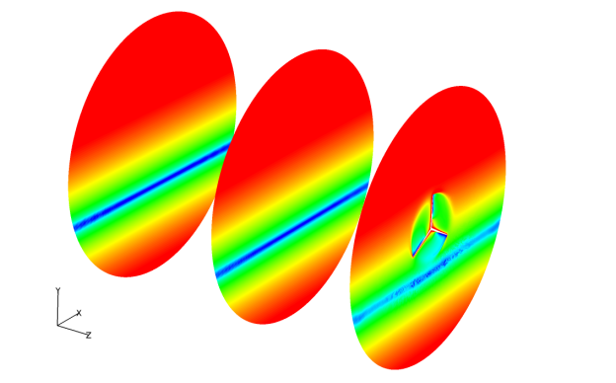
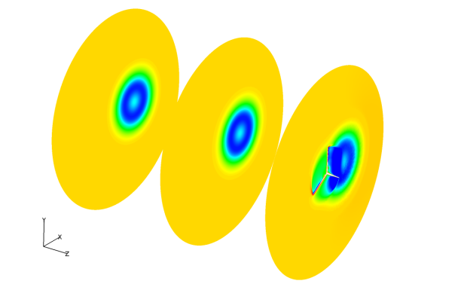
Canonical Cases
The canonical cases should:
Isolate specific flow situations
Avoid complications from structural deflections and control algorithms
Stiff structure
No controls
Ground proximity
Well defined inflow
Based on the above criteria five cases were selected (in fact nine)
Baseline case for establishing common ground
Yaw operation in non-sheared inflow (30 degrees yaw error)
Axial operation in sheared inflow (Power law with 0.2 exponent)
Half wake situation (Cylindrical wake with analytical velocity profile)
Pitch step during axial flow (+/- 2 degrees)

Slide 7
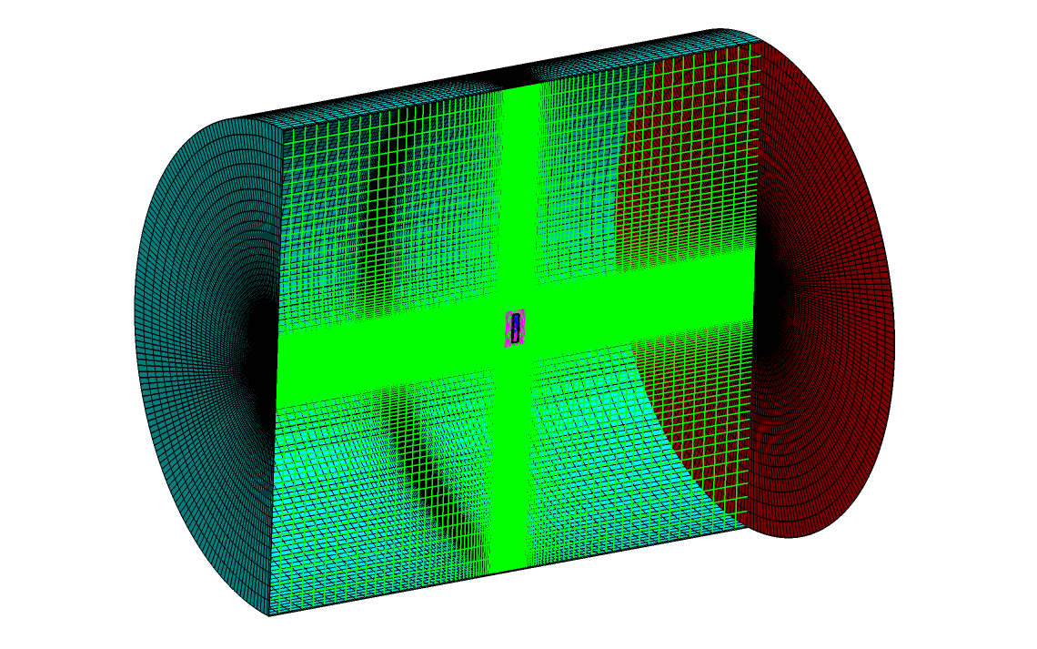
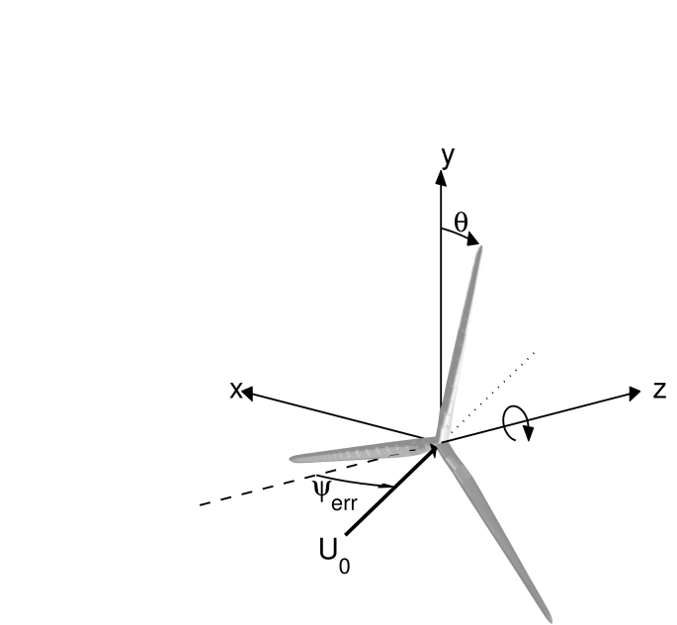
Baseline Axial Operation in Non-Sheared Inflow
AVATAR rotor (R=100 meters)
Pitch setting: 0 degrees
Temperature: 15 degrees Celsius
Static pressure: 1013 hPa
Density: 1.225 kg m³
Viscosity: 1.7879x10⁻⁵ kg m⁻¹s⁻¹
RPM: 9.0218
Free stream velocity W_{hub} = 10.5 ms⁻¹
Domain size
Length ~2000 meters
Diameter ~1000 meters
Y⁺ < 2
17 million cells

Slide 8
The involved codes
CFD solvers, compressible and incompressible
EllipSys3D
FLOWer
MAPFLOW
OpenFoam
Various levels of vortex methods
GENUVP
MIRAS
Engineering Blade Element Momentum codes (BEM)
AEROMODULE, AWSM
FAST
HAWC2

Slide 9
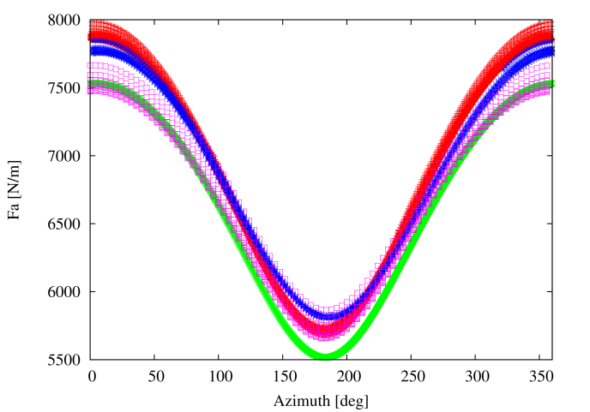
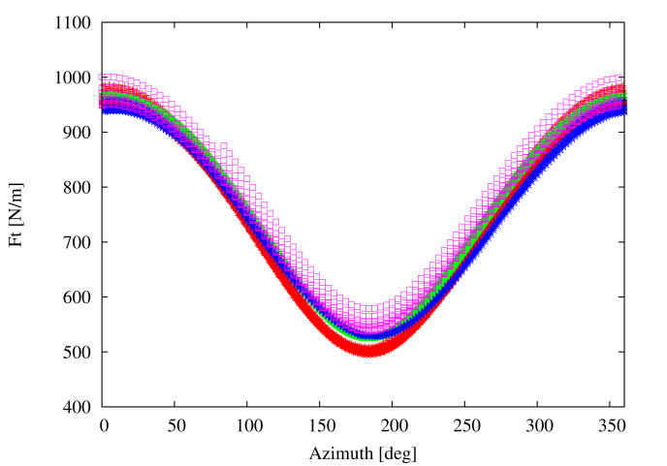
Axial Operation in Sheared Inflow

Slide 10
Validation of engineering models
Based on the verified and validated CFD/Vortex methods the engineering models
can be validated and improved.
Engineering Blade Element Momentum codes (BEM)
AEROMODULE
FAST
HAWC2
The illusive angle of attack is an integral part of most engineering methods.
Extracting the angle of attack from full scale measurements or CFD/Vortex methods is a non-trivial task. In collaboration with the MexNext II consortium, several methods for angle of attack estimation were tested.

Slide 11
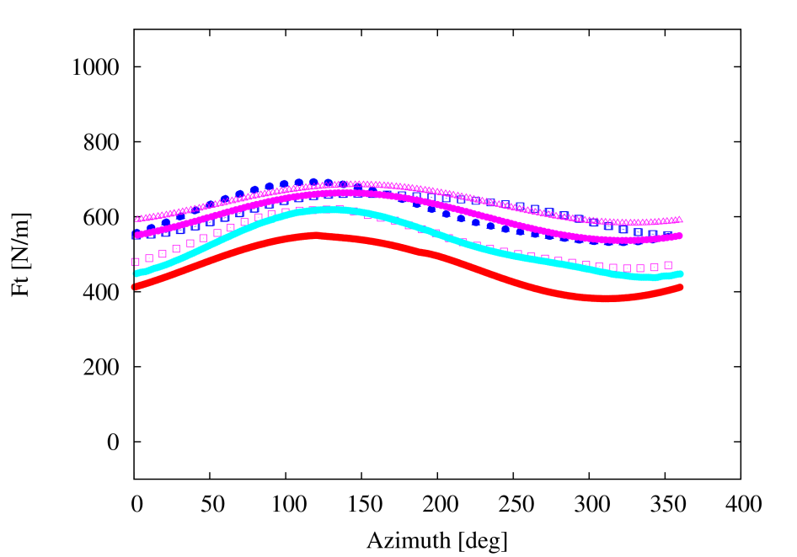
Yaw Operation in Non-Sheared Inflow
70 meters radial position

Slide 12
Detailed Radial Comparisons
Huge effect of airfoil data
Tip correction
Radial induction distribution

Slide 13
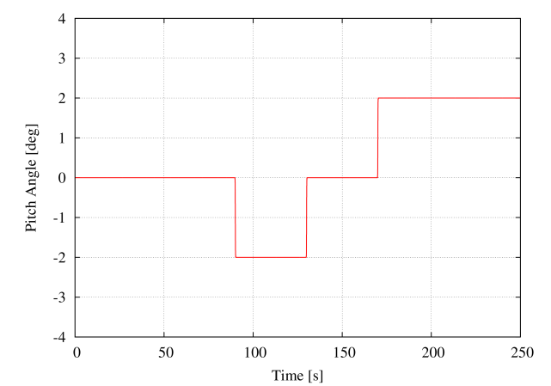
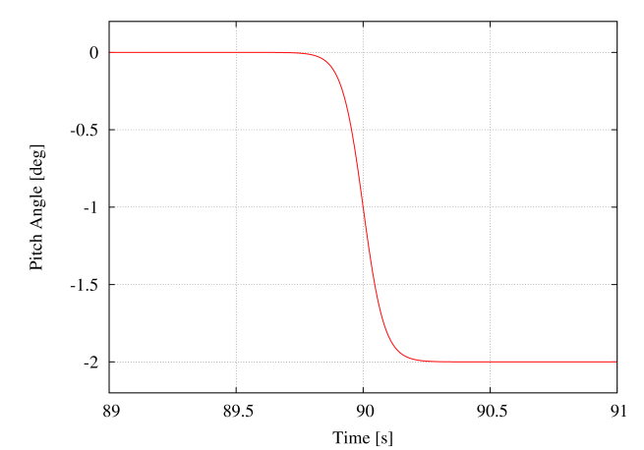
Axial Operation Pitch Case in Non-Sheared flow

Slide 14
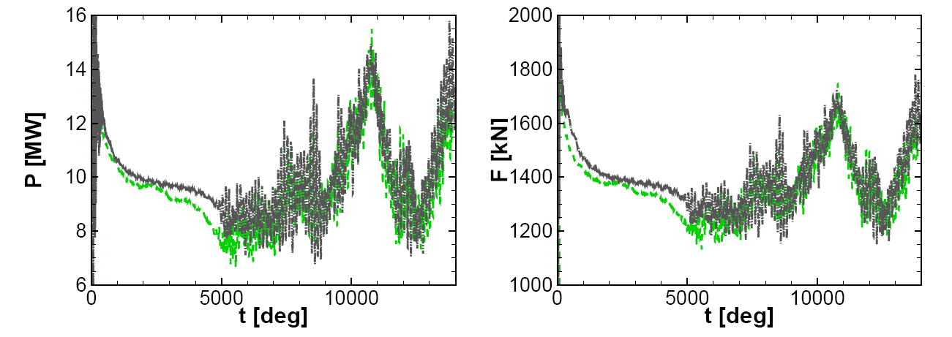
Turbulent Inflow
Case: 10.5 NTM

Slide 15
Turbulent Inflow, NM80 Turbine

Slide 16
A Few Findings from the Eng. Model Improvements
New methods for AoA determination also in dynamic situations have been developed
The comparison with HPC simulations has revealed that there is room for improvement of e.g. the yaw cases
Comparing with HPC simulations, the difference between global versus local induction modeling can be evaluated
Vortex models is a less expensive intermediate level that can be used to guide the development of eng. models
We illustrated that good agreement can be found between, eng. models, CFD type
aerodynamic models and measurements.
A data base well suited for eng. model improvements has been developed

Slide 17
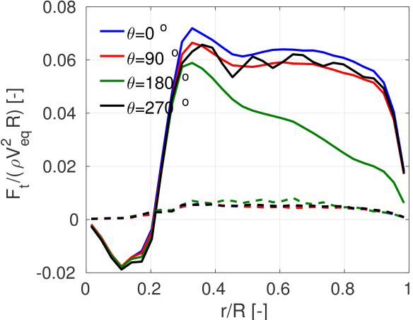
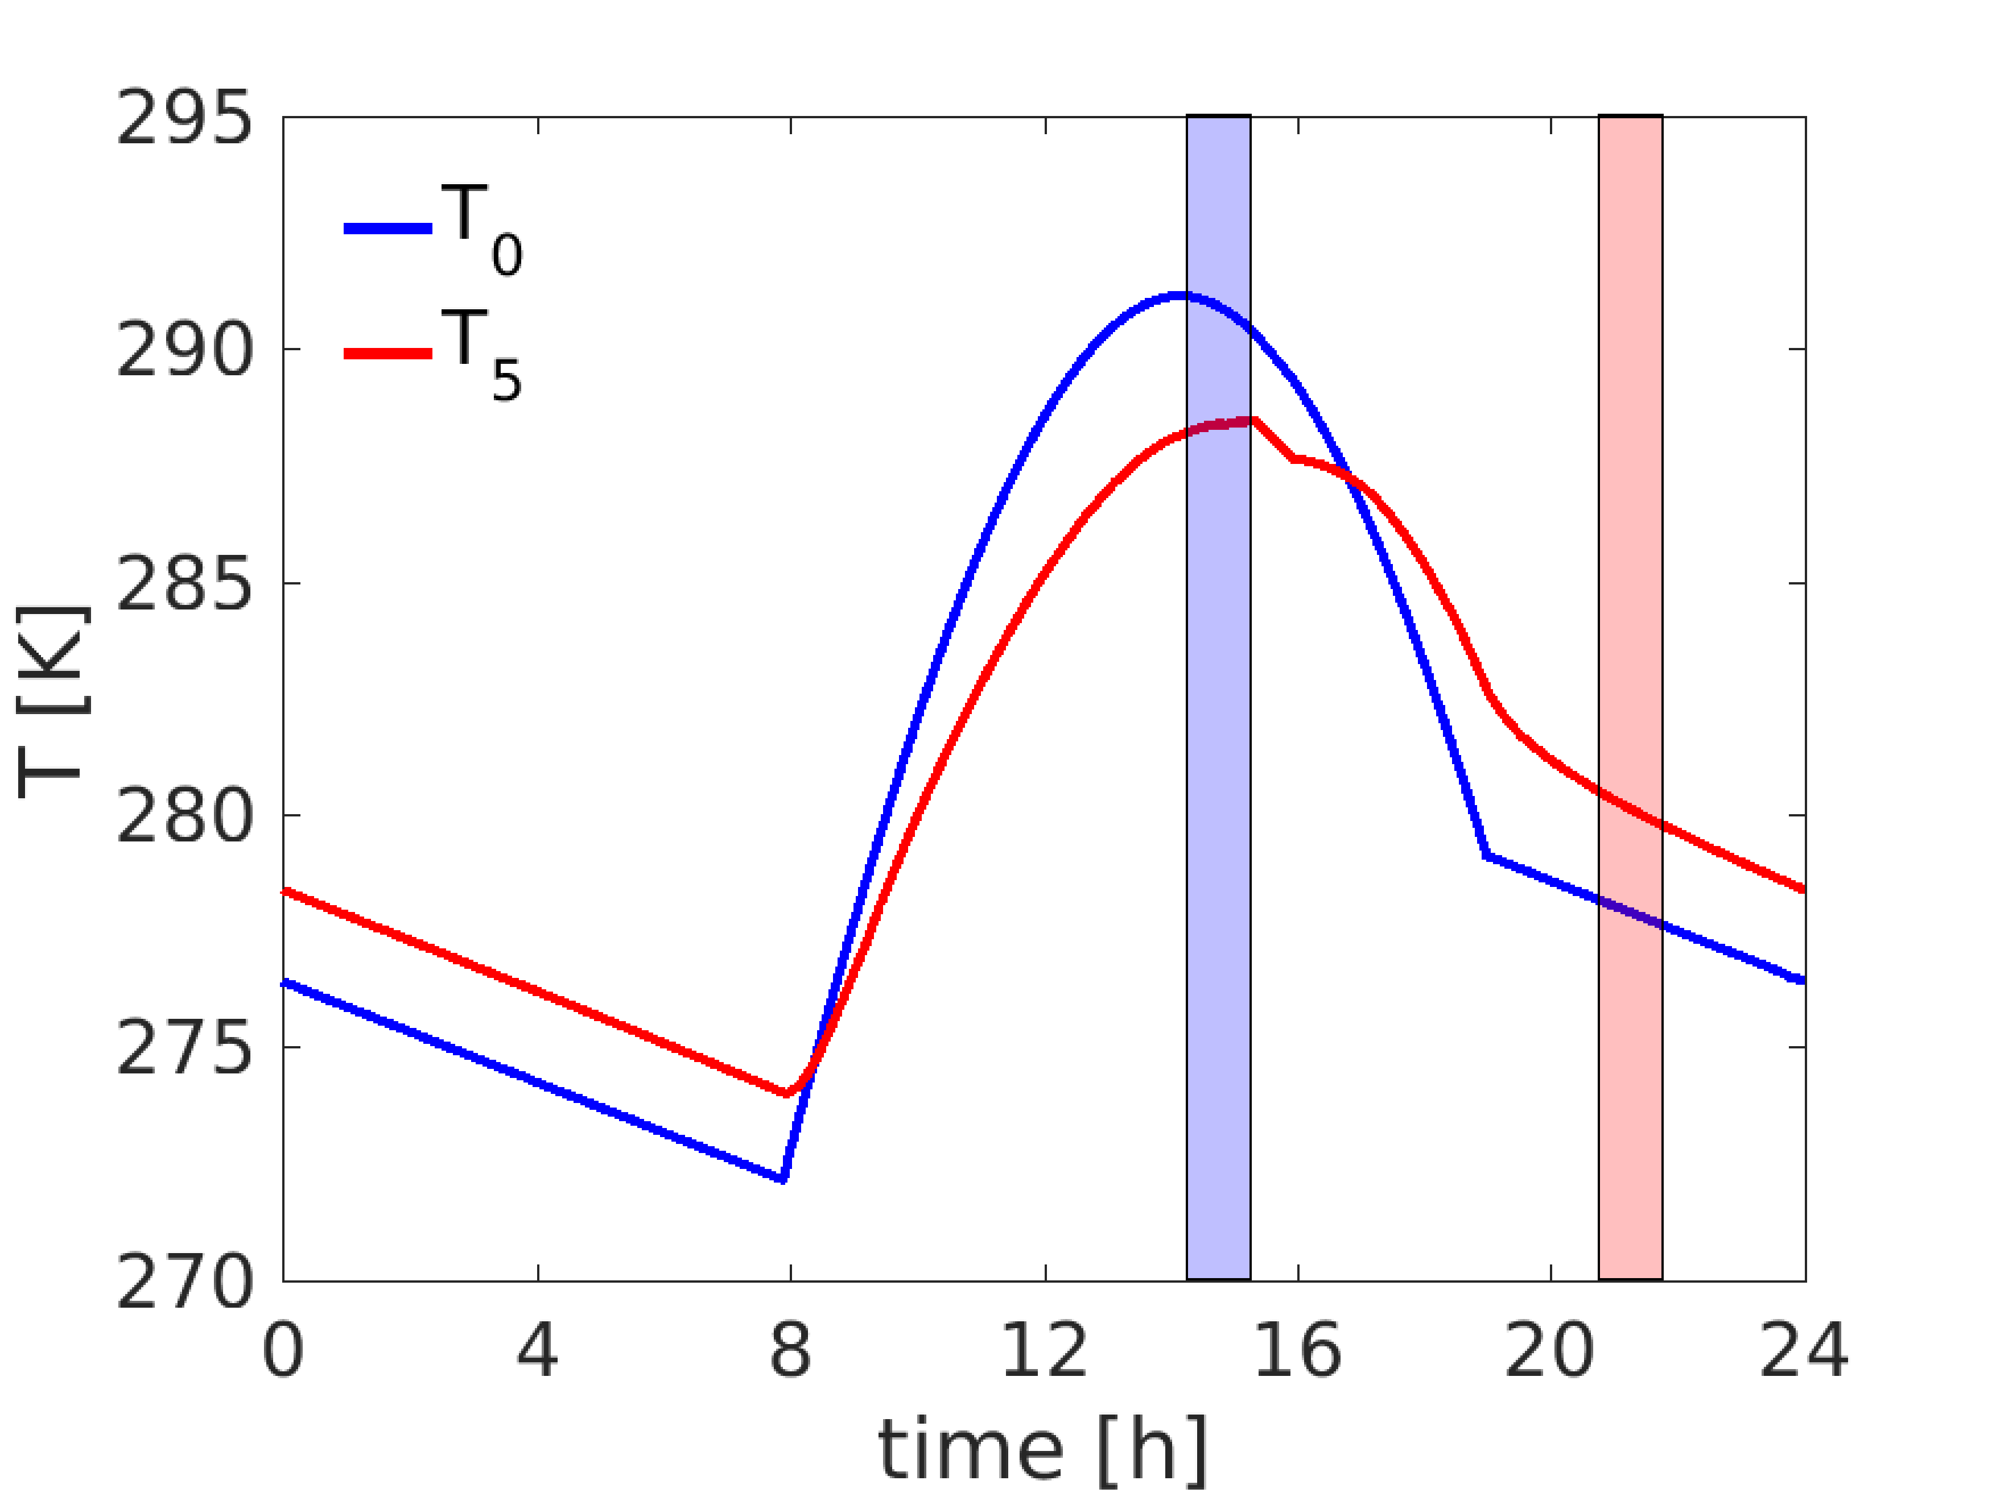
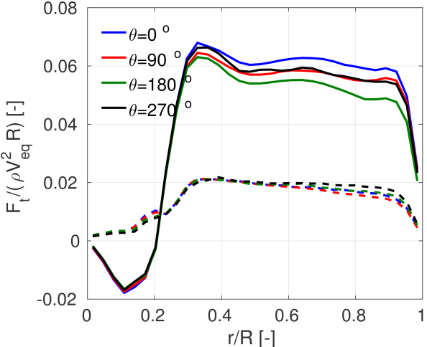
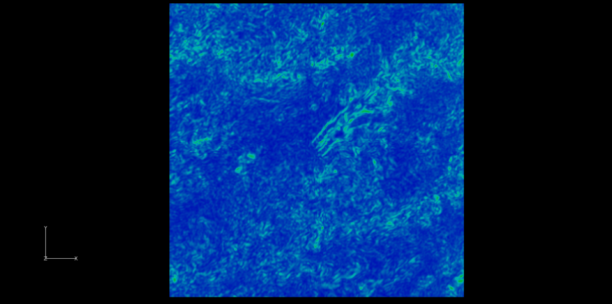
Outlook, Extending to Realistic ABL Conditions
Atmospheric Boundary Layer Flows
Stable
Unstable

Slide 18
Find out More
Reports from AVATAR WP2
D2.5 Effects of inflow turbulence, AVATAR reference rotor and DAN-AERO experiments
D2.6 Effects of complex inflow for the AVATAR reference rotor and NM80 rotor
D2.7 Thermal Stability
D2.8 Engineering models for complex inflow situations

Slide 20
Thank you for your attention

