Slide 2
Presentation Structure
Why cost reduction in Offshore Wind benefits Europeans
Offshore Wind Market Share
LCOE & SCOE
Recent developments in technologies and tools to reduce costs in a project lifecycle and the supply chain
LEANWIND Project
Impacts
From an SCOE & LCOE perspective

Slide 3
Benefit to society Cost reduction in Offshore Wind
Offshore wind could meet “at least 25% of the EU’s power needs by the end of the next decade at an average of €54/MWh in the “most favourable locations” off UK, Denmark, the Netherlands, Germany and France, according to a new resource assessment produced for industry body WindEurope by BVG Associates and Geospatial Enterprises. Societies Cost of Electricity (SCOE)”
Recharge News: 6th June 2017: Offshore Wind Conference Article “Offshore ‘can supply 25% of EU energy’
Notes:
According to the Wind Industry, Offshore Wind could supply over 25% of Europe’s power needs by 2030 in certain regions.

Slide 4
Benefit to society Cost reduction in Offshore Wind
All types of energy are subsidised, offshore wind included
Reducing the cost of Offshore Wind reduces the cost to the European consumer, and promotes the use of clean energy
Ecofys (2014), on behalf of EC: “Subsidies and costs of EU Energy, Final Report 2014
Notes:
All European citizens are paying for subsidised energy through their taxes. Some energy sources are subsidised more than others.
Reducing the cost of Offshore Wind reduces the cost to the European consumer and promotes the use of clean energy.

Slide 5
Benefit to society Cost reduction in Offshore Wind
Levelised Cost of Energy (LCOE): only provides the cost to the farm owner, not the cost to society
Societies Cost of Electricity (SCOE)
Siemens (2014), A macro-economic viewpoint: What is the real cost of offshore wind?
Notes:
We use levelized cost of energy as a parameter to describe the cost of electricity.
This traditional approach considers the cost to the developer but does not take into account the cost to the European consumer.
Siemens has therefore suggested a macro-economic perspective using a “Societies Cost of Electricity” taking into account environmental impact, social and employment effects as well as other indicators.

Slide 6
Background Policy
EU Directive 2009 20% wind energy penetration by 2020
The European Wind Initiative implementation plan
To make wind a competitive source of electricity by tapping into the vast potential of offshore wind.
Innovative logistics including transport and installation techniques, particularly in remote sites
TPWIND Strategic Research Agenda
More than 10% of Europe’s electricity demand to be covered by offshore wind.
Offshore generating costs that are competitive.
Commercially mature technology for sites with a water depth of ≤ 50m, at any distance from shore.
Technology for sites in deeper water, proven through full-scale demonstration.
WATERBORNE
Deliver more efficient and sustainable waterborne transport systems and infrastructure.
Increase support for the emerging offshore energy sector.
Reduce impact on the environment.
Help deliver a more competitive and sustainable low carbon economy.
Prioritise safety and security.
EU integrated maritime policy objective: ‘developing a thriving maritime economy, in an environmentally sustainable manner.’
Notes:
Given the obvious benefits to society, the FP7 Oceans of tomorrow call sought to fund projects driven by the following background policy objectives
Increase offshore wind energy production
Make offshore wind commercially competitive
Consider sites further offshore in deeper water
Logistics, transport and installation techniques were identified as key areas where cost savings can be achieved
Contribute to EU maritime economy: NB to make it sustainable and efficient and open or develop new markets and jobs.
It combined the Transport and Energy sectors to find efficiencies for the offshore wind industry

Slide 7
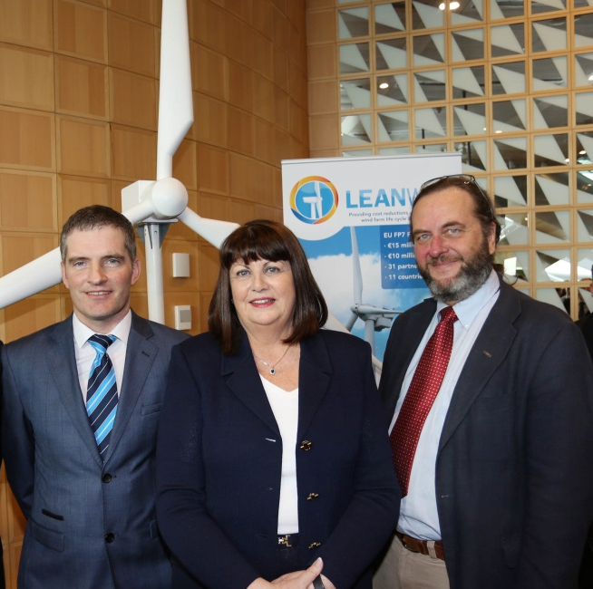
Project summary LEANWIND
Logistic Efficiencies And Naval architecture for Wind Installations with Novel Developments
UCC is coordinator
31 partner organisations
52% industry partners
Representing 11 countries;
€14.9m total funding; €10m EC funding
4 year duration
Start date: December 2013
OBJECTIVE: to provide cost reductions across the offshore wind farm lifecycle and supply chain through the application of lean principles and the development of state of the art technologies and tools.
Dr. Jimmy Murphy (UCC), Máire Geoghegan-Quinn (EU Commissioner for Research, Innovation & Science), and Ørnulf Jan Rødseth (Norwegian Marine Technology Research Institute) © Gary O'Neill
Notes:
In that context we have the LEANWIND Project: which aims to reduce the cost of offshore wind energy through technologies and tools. The project also looks at how to create a route to market for these innovative technologies and what the environmental implications are. Thereby taking into account some of those Societal Cost of Energy parameters mentioned earlier.

Slide 8
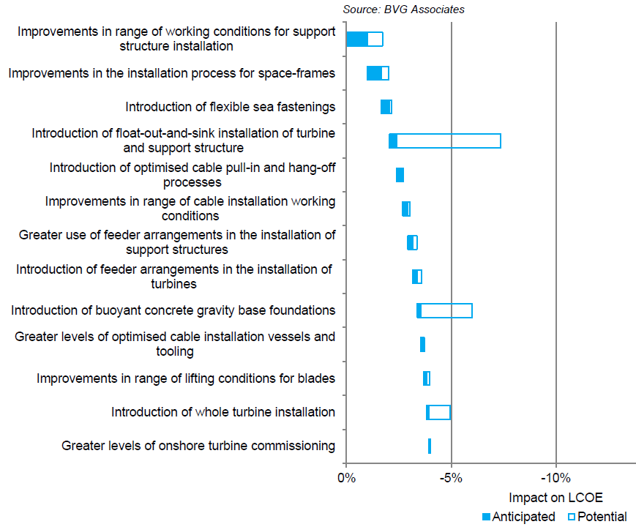
Background Offshore Wind Industry
Anticipated and potential impact of innovations on Installation (LEFT) and O&M (RIGHT) for a wind farm with 6MW-class turbines with FID in 2020 compared with 4MW turbine on the same site in 2011 (Source: BVG Associates, Offshore wind cost reduction pathways: Technology work stream, June 2012, p. 110 & 137.)
Notes:
Identified key areas for cost savings based on the call and key areas identified by industry reports

Slide 9
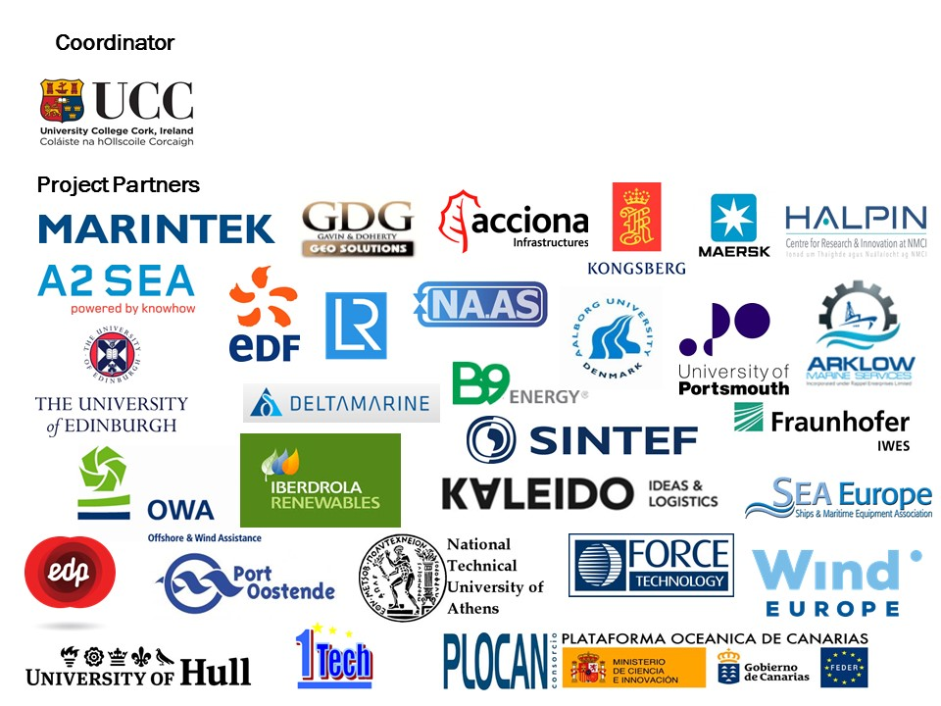
Project Summary LEANWIND Consortium
52% Industry Partners
Aims to be industry relevant and not simply an academic project

Slide 10
Voluntary external industry stakeholder group
With the intention of maximising the impact and the value of the project by involving key industry stakeholders in the delivery of the research objectives

Slide 11
LEANWIND Work Structure - Levels of Optimisation
Work is structured to follow three tiers of process optimisation
Strategic:
Project life cycle
Project life cycle assessment models – economic and logistic
Procedural/
Technological
Tactical
Strategic
Tactical: Project stage specific
Project stage assessment models – economic, logistic, O&M strategy, sub-structure selection, GIS-T transport tool
Procedural/Technological:
e.g. Vessel designs, access technologies, condition monitoring systems, remote presence technologies, sub-structure adaption for installation, etc.
Notes:
Project work is structured into 3 tiers of process optimisation looking first at the strategic level, optimising across the project lifecycle; then at the tactical level, looking at each stage of a project life and supply chain; and at the procedural/technological level.

Slide 12
LEANWIND Work Structure
Construction, Deployment & Decommissioning
Novel Vessels & Equipment
Operation & Maintenance
Integrated Logistics
System Integration (H&S and training)
Testing & validation of tools & technologies
Economic & Market Assessment
Notes:
Work is divided under the following themes.

Slide 13
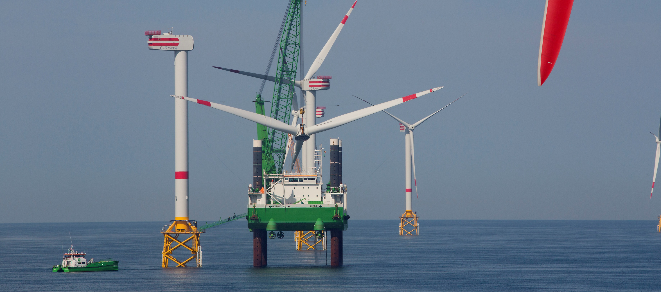
LEANWIND Work Structure
Construction, Deployment and Decommissioning
Leading work: GDG Ltd.
Cost and time optimisation/innovation of the assembly, deployment and decommissioning of wind turbines and their support structures.
Focus on innovative sub-structure concepts designed to minimise the requirement for HLVs (fixed and floating) and innovations to their associated deployment strategy.
E.g. float-out of gravity base structures, piles v suction bucket for jacket structures, seabed preparation, pre-installed cables
http://www.marinelog.com/DOCS/NEWSMMIX/2009jul00230.html
© GeoSea, DEME Group
http://www.heavyliftspecialist.com/wind-energy/page/10/
Notes:
The first looks at innovative sub-structure concepts to minimise the need for HLVs and optimise their associated deployment strategy.

Slide 14
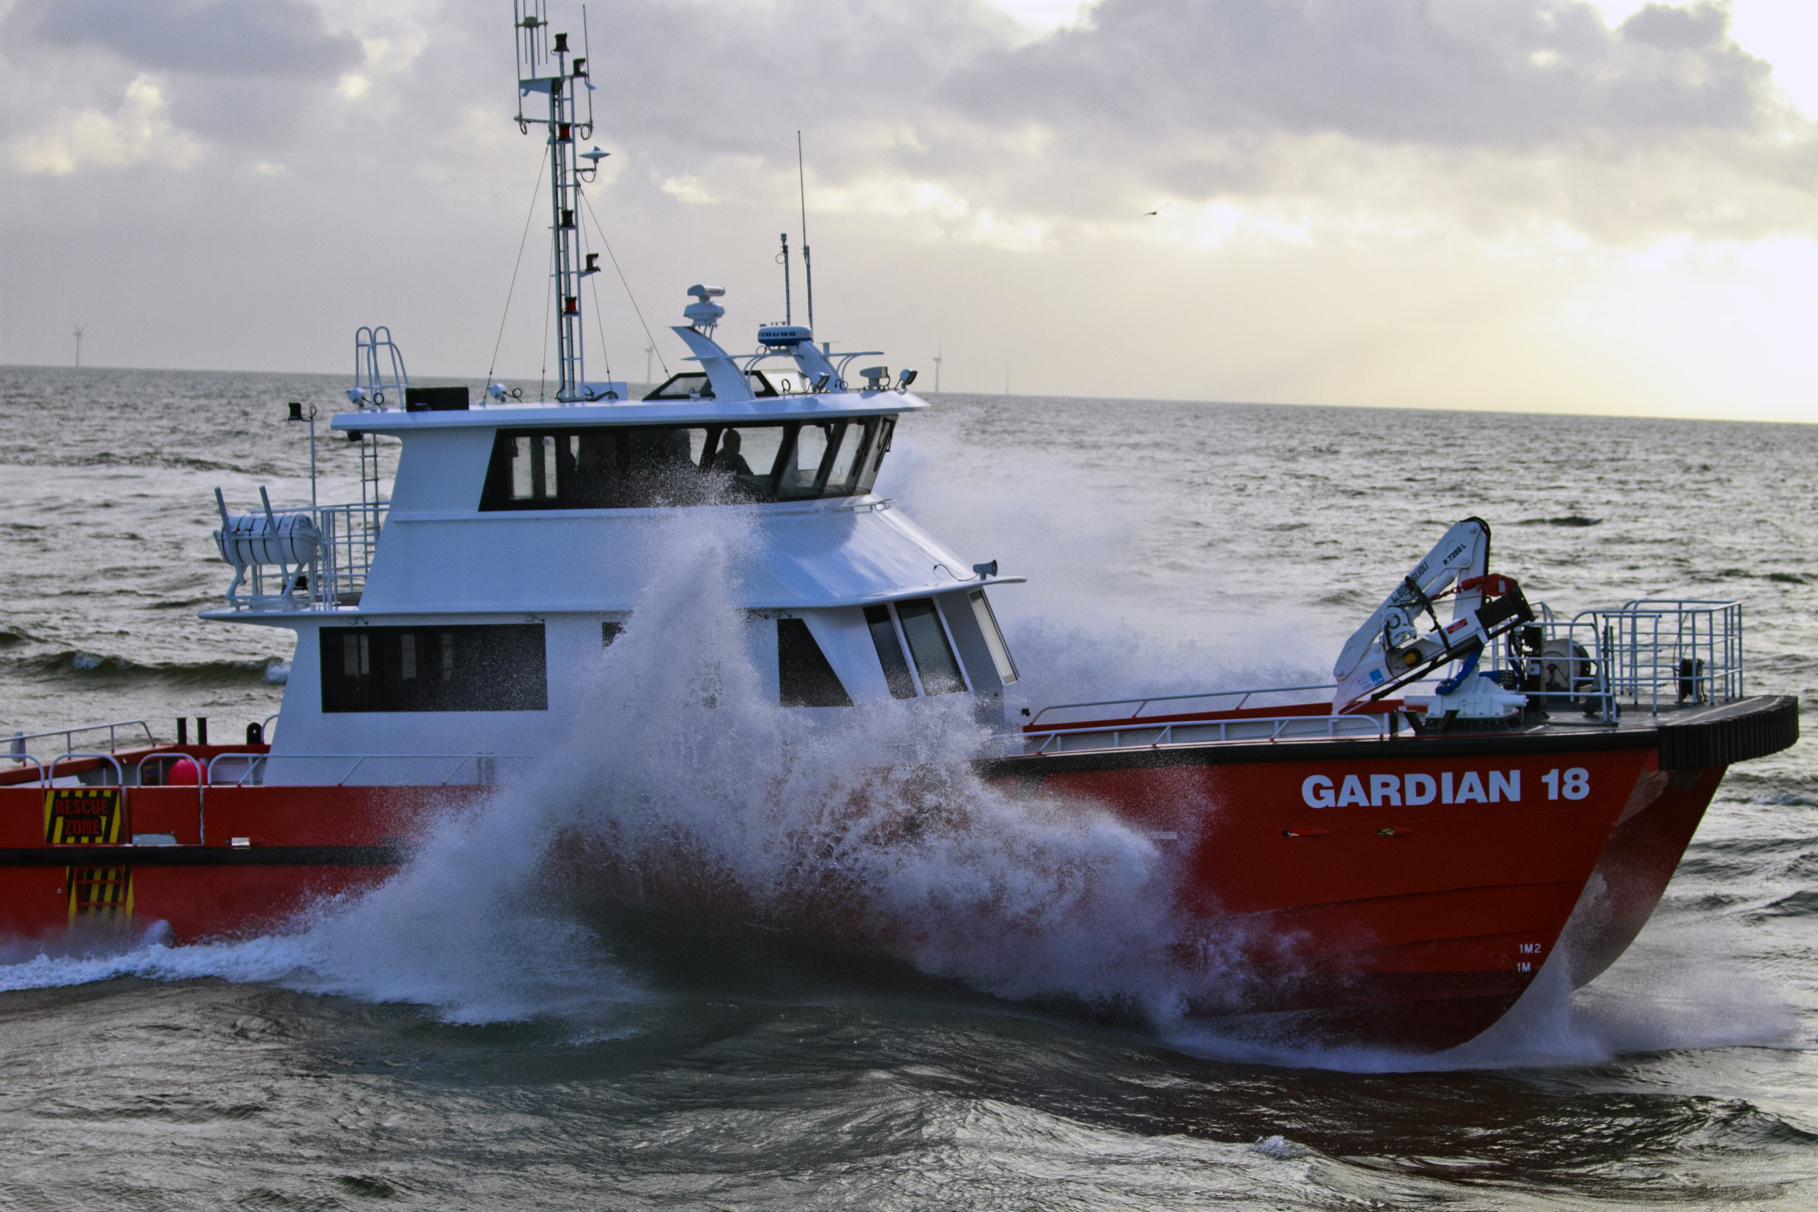
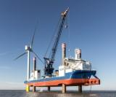
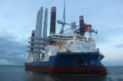
LEANWIND Work Structure
Novel Vessels & Equipment
Leading work : Lloyd’s Register
- Improvements to the primary vessel types used for wind farm installation and O&M
- Improve efficiencies of vessels
- Design new vessel concepts tailored specifically to industry requirements
- Compare the benefit of using jack-up ‘v’ DP vessels for increasing water depths
- O&M personnel transfer systems
Wider weather window access of vessels and personnel transfer
http://www.swire.com.sg/Media/News-Archive/2014/Swire-Blue-Ocean-A-S-signs-key-contract-with-Van-O.aspx
Courtesy of A2SEA
Courtesy of A2SEA
Courtesy of Arklow Marine Services
Notes:
We have also developed novel vessel design concepts for O&M and installation

Slide 15
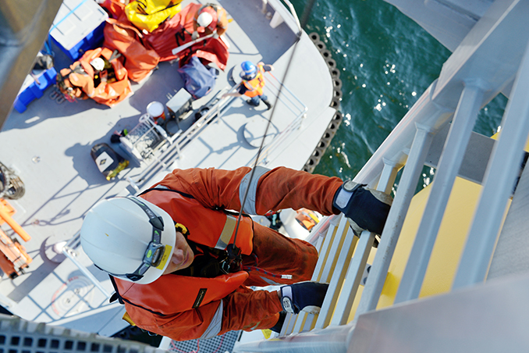
LEANWIND Work Structure
Operation and maintenance strategies
Leading work : University of Aalborg
- optimise existing O&M strategies
- develop & test condition monitoring and remote presence systems
- Use of flotels, launch and recovery, centralised offshore hubs, helicopter access, etc.
- Adapt O&G knowledge for offshore wind
O&M vessel fleet optimisation
Maintenance at Sheringham Shoal Offshore Wind: Image – Statkraft, www.offshorewind.biz/2014/06/06/photo-of-the-day-maintenance-at-sheringham-shoal-offshore-wind-farm/
Notes:
The project also looks at optimising O&M strategies, developing a decision support and dynamic scheduling tools and technologies including CM software and remote presence systems.

Slide 16
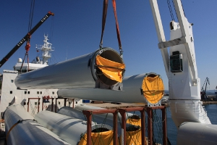
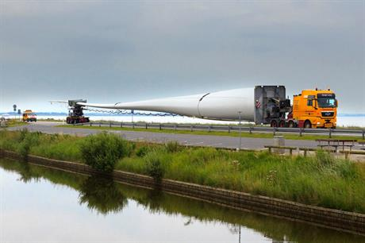
LEANWIND Work Structure
Integrated Logistics
Leading work : MARINTEK
- Optimise the logistics of the offshore wind farm supply chain throughout the lifecycle
- Develop a holistic logistics optimisation model specific to the offshore wind farm development using mathematical algorithms
- Ports management and development for the sector
- A coupled economics and logistics optimisation model for offshore wind farm project management
Image - ISL, www.isl.org/en/consulting-and-transfer/offshore-wind-power-logistics
Image - Siemens, www.windpowermonthly.com/article/1296011/challenges-finding-best-sites-wind-development
Notes:
At the core of the project is optimising logistics at each phase of the supply chain and across the lifecycle. We have developed a holistic logistics optimisation model for this purpose with individual modules applicable to port logistics, transport, vessel chartering etc.

Slide 17
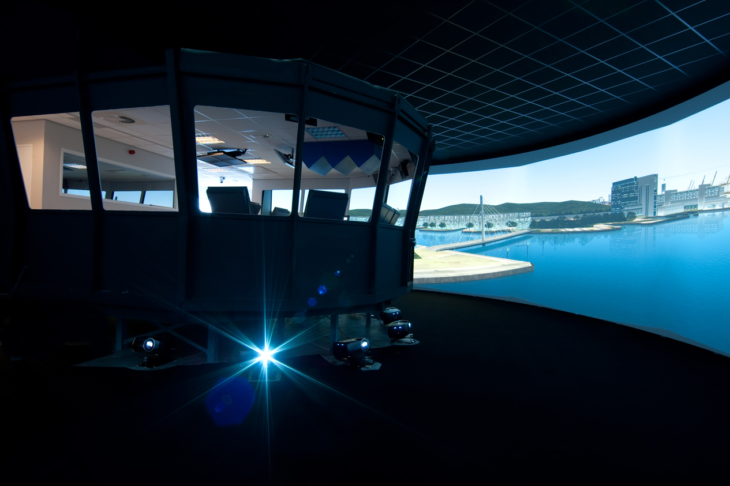
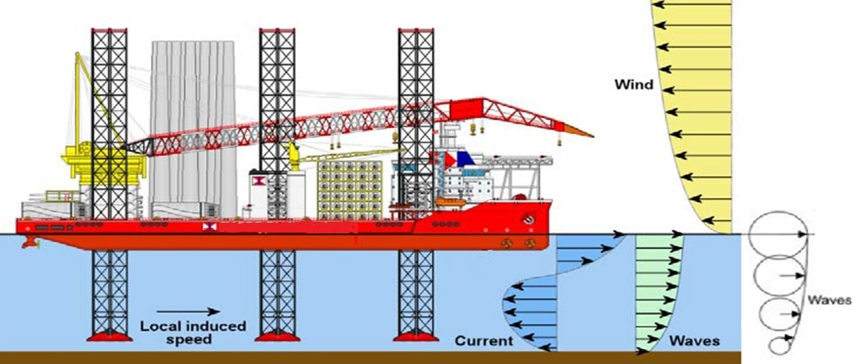
LEANWIND Work Structure
System Integration
Leading work: Fraunhofer-IWES
integrate the other work
examine relevant H&S and training procedures.
Testing & validation of tools and technologies
Leading work : PLOCAN
Test and validate the technologies and tools through:
1) Simulation; 2) Field testing through in-situ trials or case studies; 3) Case study validation using the project tools
Economic & market assessment
Leading work: MaREI, UCC
place the work in an economic context
relevant policy, business regulation and commercial framework for successful commercialisation
Determine the direct cost benefits
examine business models & risk sharing
market & non-technical impacts
Courtesy of FORCE Technology
Notes:
We have also looked at the H&S and training requirements in the industry; undertaken field testing of project innovations and are about to conduct simulations of the O&M and installation vessels to develop recommendations for H&S and training as well as validate the concepts and show how simulation can be used to optimise activities before they are done in real life; we will also apply the O&M and logistics decision support tools along side a full life-cycle financial model to show the cost-benefit of project innovations and provide recommendations for areas where further savings may be found for future sites and technologies.

Slide 18
LEANWIND Key project outputs
GIS-T model to inform logistics decisions
Port layout/configuration decision making model
O&M strategy model considering preventative and corrective maintenance, condition monitoring, reliability based design and remote presence
Economics model and full supply chain logistics model
Novel adaptations to existing substructures to improve installation
Novel and adapted vessel and equipment design for installation and maintenance
Simulator models and training for installation and maintenance activities
New business models considering risk
Novel condition monitoring equipment installed and tested at the NOWERI test site
Viability and implementation roadmap and strategy document
Notes:
To summarise some of the key outputs…

Slide 19
Contact us
Website – www.leanwind.eu
Sign up to our newsletter
View public reports and
executive summaries
See upcoming events & news
Follow us on twitter @LEANWINDFP7
Email - leanwind@ucc.ie
Notes:
Further information, public reports and upcoming showcases and events can be found on our website or follow us on twitter

Slide 20
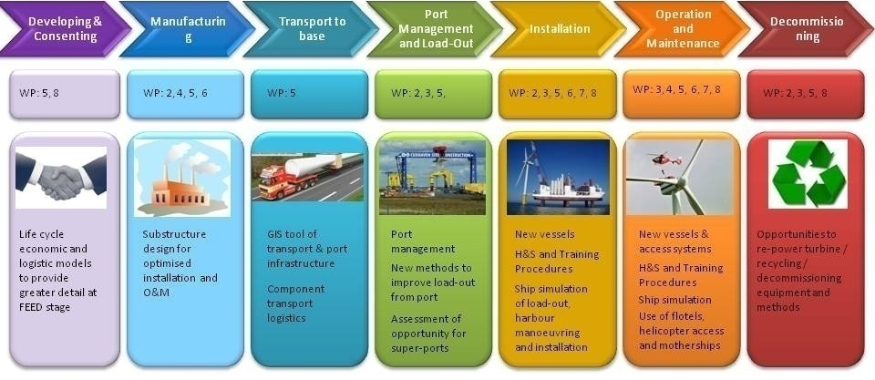
LEANWIND Expected Impact
Support the development of new niche markets for EU shipping and shipbuilding industries thereby contributing to the competitiveness of the sector and to the creation of new jobs.
LEANWIND will support sustained growth of the offshore wind sector by accelerating the route to market of new innovative tools and technologies that address industry challenges in the short, medium and long term.
The “value added” at each stage of the supply chain.
Notes:
Looking at the broad impacts on society, LEANWIND will support the development of new niche markets for EU shipping, contributing to the competitiveness of the sector and the creation of new jobs. It will also support the growth of the sector by accelerating the route to market of new innovative tools and technologies that address industry challenges.

Slide 21
LEANWIND Expected Impact Cost reduction potential
Innovations developed in LEANWIND could potentially reduce the LCoE of offshore wind energy by up to 13.8% over the next decade.
Wind Farm Construction 7%
Balance of Plant 4.3%
Operations and Maintenance 2.5% [1]
[1] Based on impacts of innovations described in Future renewable energy cost: offshore wind. BVG Associates, May 2014
Wind Farm Construction | Potential reduction in LCOE
Improvements in the installation process for space-frames | 1.1%
Improvements of working conditions & feeder for structure installation | 1.3%
Introduction of buoyant concrete gravity based foundations | 1.6%
Introduction of float-out-&-sink installation of turbine & support structure | 3.0%
Balance of Plant | Potential reduction in LCOE
Improvement in monopole designs and designs standards | 2.0%
Improvements in jacket design and design standards | 1.2%
Introduction of suction bucket technology | 1.1%
Operations & Maintenance | Potential reduction in LCOE
Improvements inventory management | 0.1%
Introduction of turbine condition-based maintenance | 0.7%
Improvements in O&M strategy for far-from-shore wind farms | 0.8%
Improvements in personnel transfer from base to turbine location | 0.2%
Improvements in personnel access from transfer vessel to turbine | 0.7%
Notes:
Based on the impacts of innovations described in the BVG Associates 2014 report, it is anticipated that the innovations developed in LEANWIND could potentially reduce the LCoE of offshore wind energy by up to 13.8% over the next decade.
The final reports of the LEANWIND project will look at the LCOE impacts of these technologies in more detail and will be presented at our final event in Amsterdam at the WindEurope conference in November.
Note for further information: The impacts from wind farm technology innovations (excluding transmission, decommissioning, supply chain and finance effects) contribute a total anticipated 27% reduction in the LCOE (for typical wind farm with FID 2014 compared to FID in 2025). [1]

Slide 22
LEANWIND Expected Impact Environmental & Societal
Environmental and Societal Impacts of Technology Innovations
Life Cycle Analysis of given technology types
Other environmental impacts of offshore wind activity based on recent literature
Societal and employment impacts of offshore wind developments on port communities
The market impact of these technology innovations in the industry
Notes:
In order to contribute to the societal cost analysis of offshore wind farm projects, the presenters that follow will be outlining the work done in LEANWIND on environmental, societal, employment impacts of the offshore wind industry as will as the potential market impact of project innovations.

