Slide 1
INNWIND.EU
INNOVATIVE WIND CONVERSION SYSTEMS (10-20MW) FOR OFFSHORE APPLICATIONS
Key Findings towards lowering the LCOE of Offshore Wind turbines
Project Coordinator Peter Hjuler Jensen, DTU WIND ENERGY

Slide 2
The INNWIND.EU project
Starting point: The €23 mio. EU project UpWind project ended Feb 2011 produced low TRLs - research results for the next generation 10-20MW offshore WT’s, pointed on innovations to drive cost down and was starting point for INNWIND.EU
The INNWIND.EU is a EU funded EERA project with 27 partners, a budget of 20 mio Euro, a duration of 5 years and DTU Wind Energy is coordinator
Idea: With innovations lower LCOE and through upscaling up to 20 MW
beat the “Cubic law”
Objective: Develop Wind turbine concepts, demonstrators and innovations to higher TRL levels for 10 to 20 MW offshore WT’s at 50 meter water depth or more

Slide 3
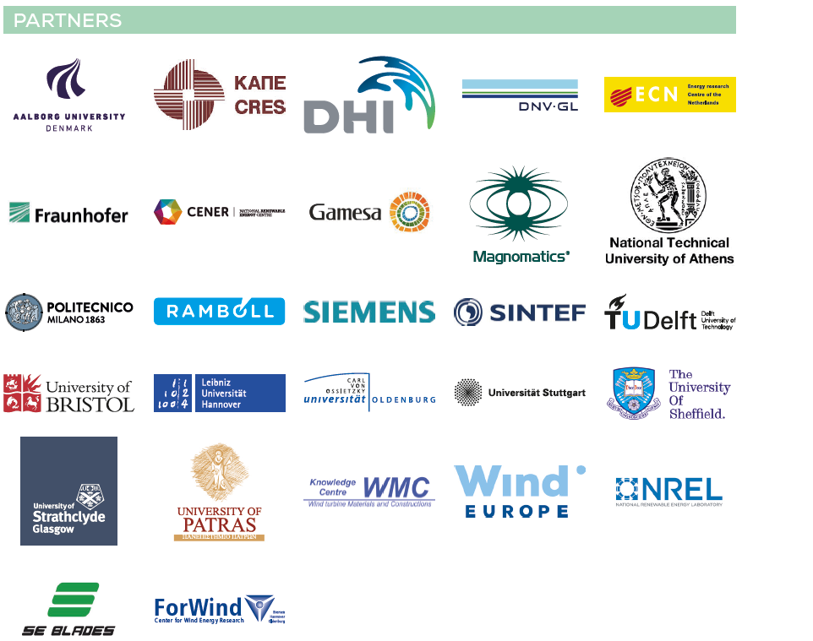
The 27 Partners in the INNWIND.EU Consortium

Slide 4
Structure of the Project
Task: develop Innovative 10 to 20 MW offshore wind turbine designs
Component level innovations integrated into the wind turbine, virtually tested and further developed.
Demonstration of Innovations include super conducting generators, pseudo magnetic drives and smart blades.

Slide 5
System Integration, models and reference measurements
Cost model for LCOE Evaluation and structural integrity check
Method to assess the performance of components and concepts
WT concepts: HAWT: 3-bladed WT, 2-bladed WT, multirotor WT, VAWT and bottom mounted and floating WT (10 and 20 MW)
Develop a nacelle with front mounting of generators in front of the hub or behind the hub
Develop new design models e.g. optimization models including integrated aeroelastic and structural design models
Develop improved reference database for external conditions
Establish wave tank reference measurements for floating WT’s

Slide 6
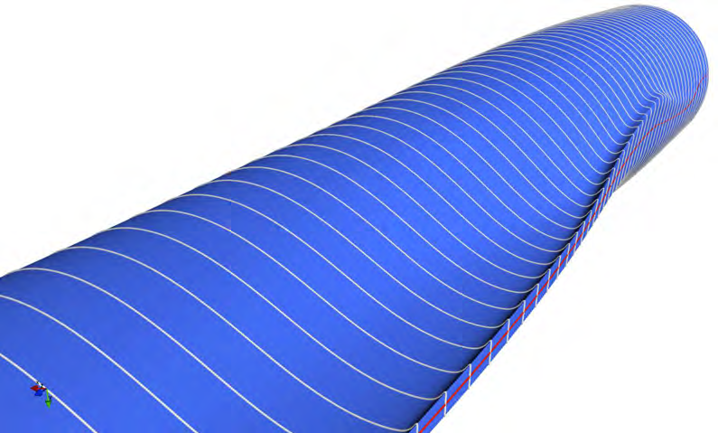
Innovations in INNWIND
Kingpin Drive – Superconducting Generator in front of the rotor
Magnetic Gearing – Pseudo Direct Drive
Smart blades and high tip speed low induction blades
10 and 20 MW concepts

Slide 7
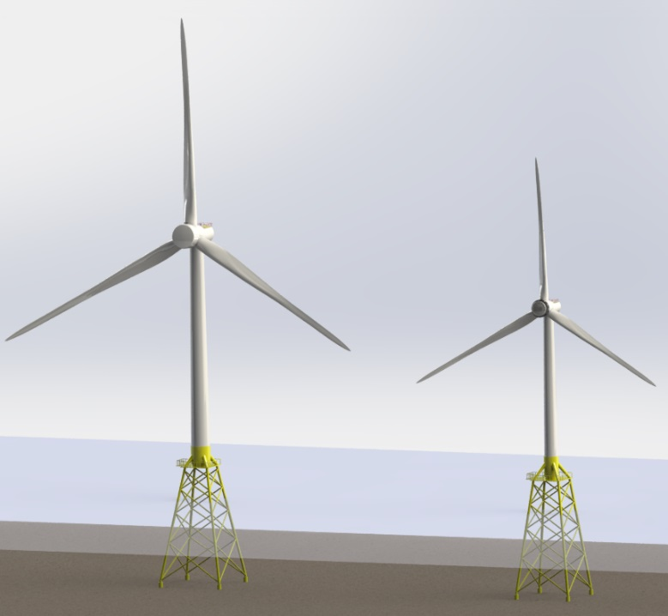
INNWIND.EU Reference Wind Turbines
Integration and communication

Slide 8
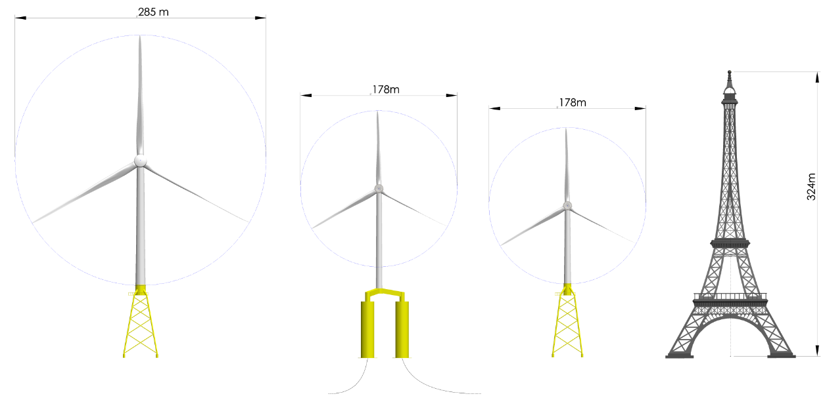
Dimensions of 10 and 20 MW Concepts

Slide 9
Cooperation with other Research Projects and Test Centers
Wave tank tests done at Nantes, France in cooperation with EU FP7 funded Marinet project
Wave tank tests done at DHI, Denmark based on access granted by DHI
Spinner Lidar demonstrations done at NREL and Sandia Labs, U.S.A. in collaboration with other projects.
Wind/Wave measurements database access from FINO3 platform for design assessment studies
Cooperation with EU FP7 project Suprapower on demonstration of superconducting generators
Cooperation with H2020 Demowind on Pseudo-Magnetic direct drive generator demonstrations

Slide 10
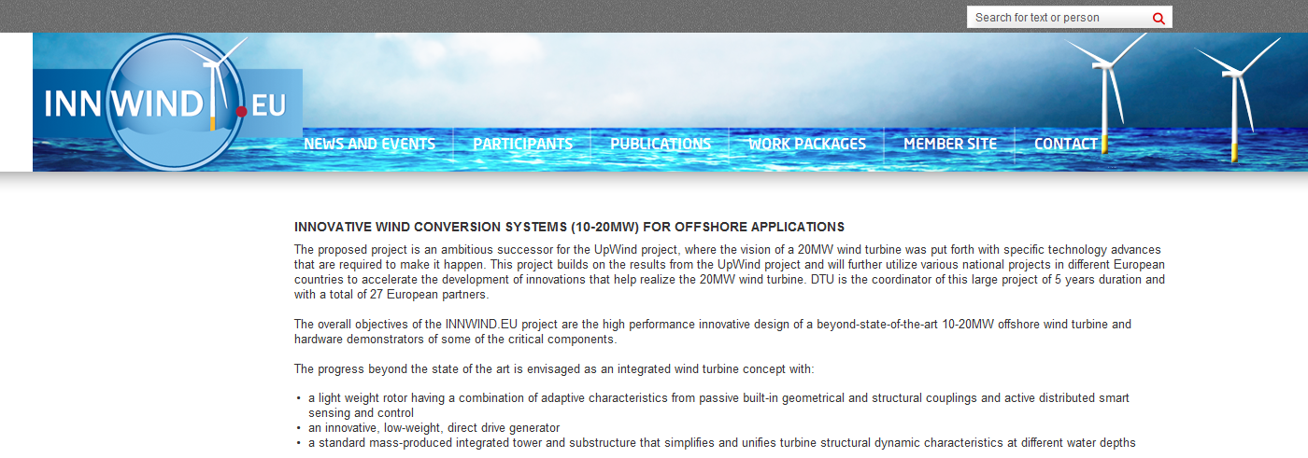
Conclusions
A very successful project with 10 and 20 MW WT offshore concepts and a lot of promising innovations
LCOE reductions in concepts up to an overall reduction of more than 30% compared to the reference 5 MW turbine
Program: 6 presentations of results from INNWIND.EU:
  Lightweight Rotor design for 10 MW –20 MW wind turbines
  Wind observers and advanced controls for Innovative Turbines
  Wind observers and advanced controls for Innovative Turbines
  Drivetrain Structures for 10 MW - 20 MW Wind Turbines
  Cost Effective Fixed and Floating Sub Structures
  LCOE reduction for the 20 MW wind turbine
Final reports is available as deliverables on the web site:
  www.innwind.eu

