Slide 2
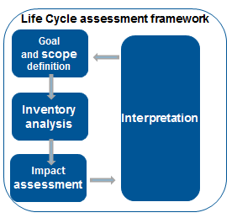
1. INTRODUCTION TO LCA
LCA METHODOLOGY
Assess the environmental aspects and potential impacts associated with a product, process, or service.
Systematic process with four components
“Cradle-to-grave” approach
INPUTS
Raw material extraction
OUTPUTS
Raw materials
Energy
Fuel
Emissions to air
Emissions to water
Solid waste
Coproducts
Others
Manufacture/ Installation
Use/ Maintenance
Recycling/ Waste treatment

Slide 3
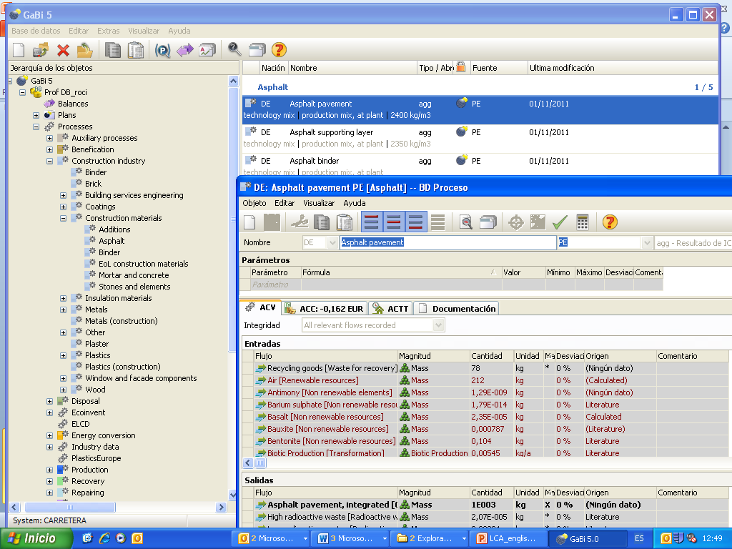

2. LCA TOOLS
GaBi 6 SOFTWARE
Provided by PE International, in collaboration with IKP University of Stuttgart
The program incorporates its own database with information of many processes
It includes Ecoinvent, GaBi and ELCD databases (update 2016)
Latest upgrade: Gabi 6

Slide 4
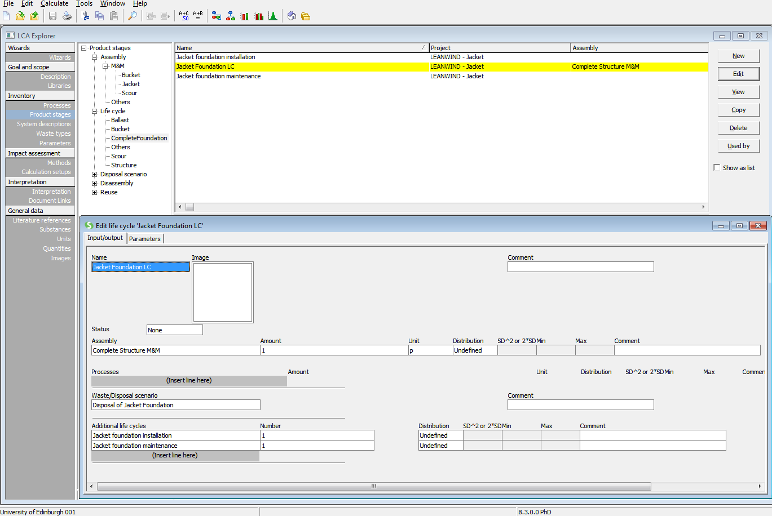

2. LCA TOOLS
SIMAPRO 8.3 PhD
A leading software produced by PRé Consultants, similar to the GaBi software.
Available databases include latest versions of Ecoinvent and ELCD.
Research has shown that different software tools introduce discrepancies into results, affecting comparability (Herrmann & Moltesen, 2014).

Slide 5
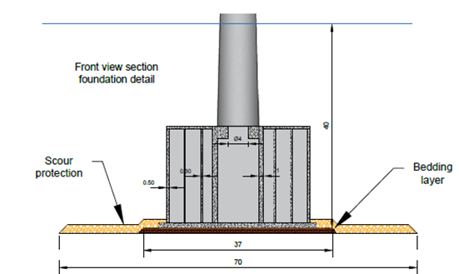
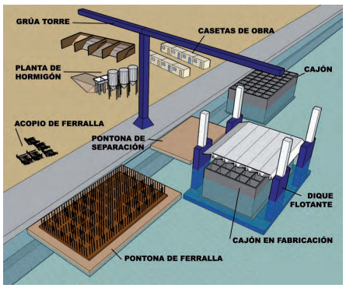
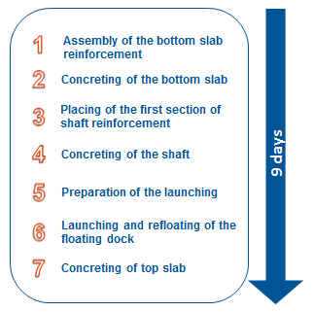
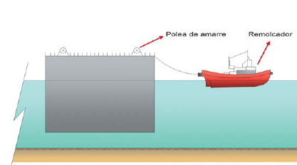
3. GRAVITY BASE FOUNDATION
Functional unit
Reference product: Gravity Base Foundation
Function: Support of 8 MW Wind Turbine
PRODUCTION PROCESS
Life Cycle Inventory

Slide 6
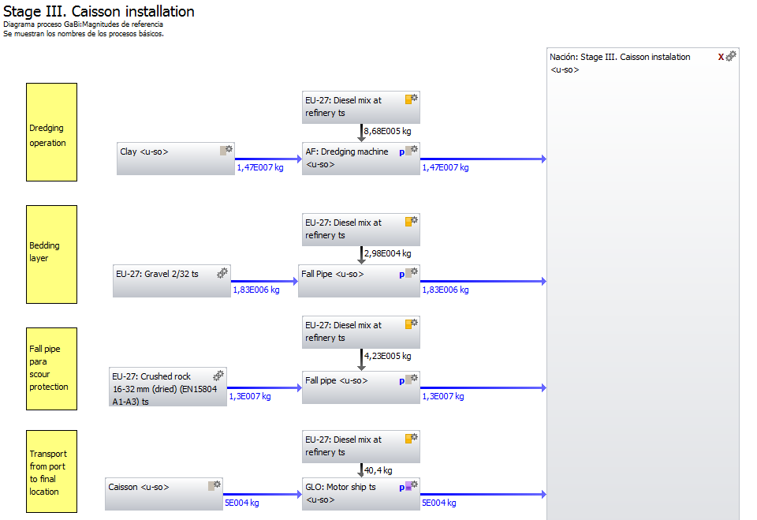
3. GRAVITY BASE FOUNDATION
STEPS
LCI
LCA
LCA in 3 stages:
Stage I: Installation and mobilization of equipment
Stage II: Caisson construction
Stage III: Caisson installation

Slide 7
4. LCA RESULTS FOR GBF
Impact category | Stage I | Stage II | Stage III
Global warming potential (100 years) | 0,04 % | 24,57 % | 75,39 %
Ozone depletion potential | 0 % | 62,26 % | 37,73 %
Acidification potential | 0,01 % | 9,09 % | 90,90 %
Eutrophication potential | 0,01 % | 5,34 % | 94,66 %
Photochemical ozone creation potential | 0 % | 3,92 % | 96,08 %
Depletion of abiotic resources (elements) | 0,01 % | 84,45 % | 15,54 %
Depletion of abiotic resources (fossil) | 0,04 % | 13,88 % | 86,08 %
Primary energy demand from ren. and non-ren. resources (net cal. value) | 0,04 % | 16,19 % | 83,77 %
55% Dredger
26% Fall Pipe
GWP(g CO2eq/kWh) of the GBF per life cycle stage
CFC in reinforced steel
Gypsum in cement → Scarcity of sulphur

Slide 8
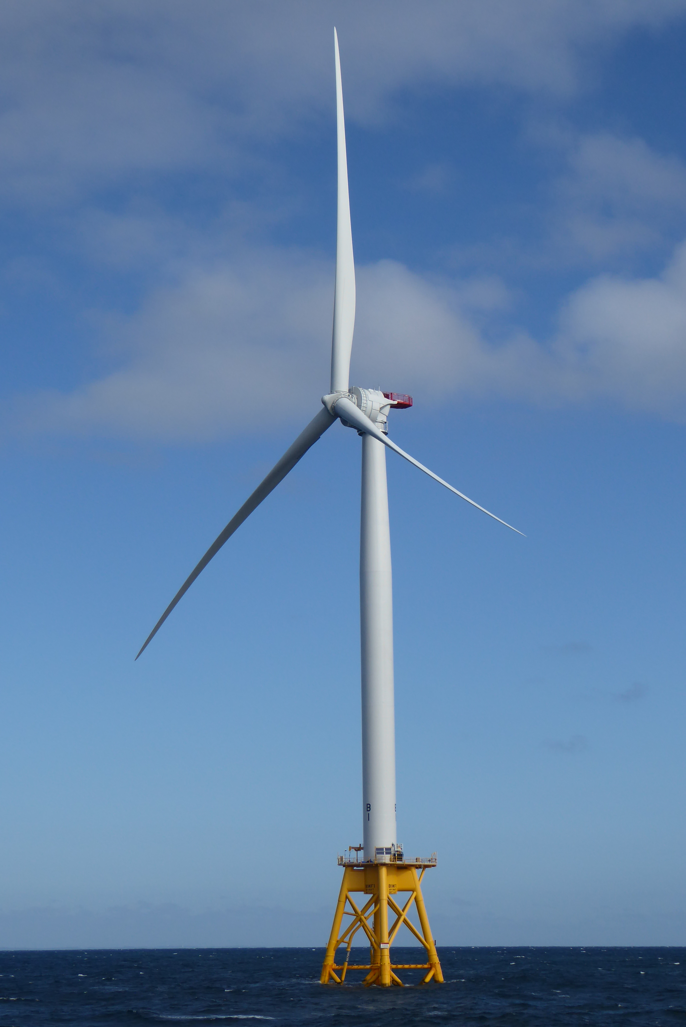
5. JACKET FOUNDATION
description
Innovative floating solution
4-legged
Installation at depths of up to 60m
Floating/suction buckets also act as anchors to avoid use of piles
Designed to support an 8MW turbine
Focuses solely on foundation – doesn’t include turbine, cables or transition piece

Slide 9
5. JACKET FOUNDATION
ANALYSIS
Materials & Manufacture
Installation
Maintenance
Estimated foundation maintenance to be equivalent to one maintenance visit in lifetime
Disposal
Decommissioning assumed to involve the same processes as installation (except scour)
1230 tonnes of steel with cutting, welding and surface treatment
Also aluminium alloy sacrificial anodes, concrete ballast, gravel for scour protection
Towed to site by tugboat
Construction support vessel
Side-stone dumping vessel for scour protection
Carried out by a construction support vessel
90% of all waste metals recycled, remainder of materials to landfill
Recycling only considered as an avoided disposal impact – recycled content or 100:0 method

Slide 10
6. LCA RESULTS FOR JACKET
Impact category | Unit | Total | Materials & Manufacture | Installation | Maintenance | Decommissioning & Disposal
Global warming (GWP100a) | kt CO₂ eq | 4.52 | 96% | 2% | 2% | 0%
Ozone layer depletion (ODP) | kg CFC-11 eq | 0.34 | 89% | 6% | 5% | 1%
Acidification | t SO₂ eq | 25.24 | 84% | 6% | 9% | 2%
Eutrophication | t PO4--- eq | 12.46 | 96% | 2% | 2% | 0%
Photochemical oxidation | t C₂H₄ eq | 2.18 | 94% | 2% | 3% | 1%
Abiotic depletion | kg Sb eq | 59.12 | 100% | 0% | 0% | 0%
Abiotic depletion (fossil fuels) | TJ | 49.06 | 94% | 2% | 3% | 1%
Human toxicity | kt 1,4-DB eq | 12.81 | 99% | 1% | 0% | 0%
Fresh water aquatic ecotox. | kt 1,4-DB eq | 8.77 | 62% | 38% | 0% | 0%
Marine aquatic ecotoxicity | Mt 1,4-DB eq | 12.02 | 91% | 9% | 0% | 0%
Terrestrial ecotoxicity | t 1,4-DB eq | 65.54 | 99% | 1% | 0% | 0%
Cumulative Energy Demand | TJ | 58.39 | 95% | 2% | 2% | 1%

Slide 11
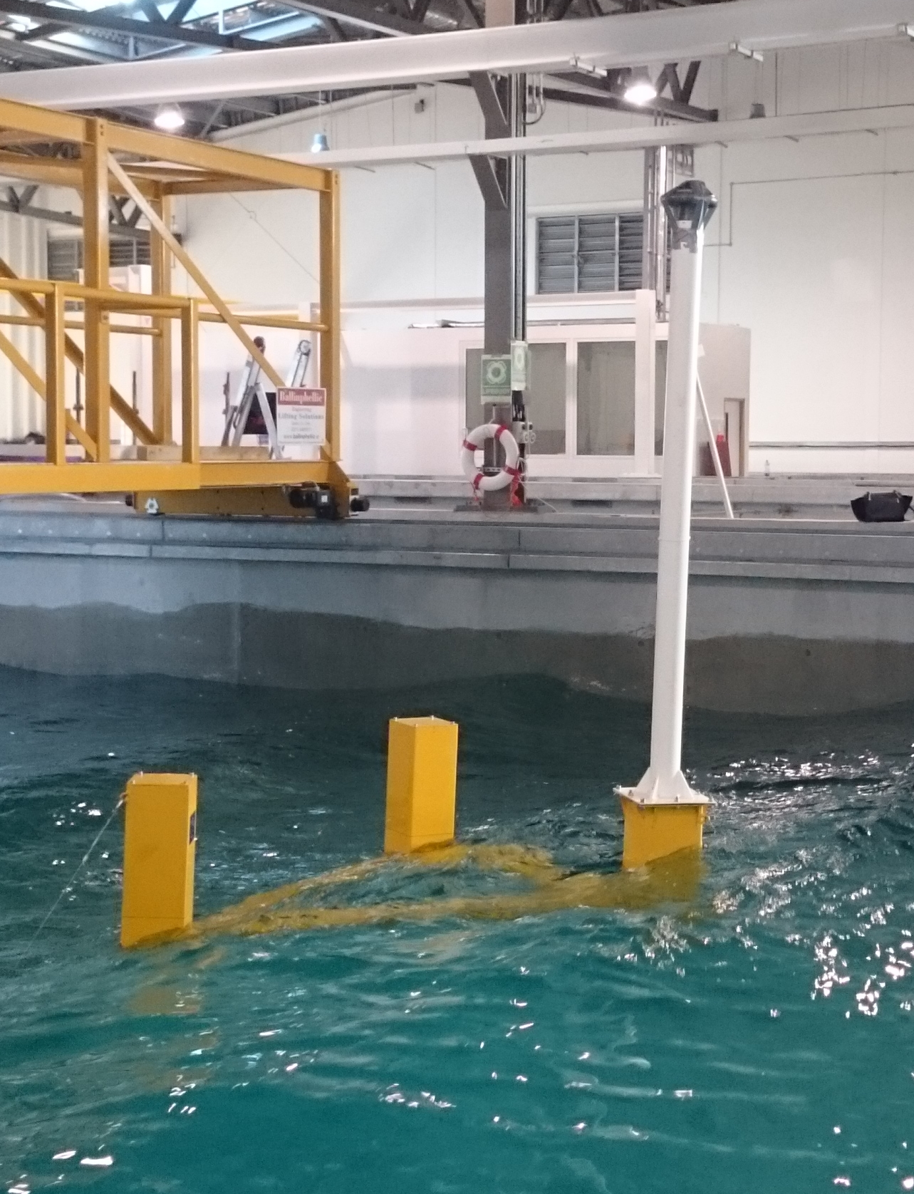
7. FLOATING FOUNDATION
description
Semi-submerged triangular design
3-catenary line mooring system – sized for 60m water depth
Currently designed to support a 5MW turbine
Focuses solely on foundation – doesn’t include turbine, cables or transition piece

Slide 12
7. FLOATING FOUNDATION
ANALYSIS
Materials & Manufacture
Installation
Maintenance
Estimated foundation maintenance to be equivalent to one maintenance visit in lifetime
Disposal
Decommissioning assumed to involve the same processes as installation
1700 tonnes of steel with cutting, welding and surface treatment
3 x 895m mooring lines from marine-grade steel
Towed to site by tugboat, with turbine. Impacts allocated by mass.
Anchor handling support vessel for installation of moorings
Carried out by a construction support vessel
Recycling only considered as an avoided disposal impact – recycled content or 100:0 method
Sea water ballast, so no impacts considered
90% of all waste metals recycled, remainder of materials to landfill

Slide 13
8. LCA RESULTS FOR FLOATING
Impact category | Unit | Total | Materials & Manufacture | Installation | Maintenance | Decommissioning & Disposal
Global warming (GWP100a) | kt CO₂ eq | 4.79 | 94% | 2% | 2% | 2%
Ozone layer depletion (ODP) | kg CFC-11 eq | 0.32 | 80% | 9% | 6% | 6%
Acidification | t SO₂ eq | 30.16 | 75% | 8% | 8% | 8%
Eutrophication | t PO4--- eq | 13.07 | 95% | 2% | 2% | 2%
Photochemical oxidation | t C₂H₄ eq | 2.29 | 90% | 4% | 3% | 3%
Abiotic depletion | kg Sb eq | 66.09 | 100% | 0% | 0% | 0%
Abiotic depletion (fossil fuels) | TJ | 51.56 | 91% | 3% | 3% | 3%
Human toxicity | kt 1,4-DB eq | 27.48 | 99% | 1% | 0% | 0%
Fresh water aquatic ecotox. | kt 1,4-DB eq | 11.35 | 67% | 33% | 0% | 0%
Marine aquatic ecotoxicity | Mt 1,4-DB eq | 13.13 | 91% | 9% | 0% | 0%
Terrestrial ecotoxicity | t 1,4-DB eq | 83.85 | 99% | 1% | 0% | 0%
Cumulative Energy Demand | TJ | 61.55 | 92% | 3% | 3% | 2%
Materials and Manufacture

Slide 14
9. COMPARISON OF LEANWIND FOUNDATIONS
Highest impacts
Floating foundation:
Human toxicity:
High quantity of steel (90% more than Jacket)
Marine-grade steel for mooring lines
GBF:
POCP:
Installation vessels
Primary Energy Demand
Jacket foundation:
ODP:
Steel production
Abiotic depletion (elements):
Steel and aluminium alloys

Slide 15
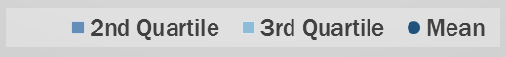
10. Impact of LEANWIND Innovations

Slide 16
11. KEY CONCLUSIONS
Floating foundation
Higher impacts than jacket and GBF
More steel per unit of energy produced → High human toxicity
Jacket foundation
Lower impact than GBF in 5/8 most important impact categories
Better environmental option?
GBF
Higher impact than Jackets in 5/12 impact categories but including 3 crucial categories.
Worse environmental option than jackets? → subjective decision
Advantage of typology: flexibility over the choice of installation location
Perform worst in terms of POCP and energy demand → Installation vessels
Key areas
Floating foundation → Reducing the length of the mooring lines per turbine / sharing the lines
Floating and Jacket foundations → Optimising the design for minimal use of steel
GBF → optimising installation vessels (seabed preparation) for reducing fuel consumption
Perform worse in terms of ozone and abiotic depletion → Steel production, aluminium alloy

Slide 19
10. Impact of LEANWIND Innovations
Only one study identified reporting impacts of a gravity base foundation
Higher impacts for LEANWIND foundation
Could be due to higher proportion of steel
Also much higher impacts of sea bed preparation considered in LEANWIND study
(Literature values adjusted for same capacity factor (40%) and design life (20 years) as this analysis.)

Slide 20
10. Impact of LEANWIND Innovations
LEANWIND foundation impacts lower than average of adjusted literature values
All but one of the studies considers installation in much shallower water depth (25 – 30m)
Impacts per unit mass of LEANWIND foundation are significantly lower than literature
  Could indicate impacts have been underestimated in this study
(Literature values adjusted for same capacity factor (40%) and design life (20 years) as this analysis.)

Slide 21
10. Impact of LEANWIND Innovations
LEANWIND foundation impacts lower than average of literature values
Lowest literature values don’t include mooring lines
Impacts per unit mass of LEANWIND foundation are significantly lower than literature
  Could indicate impacts have been underestimated in this study
(Literature values adjusted for same capacity factor (40%) and design life (20 years) as this analysis.)

